Slide 1



The first stage of the epidemiological transition in British cities
Romola Davenport
(Cambridge Group for the History of Population and Social Structure)
Jeremy Boulton
(University of Newcastle)

Slide 2
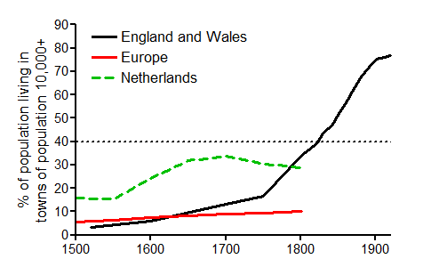
Urbanisation accelerated in England from the mid-eighteenth century
Percentage of population living in towns of 10,000+

Slide 3
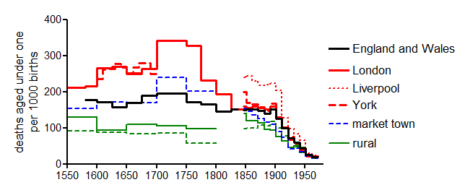
Rapid urbanisation was accompanied by a dramatic and probably necessary fall in mortality
Infant mortality (deaths in the first year of life per thousand births)
family reconstitution evidence
civil registration evidence
‘dark age’ of urban demography

Slide 4
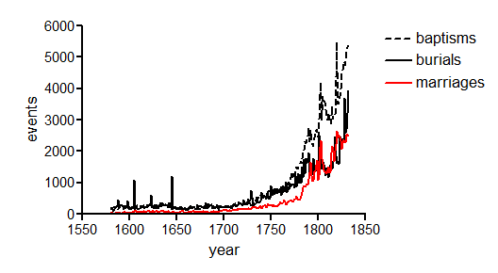
Manchester exemplifies many of the problems of vital registration in the period 1750-1837
Bills of Mortality, Manchester

Slide 5
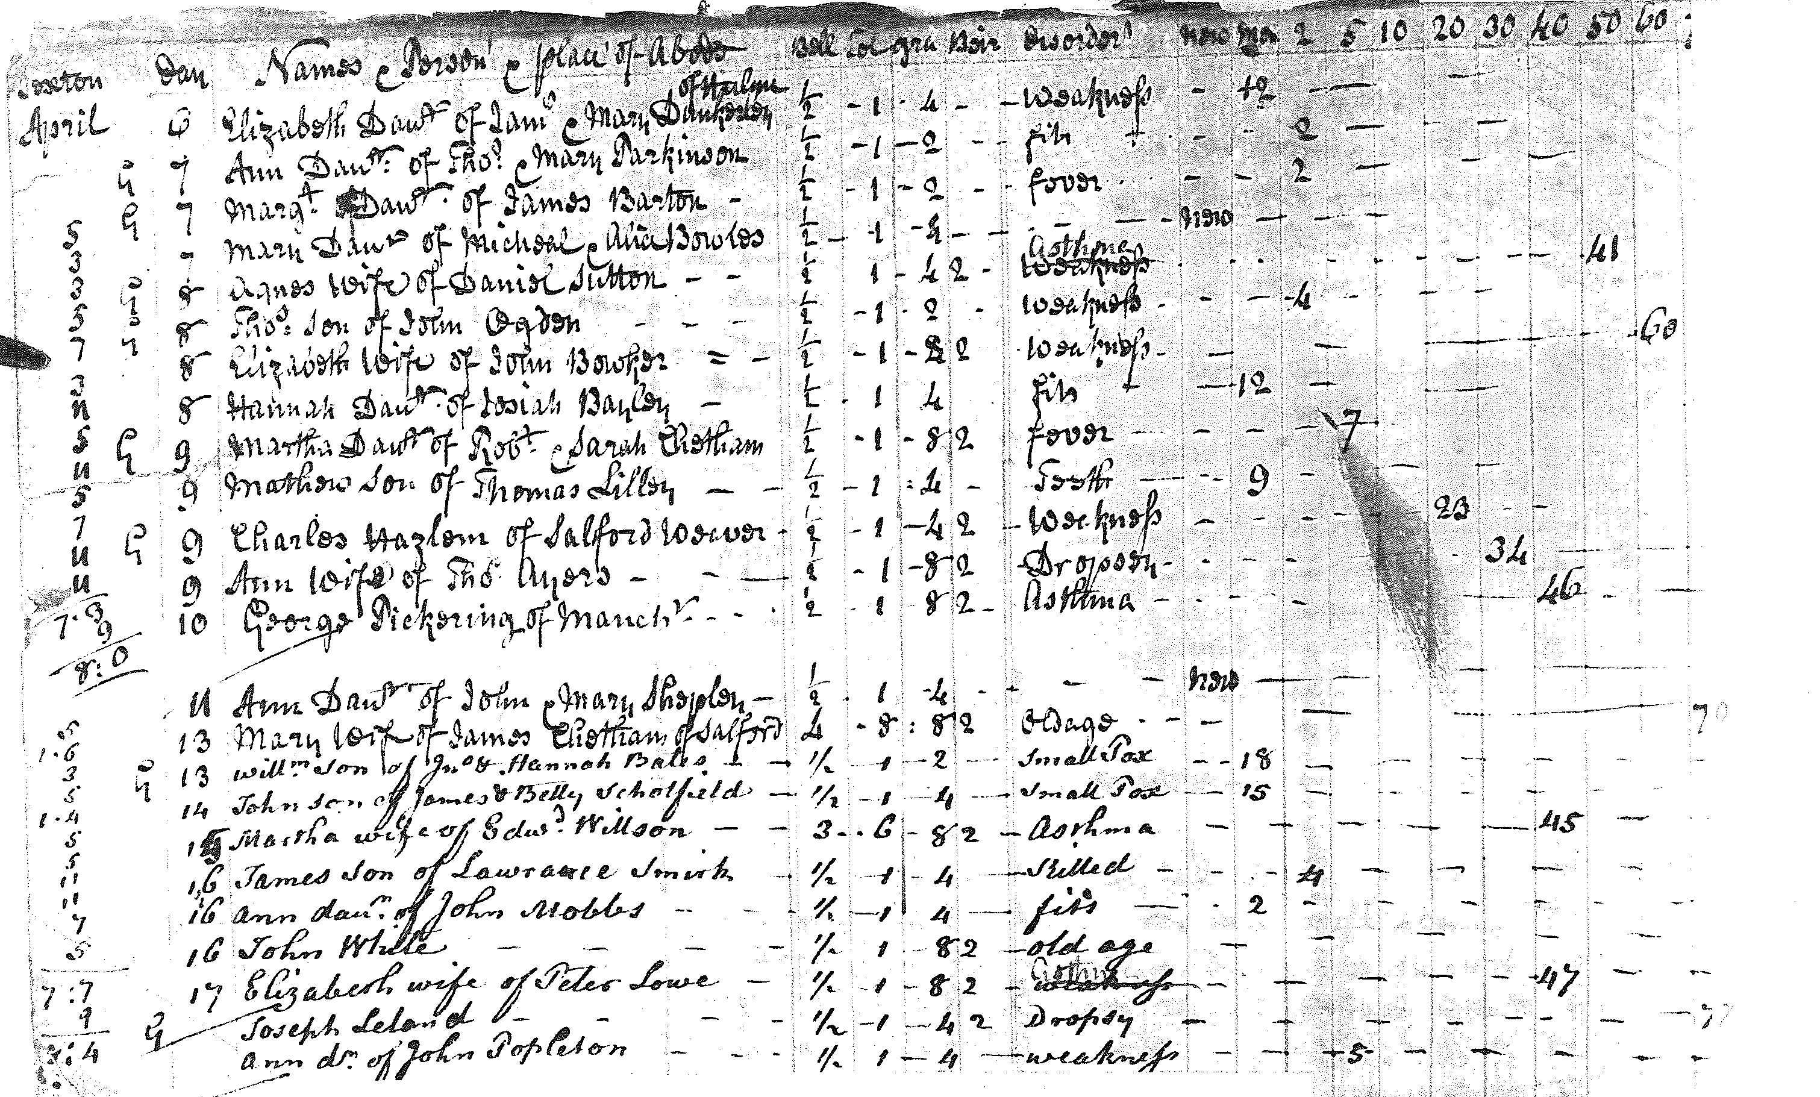

Slide 6
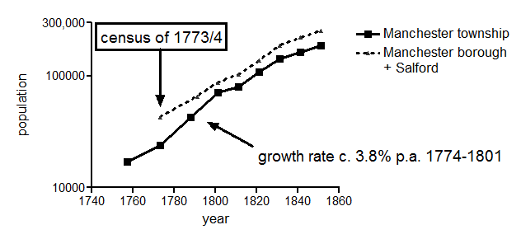
Manchester grew most rapidly in the last quarter of the eighteenth century
Notes:
1757 17101 1773 23966 1788 42821 1801 70409 1811 79459 1821 108016 1831 142026 1841 163856 1851 186986

Slide 7
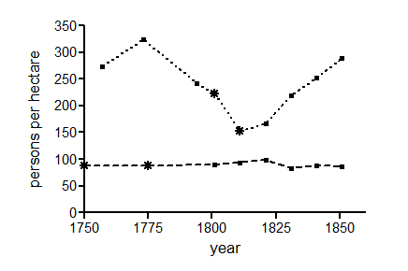
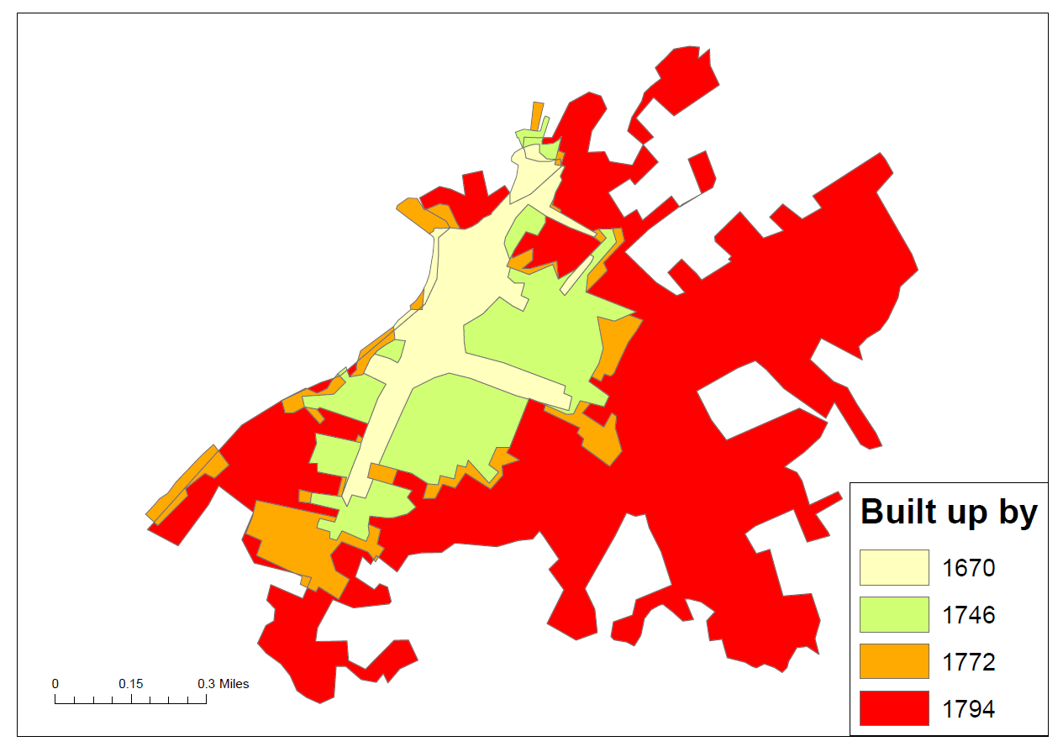
Population density peaked in the late eighteenth century
Manchester
St. Martin in the Fields
Population density and built-up areas of Manchester township
Notes:
25% of inhabited houses in the 1774 census contained two or more families (10% 3+). Aiken (1793) ‘A description of the country from 30-40 miles around manchester “As Manchester may bear comparison with the metropolis itself in the rapidity with which whole new streets have been raised... So it unfortunately vies with, or exceeds, the metropolis, in the closeness with which the poor are crowded in offensive, dark, damp, and incommodious habitations”

Slide 8
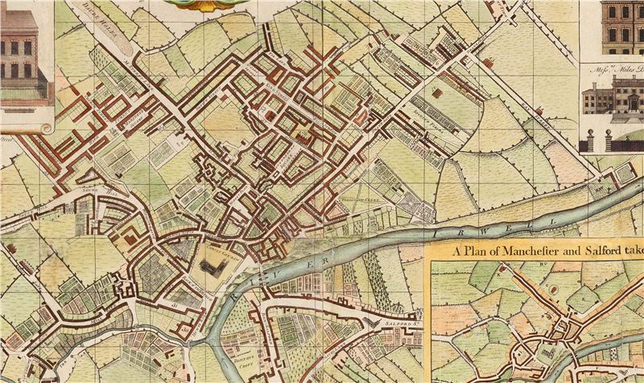
Manchester 1750

Slide 9
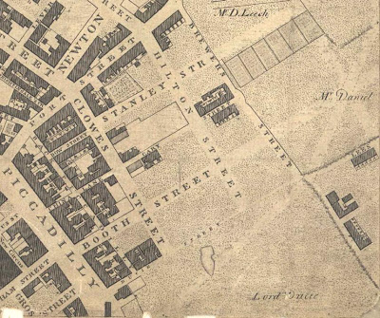
Manchester in 1794

Slide 10
Manchester’s population became younger, and more sex-balanced in the late eighteenth century
1774
male
female
1841
Percentage of population

Slide 11
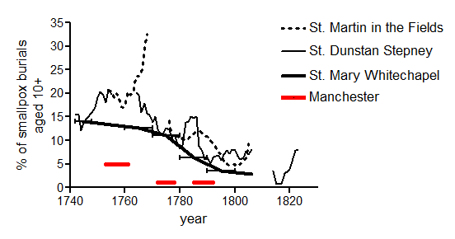
The migrant hinterland of Manchester was smaller and epidemiologically integrated

Slide 12
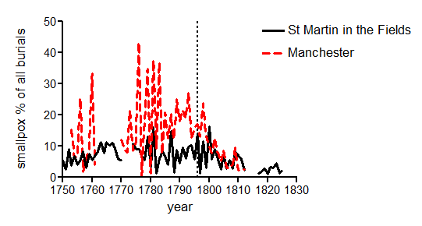
Smallpox was a much more significant cause of death in Manchester than London
vaccination
introduced

Slide 13
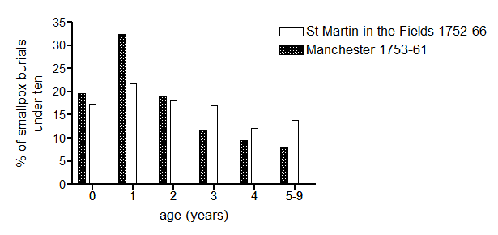
Smallpox circulated as least as rapidly in Manchester as London

Slide 14
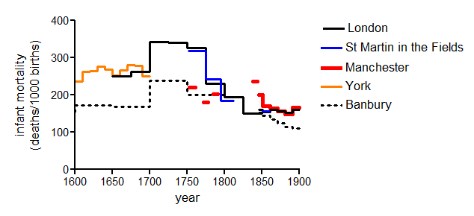
Estimates of infant mortality for Manchester pre-1800
Notes:
Includes all extant Anglican burials and those few diseenter burials we can find pre-1800, and all extant Anglican baptisms – don’t know re Catholics and dissenters

Slide 15
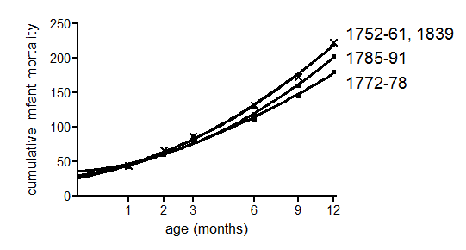
Some proportion of early neonatal deaths are missing

Slide 16
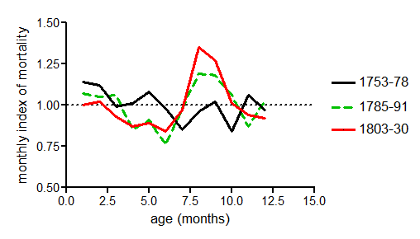
Summer peaks in infant deaths suggest a shift to early weaning
Mortality in first six months of life

Slide 17
Conclusions
Infant mortality was probably substantially lower in Manchester than London in the second half of the eighteenth century (despite crowding and high smallpox rates) – higher prevalence of maternal breastfeeding?
Economic changes in the late eighteenth century may have been associated with a decline in breastfeeding (and worsening infant mortality)
Infant mortality probably fell after 1800 with vaccination but may have risen again with rising population size and density (measles and scarlet fever)
The impact of these changes in Manchester’s population size and density was probably greatest on young children (ages 1-4).

