Slide 1
Food, drink and diet in the Georgian Workhouse: St Martin in the Fields, 1725-1830
Jeremy Boulton (Newcastle University)
Romola Davenport (University of Cambridge)
82nd Anglo-American Conference of Historians, Senate House, 13th July, 2013

Slide 2
Recent work on nutritional intake (Rich: plump, energetic, tall and clever v. Poor: thin, tired, short and dumb?)
‘The nutritional status of a generation –shown by the size and shape of their bodies –determines how long that generation will live and how much work its members will be able to do’ (Floud et al 2011)
‘A word must be said about the gross over-indulgence of the eighteenth-century Englishman. The rich at all times, the poor when they could, were intemperate in meat and drink to an extent which made the English notorious all over Europe. The swollen limbs, bulging cheeks and pendulous paunches which nearly every artist and cartoonist of the time depicted tell their own story’ (Drummond and Wilbraham 1939)

Slide 3
‘Therefore the image of the pre-1800 workhouse diet should be updated; it was not merely generous in quantity and deficient in quality, nor was the monotony broken only by occasional but unsustainable additions (such as a Christmas treat, details which catch the eye of poor-law historians but were relatively rare in the ongoing experiences of inmates). Instead workhouse diets contained weekly or daily comforts which may have done little to restore their nutritional deficiency but made life in the mid-century house much more acceptable’ (Alannah Tomkins, 2004)

Slide 4
How generous was workhouse provision?
Were there, as some other studies have suggested, any ‘treats’ or feasts provided to vary the diet?
Was there special provision for particular categories of inmate?
Were workhouse diets supplemented ??
Did inmates consume what the workhouse provided?

Slide 5
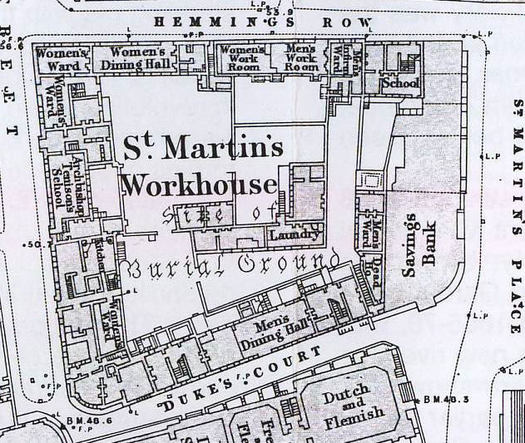
Detail of the 1871 large scale Ordnance Survey map of the Charing Cross and Trafalgar Square area showing the workhouse ground plan

Slide 6
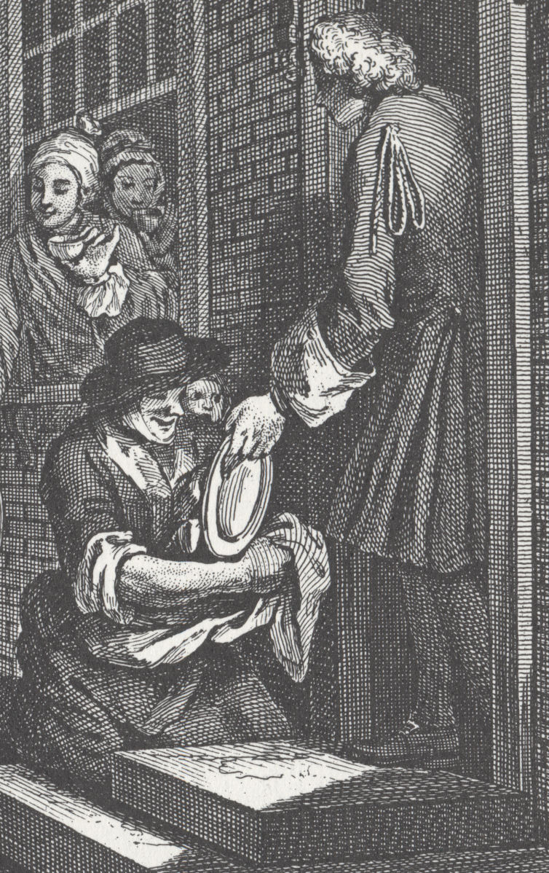
Hogarth, Industry and Idleness, 1747, plate 6

Slide 7
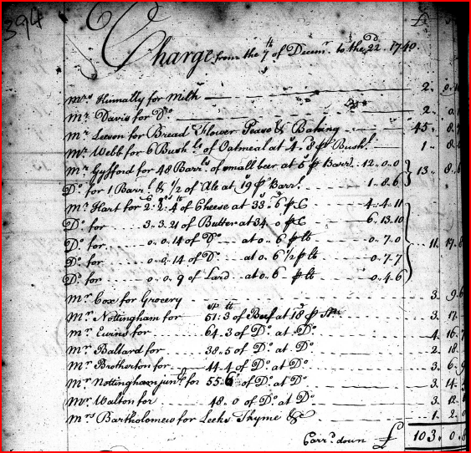
Workhouse Accounts, 7th to 22nd December 1740

Slide 8
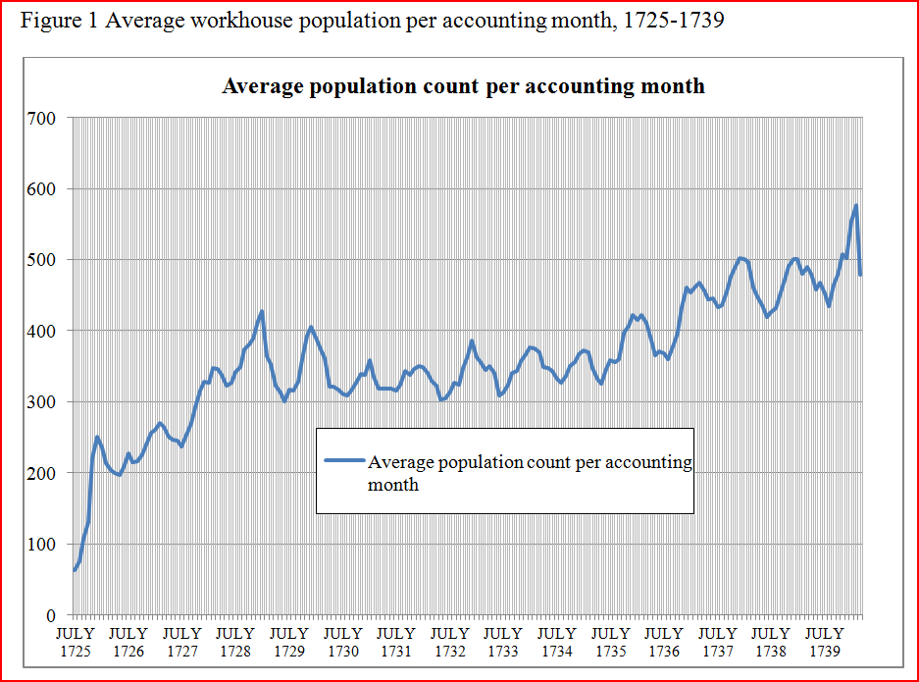

Slide 9
The workhouse master William Warburton was charged (and eventually dismissed) for incompetence in 1740, the vestry reported that he:
had neglected to give a true Account of the number of persons admitted and maintained in the workhouse by meanes whereof he had provided for thirty persons and upwards more than actually were therein that he did not attend at the Distribution of the Provisions nor take any care therein that divers parcels of Provisions had been found Wasted and Spoiled in the several Wards and others trodden under Foot in the Churchyard for want only of a due Care to prevent the same

Slide 10
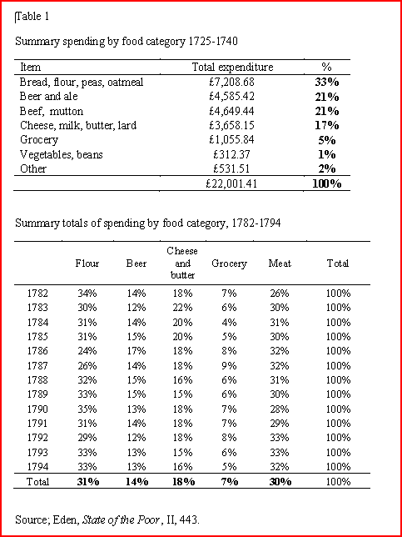
See handout

Slide 11
How generous was workhouse food and drink provision?
Table 1:
Food and drink: 64% of total expenditure, 1725-39
Pretty familiar lists of basic commodities
Note change in expenditure from bread to flour - due to construction of workhouse oven 1779

Slide 12
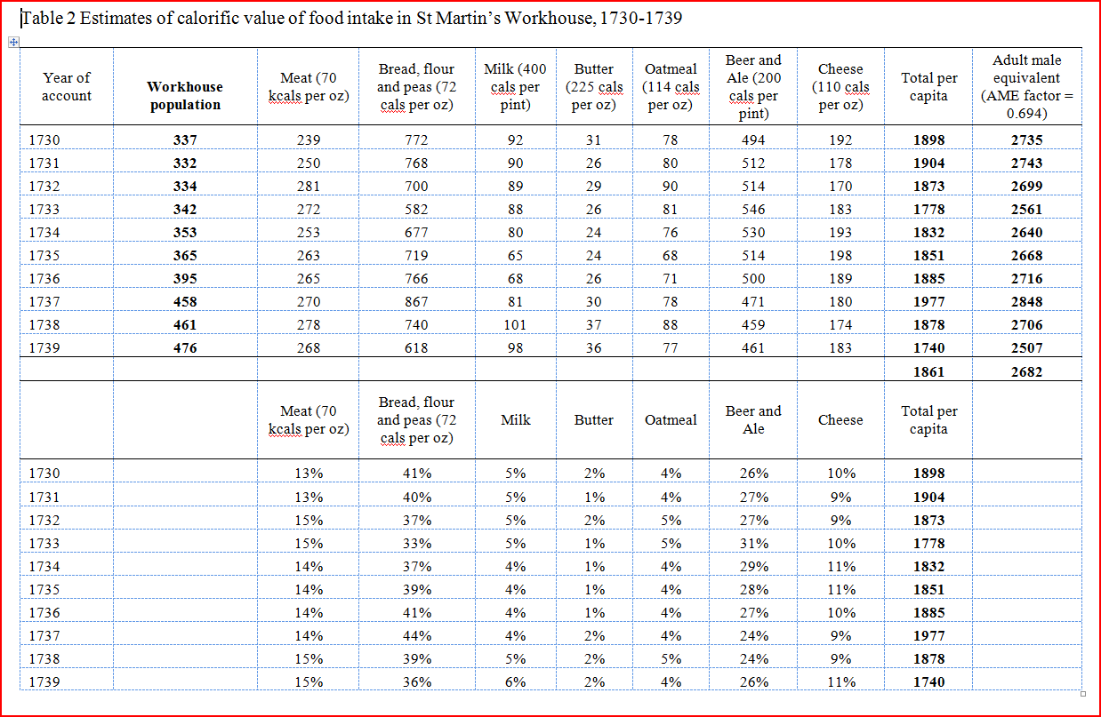
See handout

Slide 13
Table 2
‘Adult male equivalents (AME)’ and the 1752 ‘census’: point that changing gender structure in 19th would have reduced AME value.
Conservative figures where a choice. Some allowance for meat cooking.
Bread especially tricky to estimate
Lacks ‘Groceries’ and Vegetable allowance
Meat and cheese similar to Shrewsbury and York
At least ‘adequate’ diet, but not enough for hard work

Slide 14
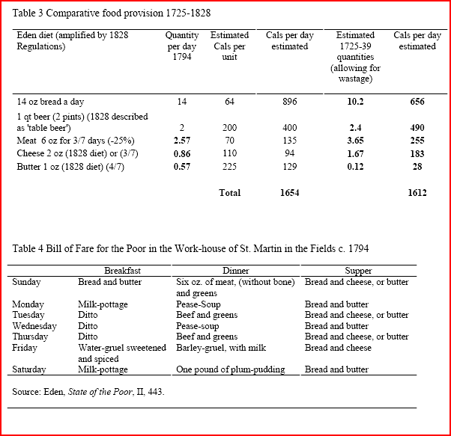
See handout

Slide 15
Tables 3 and 4
Little change in basic commodities over century
More beer, meat and cheese in earlier period, but less butter and bread: virtually identical calorific intake
Few new commodities used regularly - some evidence of potatoes as part of a treat
High prices in 1800/1 caused some cut backs in food quality and provision, but these cutbacks were reversed later

Slide 16
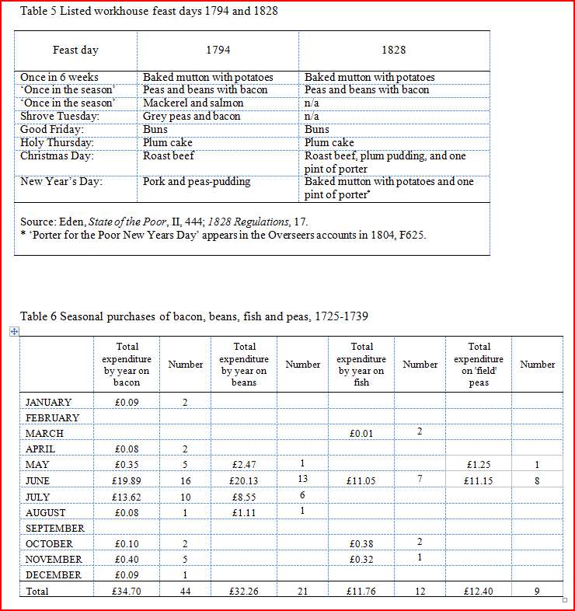
See handout

Slide 17
Were there, as some other studies have suggested, any regular ‘treats’ or feasts provided to vary the diet?
Table 5 and 6
“Mutton and potatoes” date from c. 1781
Seasonal feasts of beans & bacon/fish (mackerel/salmon)/fresh peas
Holy days marked by feasts - declined after 1794
Some one-off celebrations (e.g.. Peace of 1802)
Trivial nutritional value - but perhaps significant symbolic value
Seasonal treats in June/July occurred when lowest intake but Xmas and New Year was when intake at highest...

Slide 18
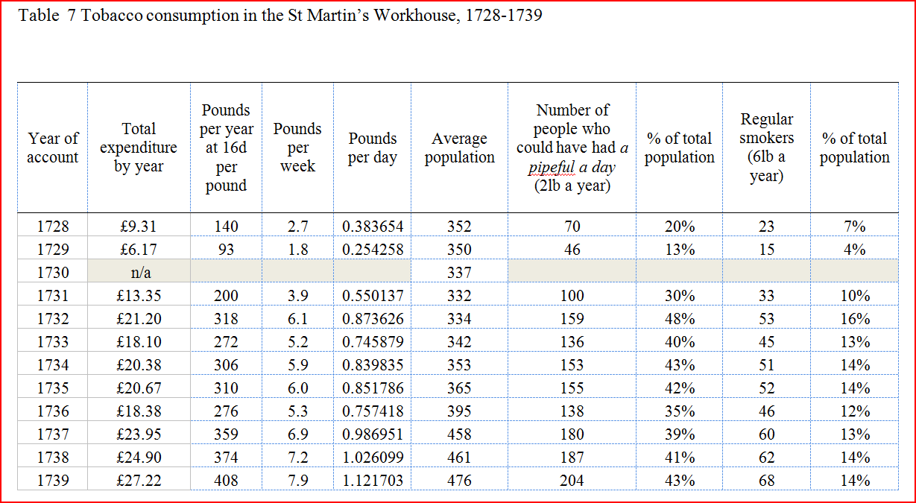
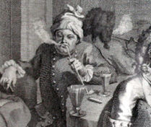
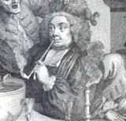
See handout

Slide 19
Table 7 Tobacco use - ‘The pleasures of the smoke’?
Relatively large quantities
Either a pipe-full for most adults or smaller proportion of regular smokers
Sometimes for medical use (Itch and foul wards..)
Restrictions due to fire hazard and once for price hike
No pipes provided for inmates
Unlikely to match levels of consumption outside

Slide 20
Was there special provision for particular categories of inmate?
House Steward and Matron – the Workhouse ‘Table’
When the workhouse clerk WS Lemage forfeited this privilege in 1812 the Board recorded that he:
‘be allowed from this day an increase to his Salary amounting to sixty pounds per annum in lieu of the perquisites hitherto enjoyed of Dining etc. at the Table appointed for the use of the House Steward and Matron.
[They added that they had also] Resolved that no Person whomsoever shall be permitted to have their Meals at the Table allowed in this House excepting the House Steward and the Matron’

Slide 21
The sick – diet prescribed by workhouse medical staff
Mutton and broth
Pint of porter for lying in married women
Spirits, ale, wine and strong beer were often prescribed possibly for anaesthetic properties
Vinegar, raisin wine, brandy
Food for the sick was usually more expensive, drink was stronger, meat of higher quality

Slide 22
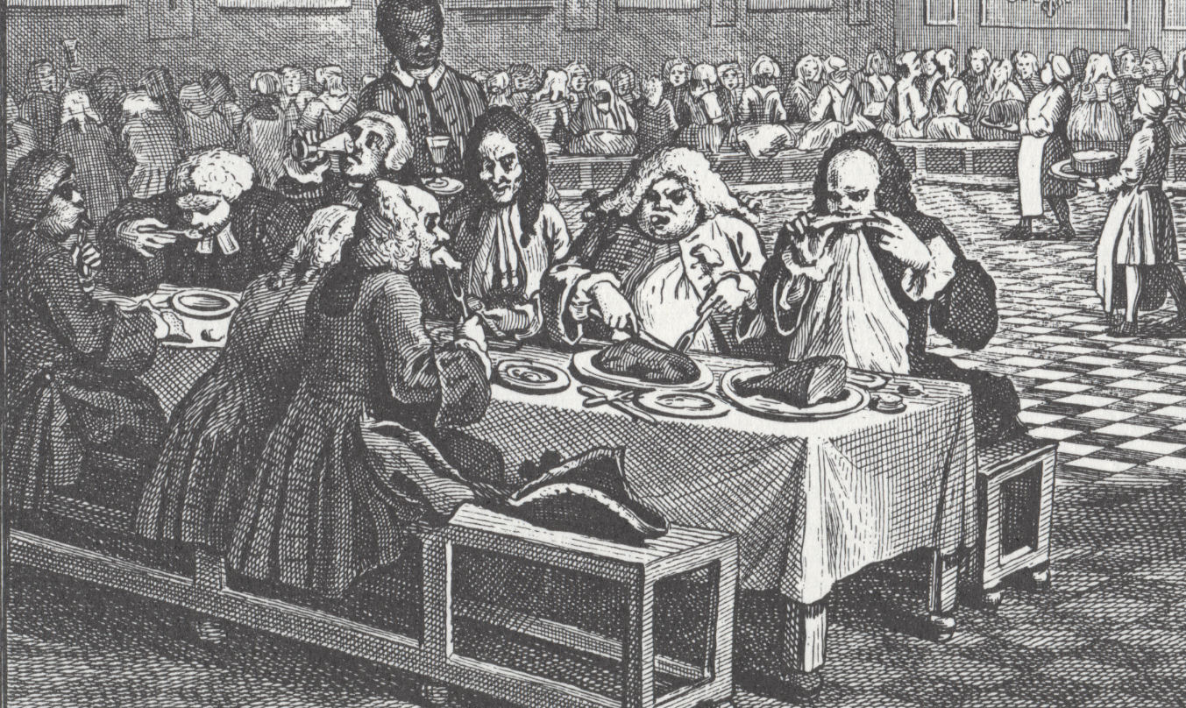
Hogarth, Industry and Idleness, 1747, plate 8

Slide 23
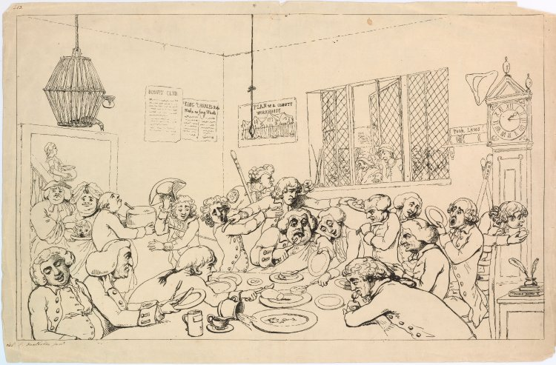
Vestrymen, parish officers, and others surround a table, some seated some standing, savagely gormandizing and shamelessly competing for the food. A stout woman enters (left) carrying on a dish a large sucking-pig at which a fat parson beside her points angrily, presumably because he thinks he has been defrauded of a tithe-pig. A man brings in a large cheese. A maidservant descends the stairs, seen through the open door, carrying a large tureen.
Through a casement window (right) is seen a crowd of the parish poor; some scowl, a man with crutches puts his hand through the window begging. An angry beadle with a staff and badged sleeve threatens him with his fist. The room is either a vestry-room or a room in one of the new county workhouses which were built after 1776. On the walls are placards headed 'Benifit Club' and 'King Charles Rules Make no long Meals', also a 'Plan of a County Workhouse', a gabled building with a high paling. A grandfather clock (right) points to 1.30. Against it lie two beadle's staves. On a shelf a book of 'Poor Laws' lies on the top of a 'Bible'. On a small table (right) an inkpot stands on two books, one inscribed 'Poors Rates'. Above the door (left) hangs a wicker cage, from which a bird, perhaps dead from hunger, protrudes its head.
Thomas Rowlandson, Easter Tuesday or the parish-meeting dinner, 1785

Slide 24
Were workhouse diets supplemented ?
Food allowances of meat (after 1800) or sugar (1790s) for performing special tasks or (1820s) for the elderly (aged 70+ got porter, tea and sugar)
Cash allowances and payments as ‘encouragements’, Christmas presents and after 1800 increasingly extensive series of weekly wages/pensions (known ironically as ‘retainers’) paid to many inmates in return for particular tasks
The ‘porous’ institution: ward nurses as go-betweens
Smuggling in food and drink (1751 Gin Act clause): - evidence of conflicting ‘food ways’ of inmates?
‘No Person shall carry or bring, or attempt or Persons carrying endeavour to carry or bring any distilled Spirituous Liquors (except to be used in the way of Medicine … ) into any Gaol, Prison, House of Correction, Work-house or House of Entertainment for Parish Poor’.

Slide 25
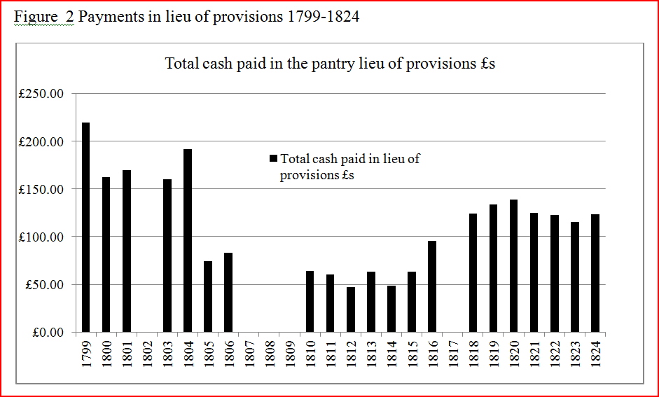

Slide 26
Did inmates consume what the workhouse provided?
Something like one in a hundred paupers were too sick to eat at all (1782 estimate) based on ‘payments in lieu of diet’ authorised by medical staff
Figure 2: payments in lieu of provisions
Suggest very large numbers of surrendered allowances – in some years more than a fifth of inmates were refusing their allowance
Suggests conflicting notions of food acceptability – perhaps particular resistance during years of shortage and cutbacks in 1800s when there were some complaints about local treatment of the poor

Slide 27
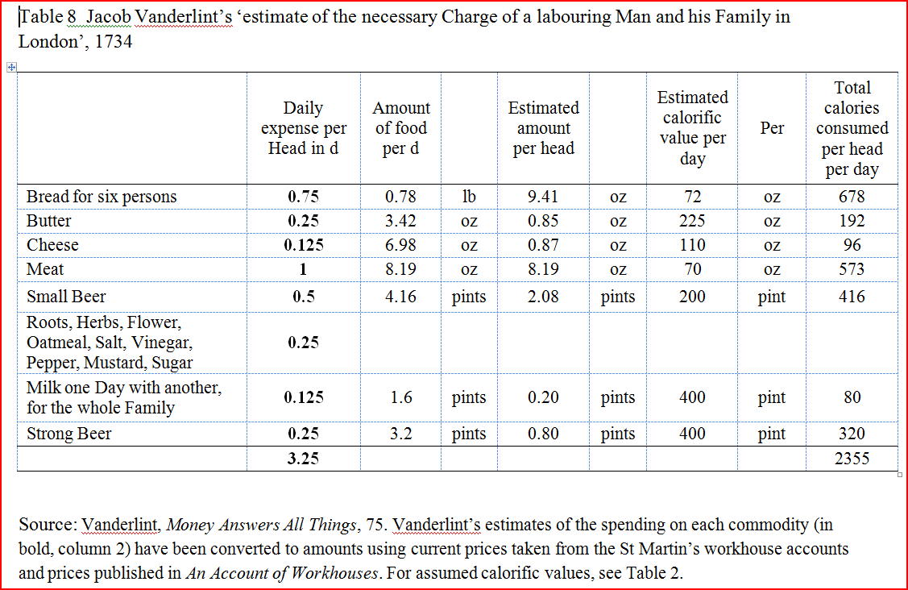
See handout

Slide 28
Conclusion: adequate, but was it relatively ‘generous’?
Groceries supplemented basic foodstuffs
Regular tobacco
1834 retrospectively - ‘excellent bill of fare for the poor’ was seen as an inducement to enter the St Martin’s workhouse.
On top of which ‘it will scarcely be believed as much as £1000 per annum used to be distributed to them in money, as retaining fees, for consuming and continuing to consume the £6,000 worth of meat, pudding, and bread supplied’
Workhouse fare was often supplemented by inmates. In later period many paupers seem to have preferred to eat out
Table 8: compared to Vanderlint’s estimate of the budget of a London labouring family, the workhouse fare lacked strong beer, meat and butter but had more cheese and similar amounts of bread, milk. Nutritional levels seem to have been higher outside the workhouse – and levels of strong drink much higher
Workhouse fare was thus not more generous than that eaten outside - to the extent to which a realistic comparison can be made – but it must have looked very familiar to most inmates..

