Slide 1

Industrial 2050 Roadmaps

Slide 2

Objectives
Understand decarbonisation options in the medium to long term (2020-2050) while remaining competitive;
Improve data for DECC modeling – 2050 calculator;
Develop shared evidence base between government and industry;
Understand investment decision-making context;
Agree on policy measures needed to achieve emissions reduction while remaining competitive, highlighting actions to be taken by industry, Government and others.

Slide 3
Outputs
Develop several modelled pathways for decarbonising each sector;
Overview of the business environment;
Build policy action plans for industry, government and others.

Slide 4
Governance
Joint project between DECC and BIS;
Consultancy consortium of Parsons Brinckerhoff and DNV·GL;
Interdisciplinary sector teams consisting of BIS and DECC officials, CPI and academic;
Involvement of academic – Professor Harald Grossman of the University of Dresden;
Involvement of Confederation of European Paper Industries;
Input from individual companies.

Slide 5
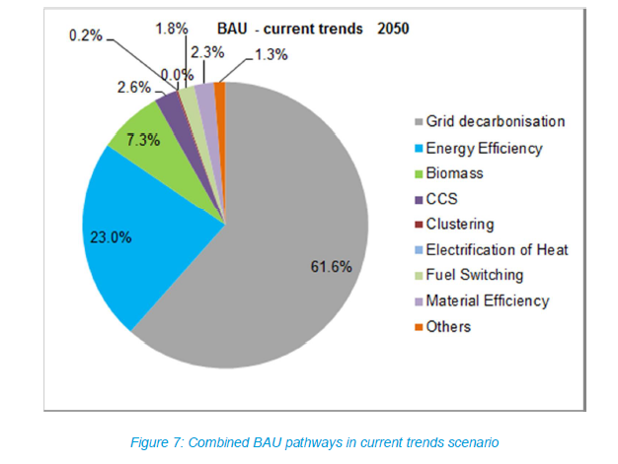
Analysis

Slide 6
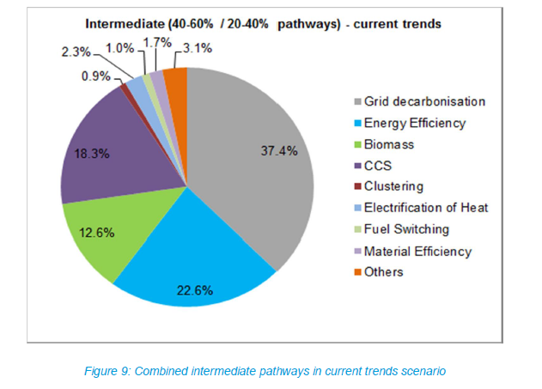
Higher Decarbonisation Pathway

Slide 7
Cross-cutting themes
1. Strategy, leadership and organisation
2. Business case barriers
3. Future energy costs, energy supply security, market structure and competition
4. Industrial energy policy context
5. Life Cycle Accounting
6. Value Chain Collaboration
7. Research, Development and Deployment (RD&D)
8. People and skills

Slide 8
(Some of the) Policy Challenges
Public Finance
Investment decision-making
Energy Prices
Industrial Strategy
Skills policy
Competition Policy
Access to EU funding
Material efficiency
Industrial Clustering

Slide 9
Timing
8 sectoral roadmaps and cross-cutting summary published in March;
Familiarising Ministers with analysis and conclusions;
Negotiation between trade associations and Government, facilitated by the consultants;
Analysis and policy conclusions ready for Spending Review. Spending Review will end in Autumn. Budget sets the scene.

