Slide 1
The Local and Regional Dimension of Employment Regulation in Italy
ESRC Seminar – The Regulation of Work and Employment: Towards a Multidisciplinary, Multilevel Framework
Luigi Burroni
Università di Firenze

Slide 2
Schema of the presentation
The Italian model of capitalism and the role of subnational differences
Local regulation and collective goods
Local agreements on welfare and competitiveness under the crisis
Conclusions

Slide 3
1. The Italian model of capitalism and the role of subnational differences

Slide 4
The Italian model of regionalised capitalism
Italy is characterised by a set of national institutions but also by a series of local variations in their functioning.
The political economy is strongly influenced by local formal and informal institutions.
The Italian model can be defined as “regionalised capitalism”.
Importance of the adoption of a multilevel analytical approach

Slide 7
Regional labour markets have different performance, with a clear cleavage between northern and southern regions
Looking at two strategic activities, manufacturing and high tech, we find that they are strongly concentrated in peculiar local system: technological and industrial districts

Slide 8
Industrial districts and manufacturing activities
The productive structure of industrial districts is based on a highly specialized division of labour among small and medium-size firms.
Only a limited number of firms have access to final markets; most of them are specialized in a single stage of production.

Slide 9
Industrial districts and manufacturing activities
Districts are specialized in the production of particular kinds of goods; the most represented sectors are the traditional ones (textiles, clothing, footwear, furniture, ceramics and so on)…
…but there were also significant development in the more “modern” sectors, particularly mechanical engineering and the machine tools sector.

Slide 10
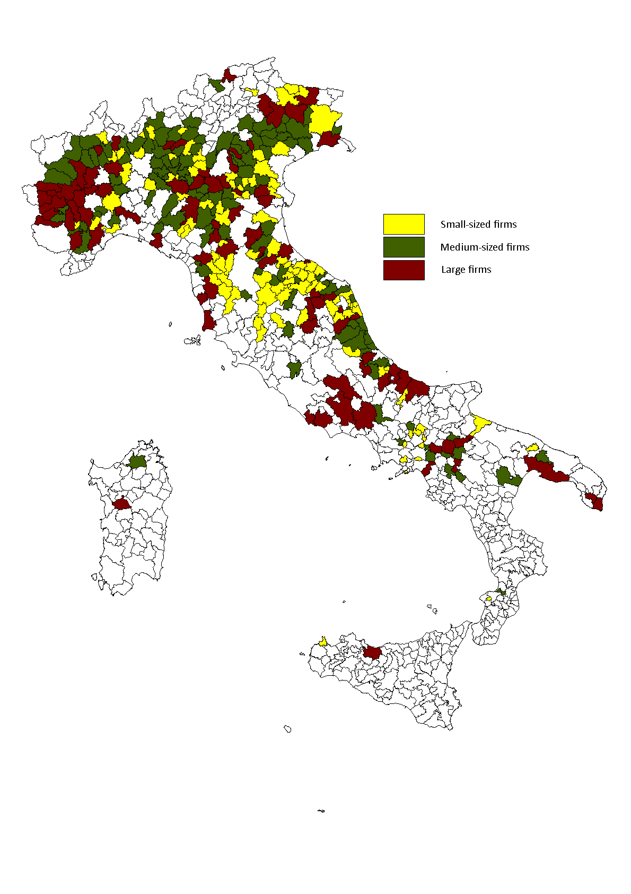
Industrial districts and manufacturing activities

Slide 11
Industrial districts
2006 | Employment rate | Unemployment rate
Industrial districts | 48.4 | 5.0
Italy | 45.8 | 6.8
2012 | Employment rate | Unemployment rate
Industrial districts | 46.9 | 8.6
Italy | 44.0 | 10.7

Slide 12
Technological districts
In 2011 the 34 technological districts gathered:
32.5% of national population
36.7% of total employment
46% of the national amount of high tech firms
63% of employment in high-tech sectors
75% of total HT patents

Slide 13
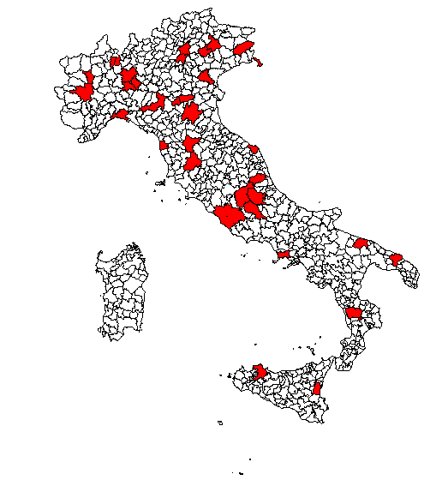
Technological districts and high-tech activities

Slide 14
2. Local regulation and collective goods

Slide 15
Why Italian firms cluster?
A large strand of research showed that local systems based on most innovative and competitive firms in manufacturing and HT activities that are open to international competition rely on non-market mechanisms of regulation.
Their competitiveness is based:
on cooperative structures based on informal social ties (individual social capital) involving both entrepreneurs and entrepreneurs and their employees;
on more formal relationships (collective social capital) between collective organisations, local and regional governments aimed at producing and allocating local collective competition goods.

Slide 16
The Italian model of regionalised capitalism
For this reasons the study of local regulation and governance gives an important contribution to the understanding of territorial disparities and territorial concentration of economic activities.
Collective public and private actors play an important role in this model (trade unions, employers associations, local governments and other organisations), especially in two different kinds of mechanisms

Slide 17
Local agreements and collective goods:
1. Policy-tools created by the national government to promote local development (Territorial Pacts; Area contracts; Integrated projects; Development programs; etc.) – Multilevel governance, the national level of regulation sets rule and a general framework leaving a large room of manouvre for local actors
2. Neo-volontaristic local negotiation between local stakeholders and local government and regional collective bargaining
What have happened to these practices during the crisis?
Notes:
Dire che sono comuni ad altri casi nazionali, legati alla promozione di competitività tra territori competitive tendering
Fortemente regolati tramite procedure uguali per tutti e individuate dal livello nazionale di regolazione e in seguito dal livello regionale
Caso interessante di governance multilivello. Per quanto riguarda le relazioni industriali si tratta di decentramento coordinato
Margini relativamente limitati per gli attori
Forte legame con politiche europee (territorial employment pacts ma anche altre politiche
Higly regulated multilevel governance structure
Si tratta di esperimenti molto studiati

Slide 18
3. Local negotiations during the crisis

Slide 19
The database of agreements
Joint research team from four Universities (Florence, Milan, Terumo and Cosenza).
We focused on agreements in which unions and employers associations played an important role. We have identified local/regional agreements with an analysis of various database (CNEL, Diario del Lavoro, Banca dati CISL, etc.) and interviews with unions’ and employers’ representatives
Up to now we have selected 53 local and regional agreements in different sectors for the period 2010-2014 (negotiation during the crisis)
The database will have a further implementation in the second part of the research
Notes:
Risultati provvisori
Si tratta di una parte della ricerca che è in progress

Slide 20
Agreements per sector
Notes:
Peso della manifattura e del made in Italy, peso minore per settori dell’alta tecnologia con alcune eccezioni come esempio Milano
Esempi dalla ricerca città dell’innovazione quando si dice che i settori high-tech in distretti high-tech sono caratterizzati da bassa sindacalizzazione e che ci sono pochi patti o esperimenti di relazioni industriali che li riguardano

Slide 21
Agreements per topic
The left part of the figure shows the importance of topics that deal directly with company level related to firm’s competitiveness
The right part of the figure shows issues related to social cohesion and territorial collective goods
Notes:
Welfare con soluzioni interessanti e innovative – contrattazione per fronteggiare la crisi
Ma anche via alta per lo sviluppo

Slide 22
2012 | Employment rate | Unemployment rate
Industrial districts | 46.9 | 8.6
Italy | 44.0 | 10.7
Local case studies | 49.7 | 7.7
Processed data from Istat Database

Slide 23
Conclusions
there is an important political space at local and regional level for unions and employers’ associations in regionalised capitalism.
Importance of a multi-level approach to study labour regulation. Not only company and national levels but also the regional one.
Local and regional bargaining cover topics related to productive organisation and to the fonctionning of the firm and on the other to issues related to territorial welfare and labour market (competitiveness plus cohesion)
This pro-active role of unions and employers associations does not hinder competitiveness. On the contrary, it seems that where associations are more active there is a better balance between competitiveness and cohesion
Notes:
Rilevanza del livello territorial come sfida per i sindacati
Il caso di Treviso mostra come non si capisce la contrattazione aziendale se non si guarda all’azione a livello territoriale
Two sides of the coin
Positive one – there is more than we expected to find
Segative one there are territorial cleavages – all this happened in some places and not in others
Sector segmentation – strategies mainly followed in manufacturing than in services here the cleavage is between manufacturing and itc

