Slide 1
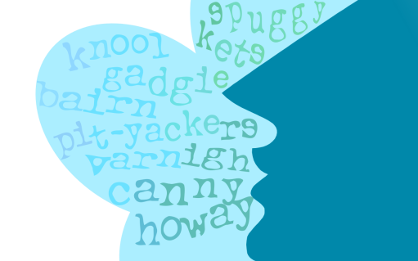
School of
English Literature, Language & Linguistics
The Talk of the Toon
Dialect Words
Answers
DECTE is funded by:
The Diachronic Electronic Corpus of Tyneside English
Notes:
See: http://research.ncl.ac.uk/decte/toon/

Slide 2
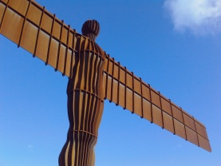
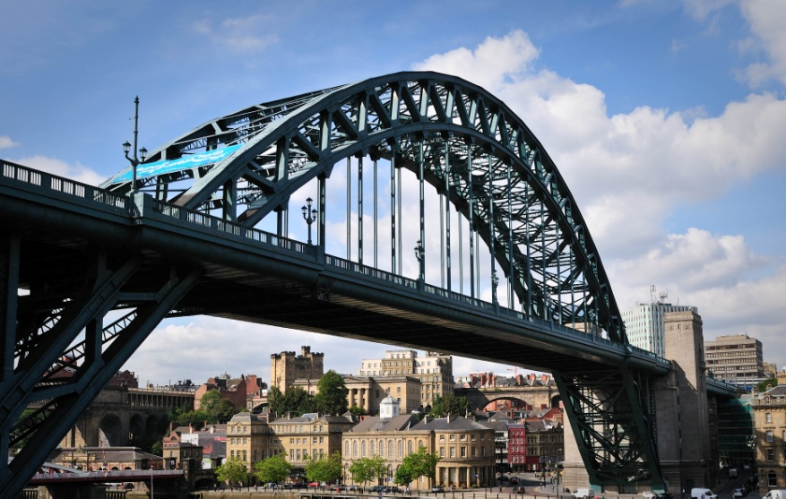
The Talk
of the Toon
Words and Meanings
What do these words mean?
Answers
scran | money | rain | food | coal
cuddy | hat | donkey | silly person | coal miner’s cart
plodge | to throw | to run quickly | to complain | to paddle, wade through water
clarty | mucky, dirty | funny | silly | gloomy, cloudy
rolley | chicken | fishing boat | coal miner’s cart | hat

Slide 3
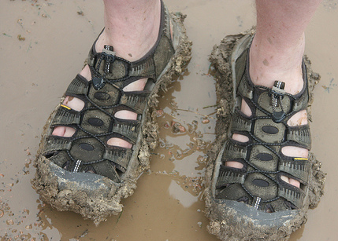
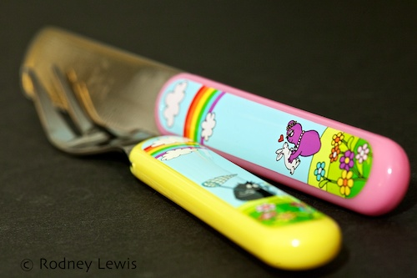
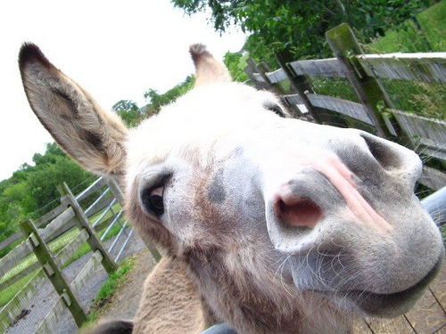
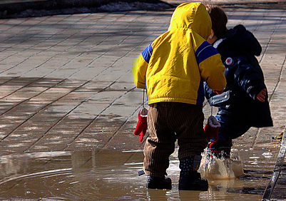
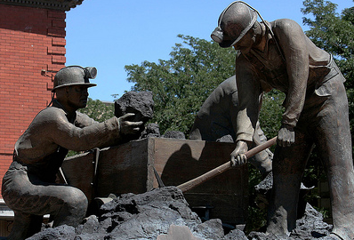
The Talk
of the Toon
Words and Meanings
What do these words mean?
The Pictures
scran
clarty
cuddy
plodge
rolley

Slide 4
The Talk
of the Toon
Words and Meanings
Rodney Lewis (2011, CC BY-NC-ND)
http://www.flickr.com/photos/70172955@N00/5978760042/
Rachael (‘MisTake111’) (2009, CC BY-NC-ND)
http://www.flickr.com/photos/misstake111/3409194271/
Glen Euloth (2011, CC BY-NC-ND)
http://www.flickr.com/photos/eulothg/5459370701/
Roger Mommaerts (2010, CC BY-SA)
http://www.flickr.com/photos/rmommaerts/4610426966/
‘cobalt 123’ (2008, CC BY-NC-SA)
http://www.flickr.com/photos/cobalt/2842342435/

