Slide 1





Traduciendo Culturas Perú / Translating Cultures Peru
“Translating Cultures: The legislated mediation of indigenous rights in Peru”
Rosaleen Howard, Newcastle University
Raquel de Pedro, Heriot-Watt University
Luis Andrade, PUCP

Slide 2
Research partners
Viceministry of Interculturality, Indigenous Rights Office, Indigenous Languages Division (DLI) - Ministry of Culture, Peru
Servicios Educativos Rurales (SER), Peru

Slide 3
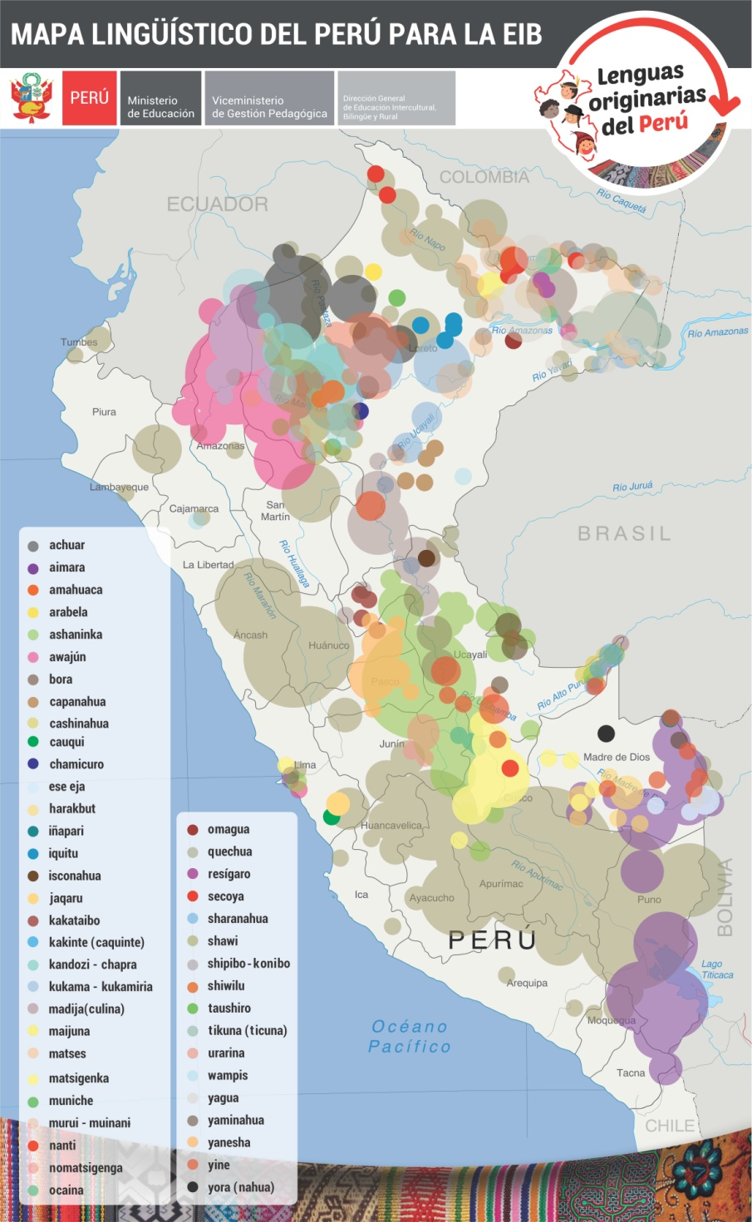
Sociolinguistic context
Geographical distribution of Peru´s indigenous languages: Andes and Amazonia
47 languages
16 language families
26 vital
3 endangered
18 seriously endangered
Official “in the zones where they predominate”
Documento Nacional de Lenguas Originarias (MINEDU, 2013)

Slide 4
Institutional and legislative context
2010 Creation of Ministerio de Cultura (Ley Nº 29565).
2011 Ley de Lenguas (Languages Act) passed (Ley 29735 Ley que regula el uso, preservación, desarrollo, recuperación, fomento y difusión de las lenguas originarias del Perú)
2012 Creation of Indigenous Languages Division within the Viceministry of Interculturality, Ministry of Culture
Language policy responsibilities extended from Ministry of Education to Ministry of Culture
2012 Launch of training courses in Translating and Interpreting in Indigenous Languages, for Consulta Previa in first instance; 8 courses have run to date
Notes:
Coyuntura política: la confrontación violenta entre indígenas awajún y policía cerca de la ciudad de Bagua, provincia Condorcanqui, departamento de Amazonas; los awajún estaban protestando contra el impacto ambiental que estaba teniendo una planta petrolera presente en su territorio. El llamado ´baguazo´ ha marcado un momento catalizador para que el estado preste más atención a los derechos indígenas.

Slide 5
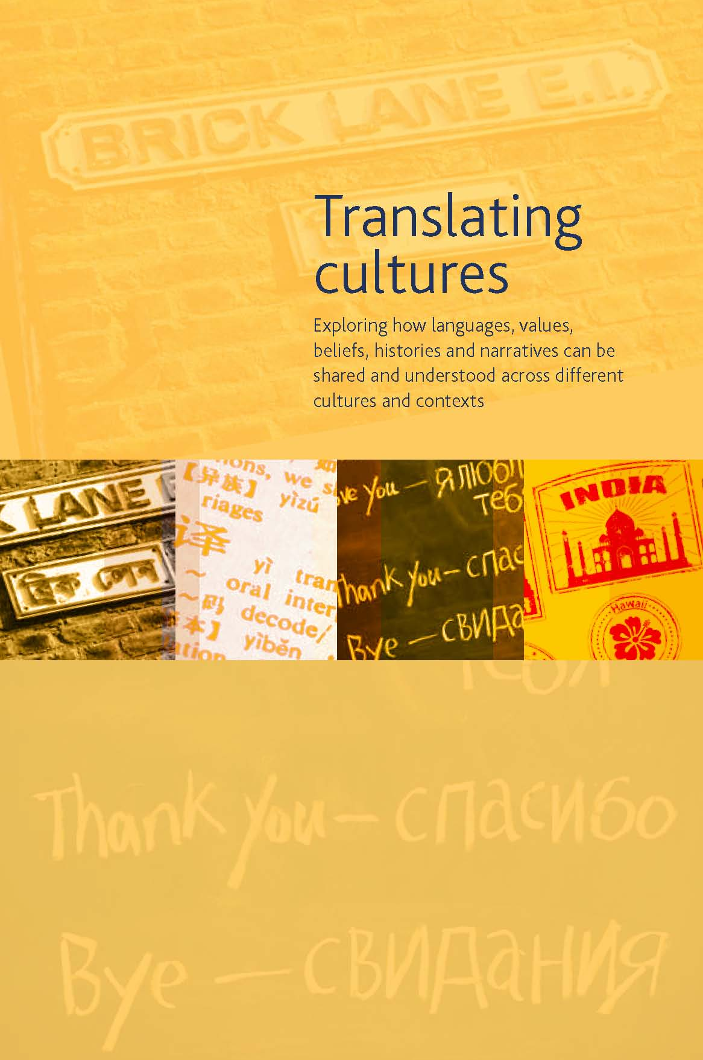
AHRC Translating Cultures theme

Slide 6
General aims
Within the context of actions taken by the Peruvian State and civil society organizations to implement the 2011 Languages Act …
To examine and to interpret the processes of translation and interpreting between Spanish and the indigenous languages that are taking place in public service and prior consultation settings in Peru

Slide 7
Basic premises
That translation and interpretation are not merely processes of linguistic transference
The analysis of translation and interpretation processes needs to take account of the particular social dynamic in which they arise, and in which they are both culturally and politically rooted
Further particularities emerge in Peru, due to the inequalities between indigenous and non-indigenous sectors of the population arising from a long and deep history of colonization

Slide 8
Initial questions
What is the nature of the translation and interpreting training programme for speakers of indigenous languages in Peru?
Who are the trainees?
After graduation from the programme how do they exercise their professional skills?
How does interpretation work as a means to overcome communication difficulties in public service and prior consultation settings?
What conceptual difficulties arose in the process of translating the Languages Act from Spanish into the indigenous languages?
How are these translations disseminated to and received by the communities where the languages are spoken?

Slide 9
Research methods
Activity facilitated by the Indigenous Languages Division team as Project Partners
Observation and participation in government sponsored events and activities
Interviews and focus groups with interpreter trainees, trainers, policy makers, and indigenous leaders – in Lima, Cuzco, Puno, Huaraz, Puerto Maldonado and Pucallpa
Participation and consultation in internal meetings of the Indigenous Languages Division
Analysis of the translations they made of the Ley de Lenguas into Aymara, Quechua x 2, Ashaninka, Shipibo – with the respective translators

Slide 10
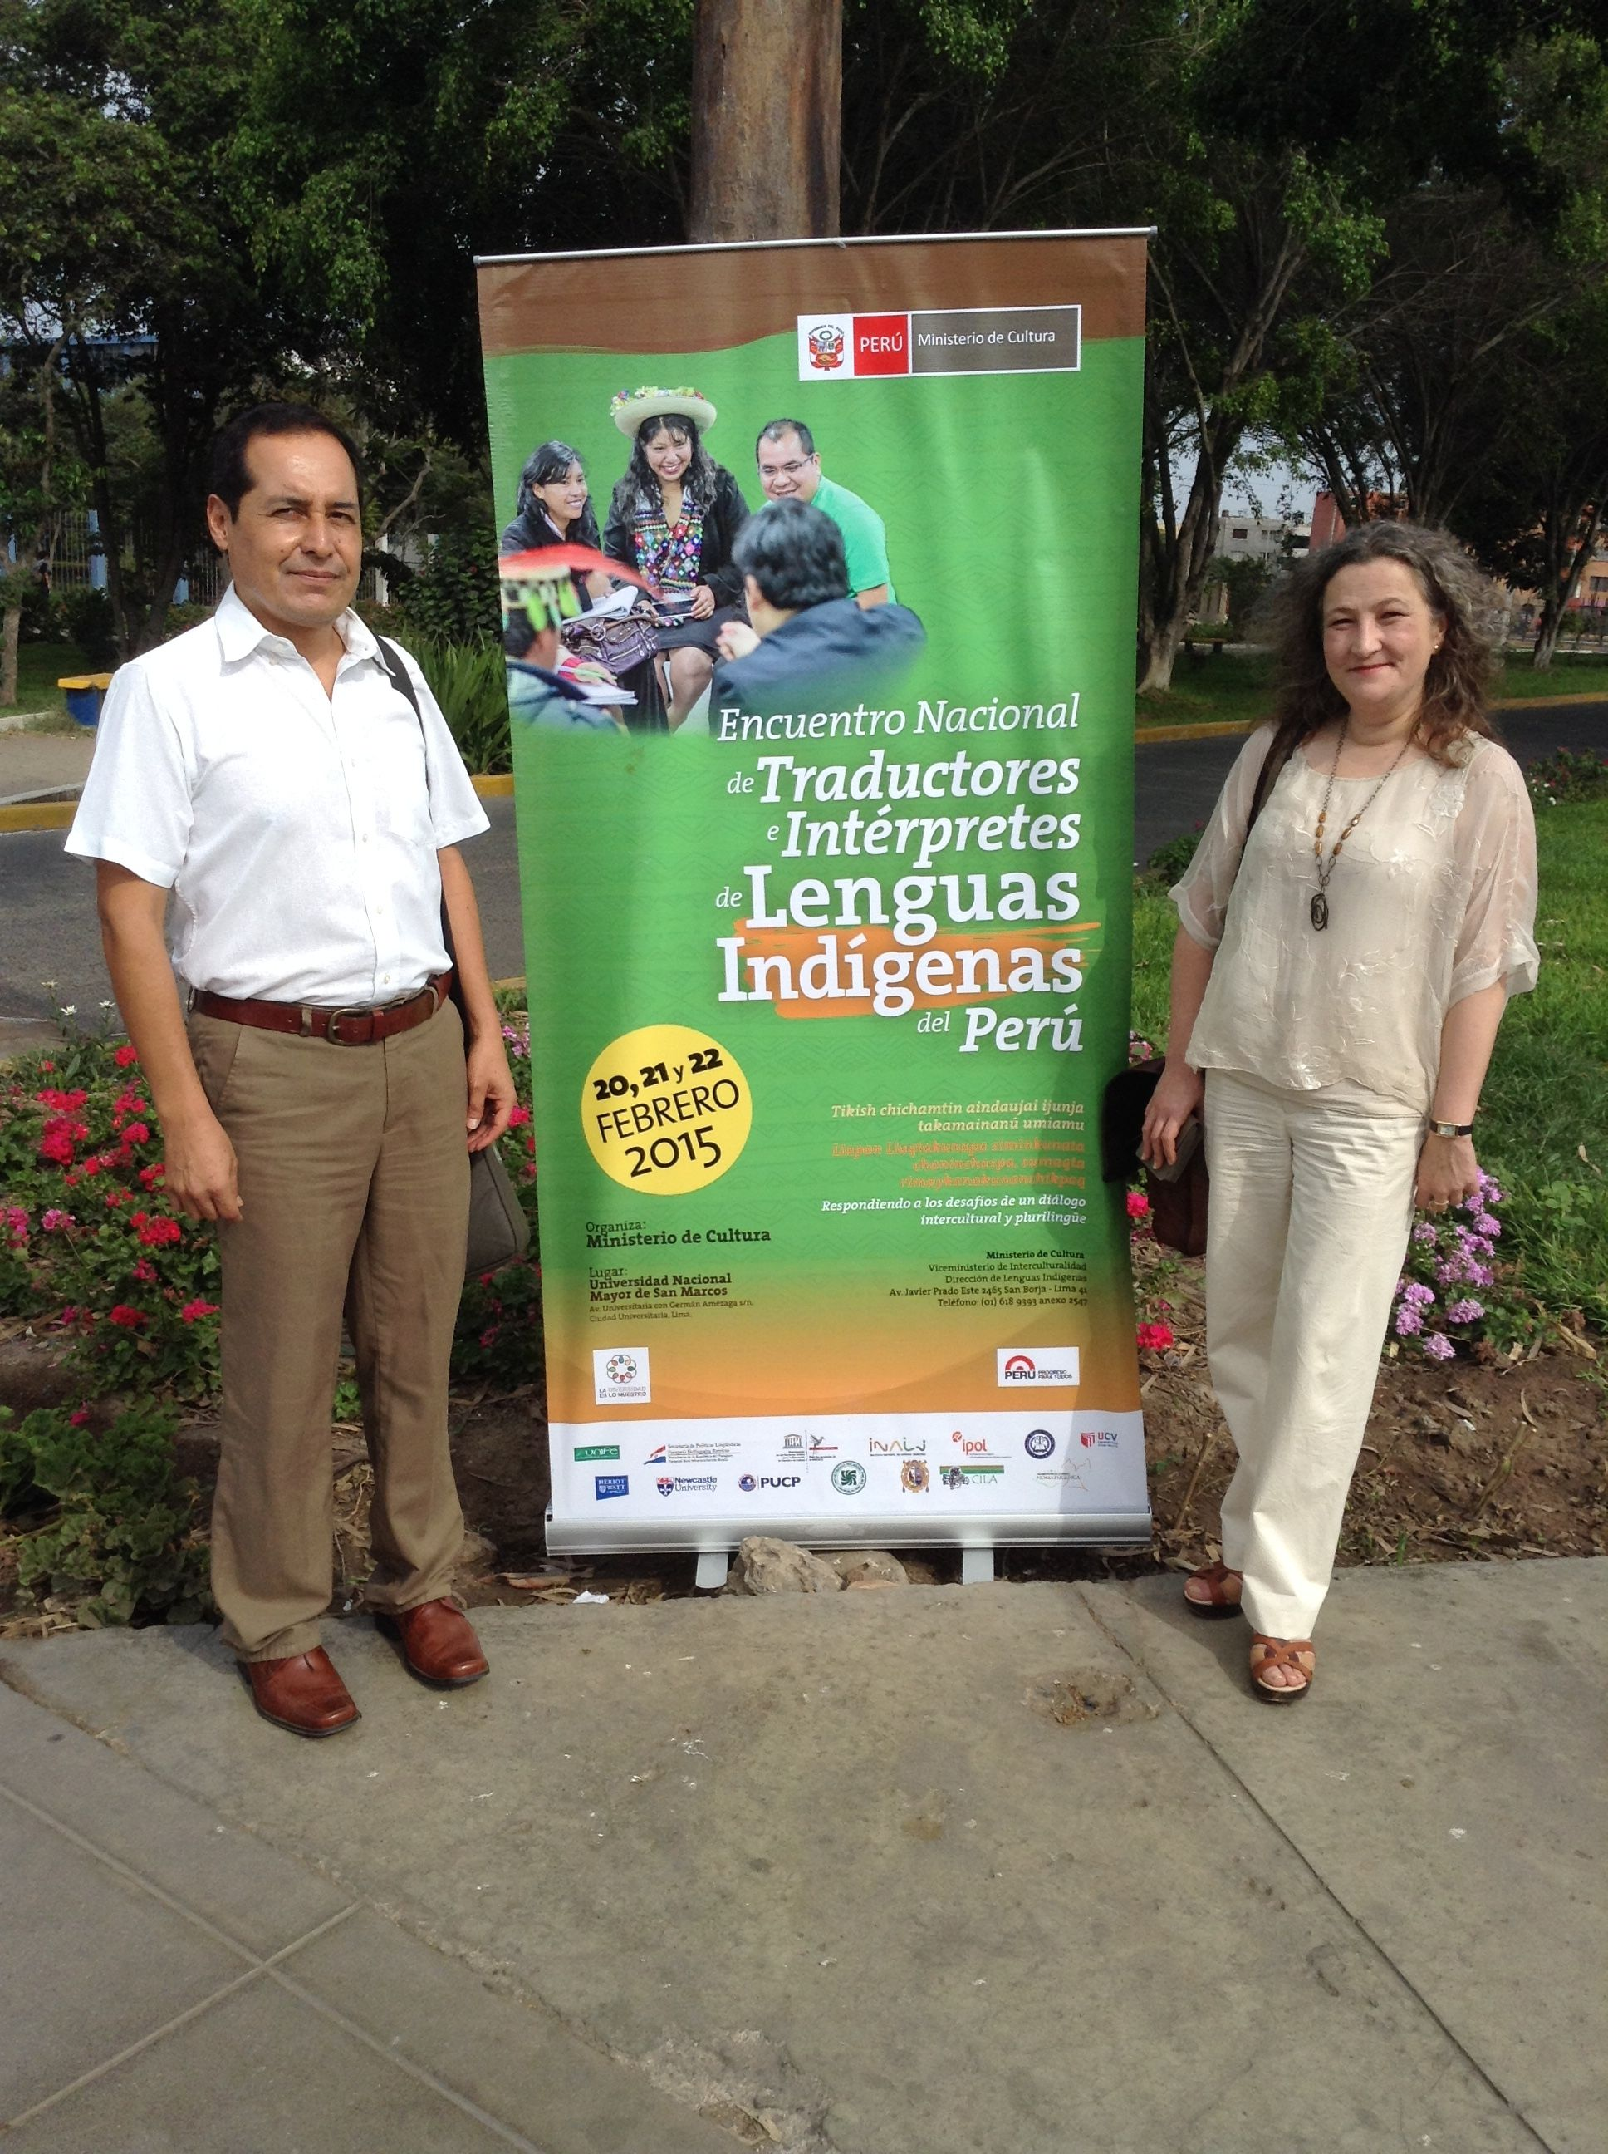
Contributions by the research team
First National Encounter of Translators and Interpreters in Indigenous Languages, Lima, 20-22 February 2015, UNMSM
Talk on community interpreting - Raquel
Talk on language policy in the UK – Rosaleen
Modertor on panel on community interpreting - Luis

Slide 11
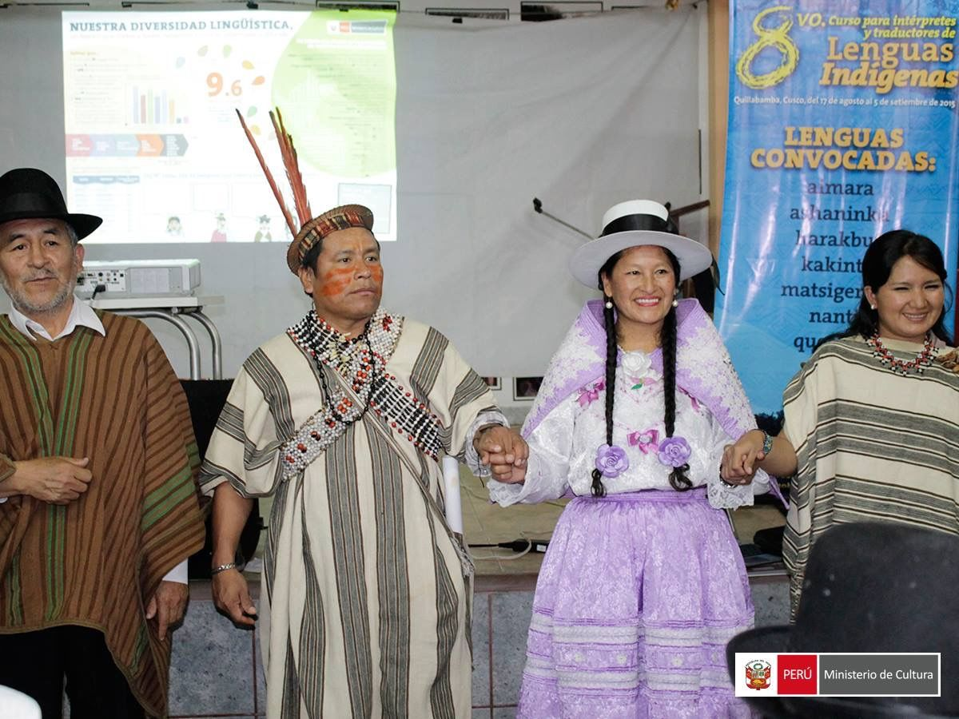
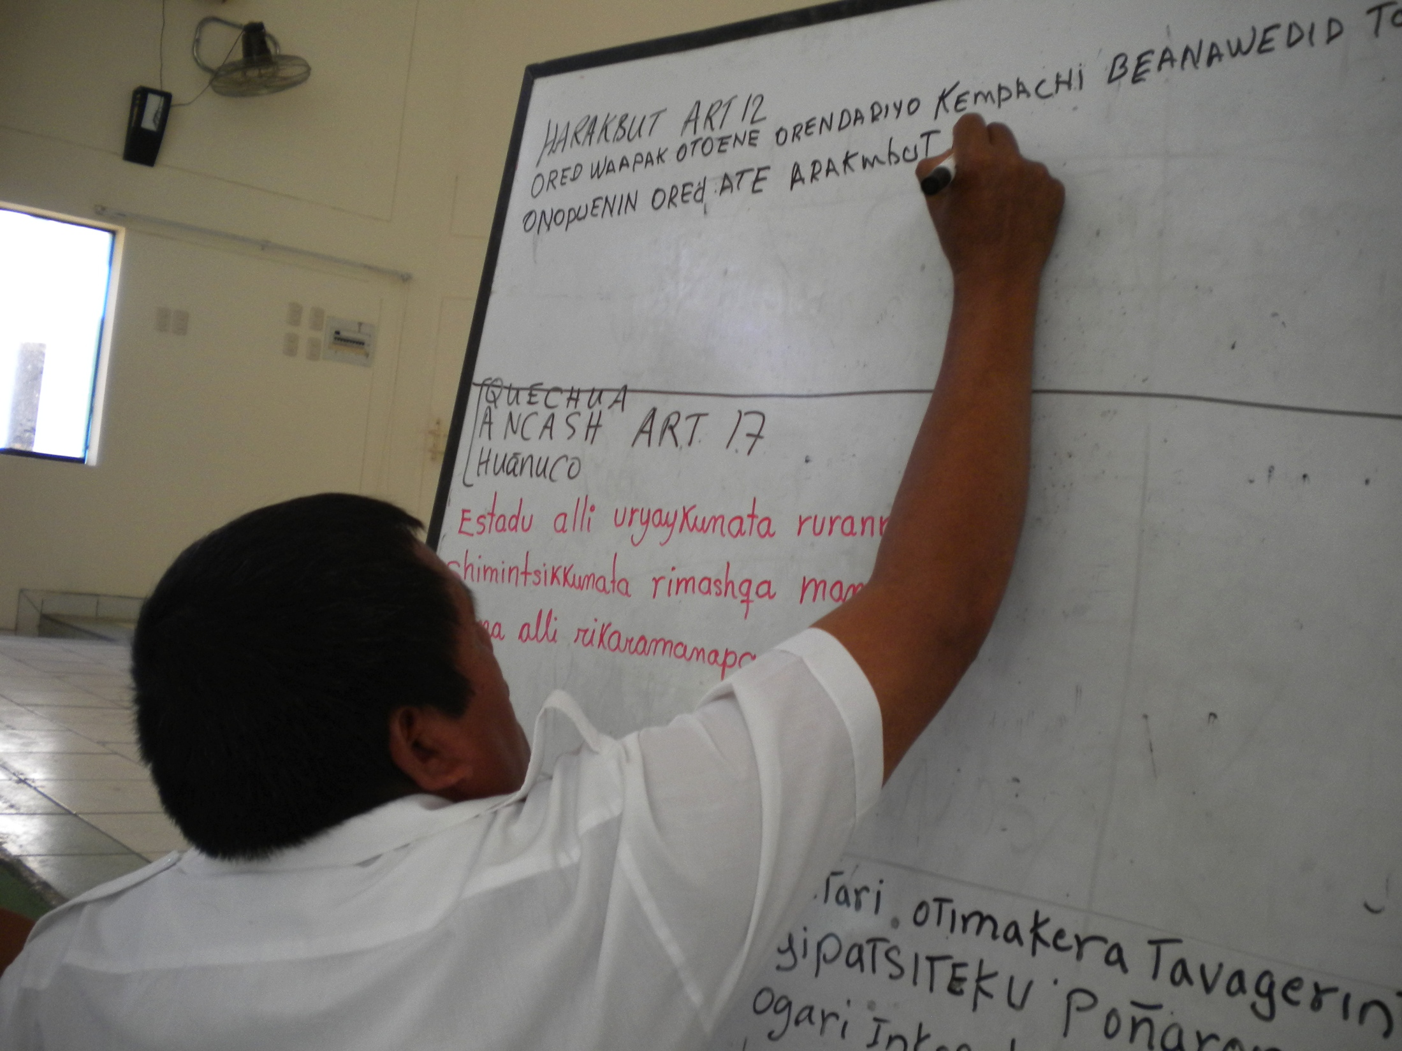
Participation and observation
8th Training Course in Interpretation and Translation in Indigenous Languages. Quillabamba, Cuzco, 17 Aug – 4 Sept 2015, convened by the Indigenous Languages Division.
Talk on interpreting ethics
Workshop on translation
Focus group on language rights
Moderation of final debate

Slide 12
Main themes emerging from the project
The complex role and identity of the State trained translators and interpreters: combining linguistic and cultural activism with professional translation and interpretayion activity
The work of interpretation in Prior Consultation settings: realities of the case
Translations of the Languages Act: sociocultural processes, textual products, reception

Slide 13
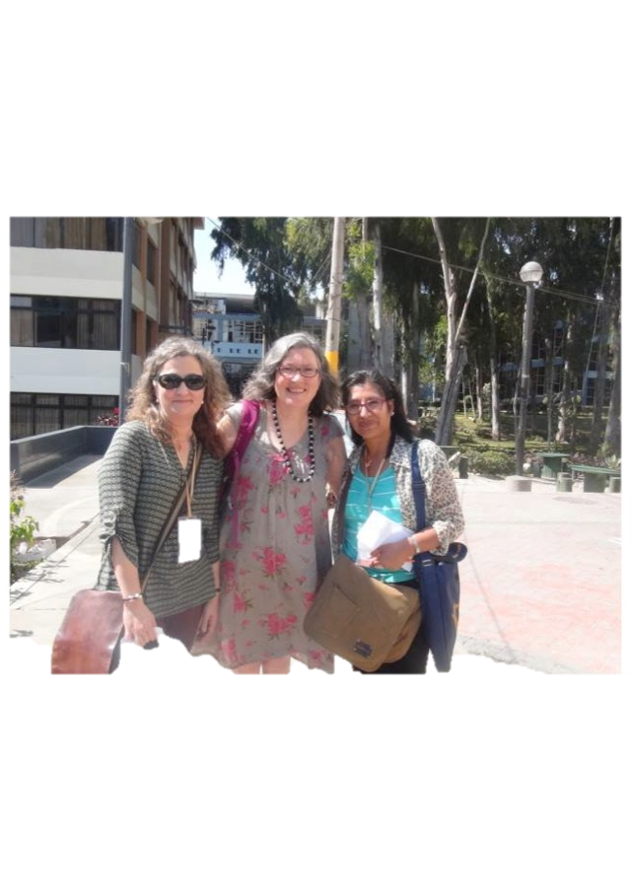
Gracias! Thank you! Diospagarisunki! Pasonki!

Slide 15
“Una palabra como ´motín´, por ejemplo, carece de explicación en awajún o wampís. O ´alevosía´, que no tiene ningún sentido, porque no existe la idea de mayor o menor gravedad en un delito.´ ´Si robas, robas; y si matas, matas´, explica Isaac Paz.”
(Roca Basadre 2014: 16).

