Slide 1





Traduciendo Culturas Perú / Translating Cultures Peru
“Translating Cultures: The legislated mediation of indigenous rights in Peru”
Rosaleen Howard, Newcastle University
Raquel de Pedro, Heriot-Watt University
Luis Andrade, Pontificia Universidad Católica del Perú

Slide 2
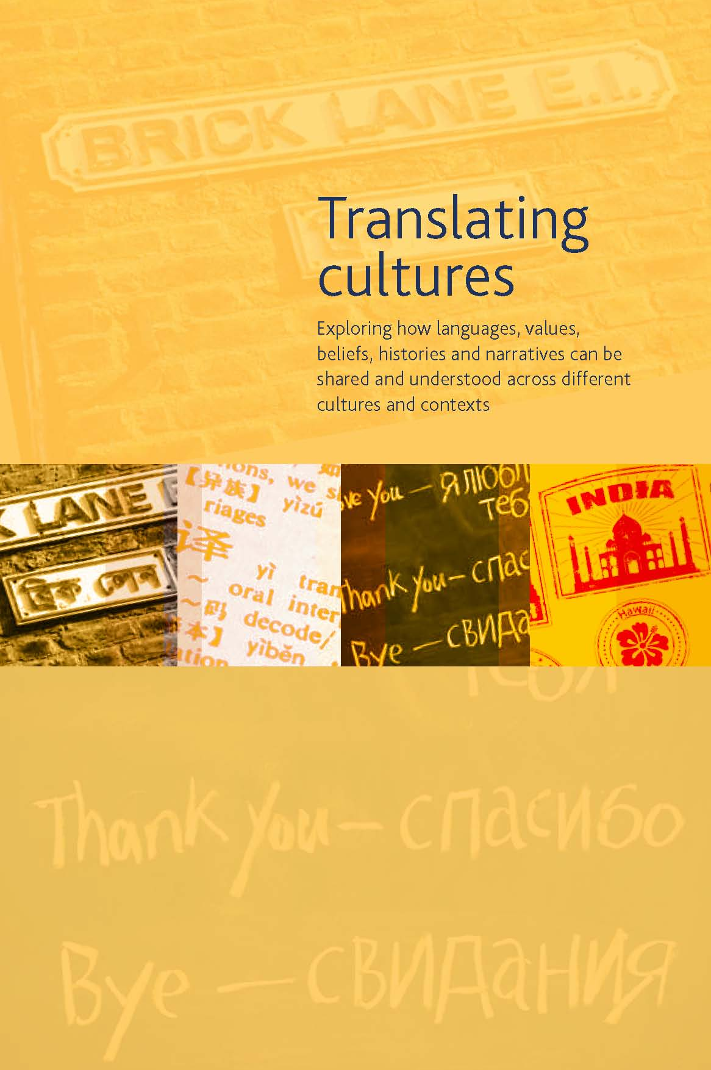
AHRC Translating Cultures theme

Slide 3
Research partners
Viceministry of Interculturality, Indigenous Rights Office, Indigenous Languages Division (DLI) - Ministry of Culture, Peru
Servicios Educativos Rurales (SER), Peru

Slide 4
Main themes emerging from the project
The complex role and identity of the State trained translators and interpreters: combining linguistic and cultural activism with professional translation and interpretation activity
Community interpreting in public service and Prior Consultation settings
Translations of the Languages Act: sociocultural processes, textual products, reception

