Slide 1
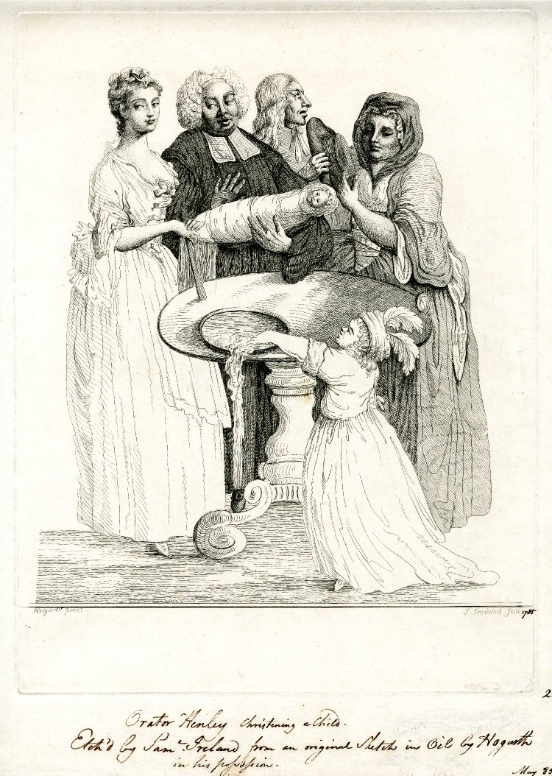
Clerical policy and local population studies: christening fees in Georgian Westminster
Jeremy Boulton, seminar presentation at the Cambridge Group for the History of Population and Social Structure, Dept of Geography, Monday 11th March 2013
© Jeremy Boulton and Romola Davenport. Do not quote without permission. Email: jeremy.boulton@ncl.ac.uk

Slide 2
Sources for the study of infant mortality by social status in St Martin in the Fields (pop. c. 27,000 in 1801) between 1750 and 1825
Sextons’ burial books (c. 75,939 records)
Baptism ‘fee books’ (c. 43,004 records)
Workhouse admission and discharge registers (86,489 records)
Settlement examinations (25,881 records)
Built up relatively socially heterogeneous urban district
ESRC/Wellcome funded...

Slide 3
Due to the growth of private baptism in Georgian London only children dying within a day or two of birth can be said to have ‘died before baptism’
The lengthening of the birth-baptism interval - commonly found in the eighteenth century - therefore cannot technically be said to have produced a risk of ‘dying before baptism’

Slide 4
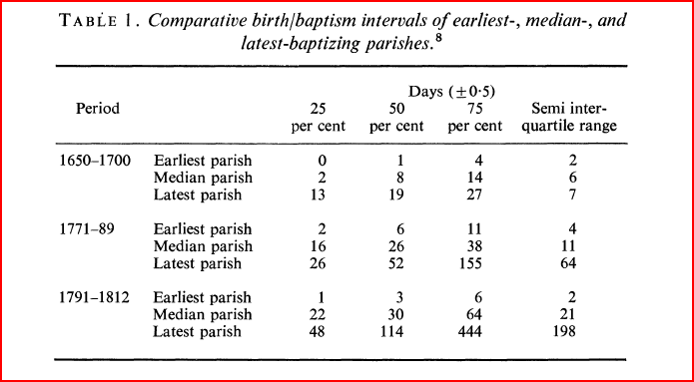
The birth-‘baptism’ interval: what is actually being measured?
The ‘classic’ article by Berry and Schofield
‘Between the sixteenth and the nineteenth centuries, the average interval between birth and baptism increased substantially, and with it the danger that a young child would die before baptism.’, Wrigley, ‘Births and Baptisms’, 281

Slide 5
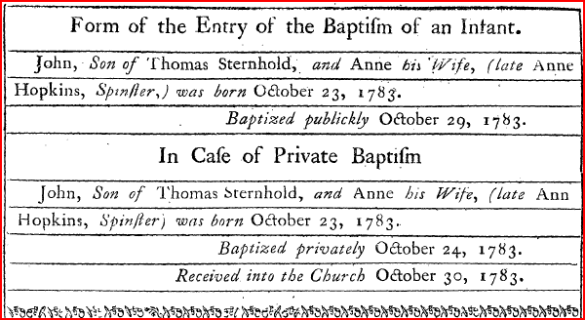
The Rubric of the Book of Common Prayer
Allowed for both public and private baptism
Private baptisms were to be brought to church subsequently for reception and certification or, if necessary, re-baptism
Form of registration recommended by Bishop of Norwich, 1783

Slide 6
Moreover private baptisms were commonest in London
Public baptism is now very much grown out of fashion; most people look upon it as a very needless and troublesome ceremony, to carry their children to the public congregation, there to be solemnly admitted into the fellowship of Christ’s church. They think it may be as well done in a private chamber, as soon as the child is born, with little company and with little noise (Sherlock, 1682)

Slide 7
Just as in other London parishes those giving birth in St Martin’s apparently waited an increasing amount of time to baptize their children in the eighteenth and early nineteenth centuries ( Handout Figure 1).

Slide 8
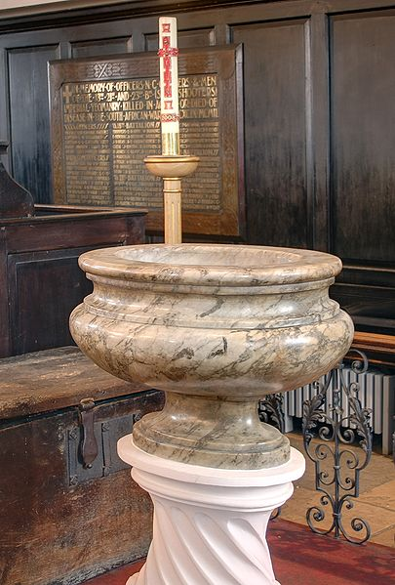
Where did public baptisms take place?

Slide 9
Given the lethal rates of infant mortality in London in the eighteenth century, we would surely expect to find large numbers of unbaptized infants in the parish burial register and large numbers of unbaptized very young children in the live population.
Even allowing for improving infant mortality rates in the later eighteenth and early nineteenth centuries, with many parents leaving baptism for months many children, surely, would have been expected to die ‘before baptism’. In fact, oddly, this is not what we find at all.
What we find – an almost complete absence of unbaptized children in registers which regularly record stillborn children – suggests that virtually all children were baptized before death...
How was this achieved is the subject of this paper...
First we should mention the whole issue of stillbirths... The burial books record stillbirths consistently throughout the period. For this reason one would expect the register to omit very few infants.

Slide 10
We think that many children dying within a few hours and days of birth in London were classified as stillbirths. These were usually buried without a forename
However, most children born live but classified as a stillbirth could surely not have been much older than a week – most cannot have been more than a day or two old…
There were 50 cases out of 3,320 cases (1.5%) of abortive or stillborn children where a forename was given, suggesting that an emergency baptism had been followed by an incorrect classification as a stillbirth.
Named ‘stillbirth’ cases were concentrated early in the period: 36/50 occurred between 1747 and 1758. There is also clustering in 1786 and 1792. There was no relationship between the incidence of baptised ‘stillbirths’ and the lengthening interval between birth and baptism

Slide 11
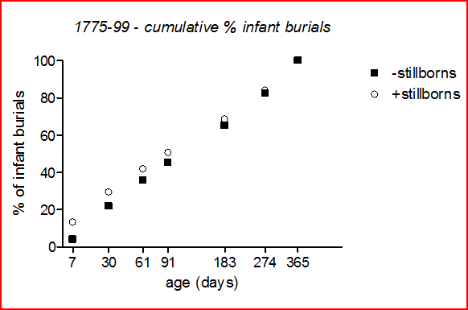
Handout Figure 2. Taking only burials recorded as live-born, there is a serious deficit of infant burials aged under 1 week (these comprised only 4% of all infant burials in the period shown in the figure, 1775-99, although this is the most dangerous period of life).
In particular, the first day of life is exceedingly dangerous, yet of 6,360 deaths aged under one recorded in this period, only one was recorded as occurring on the day of birth (compared with an average of 17 per day averaged over the first 365 days of life). Clearly there was an under-registration of very early neonatal deaths.
However this should not be taken to imply that early neonatal deaths were not buried. In stark contrast to the paucity of early neonatal burials there was a very large number of stillborn and abortive burials (15% of all burials aged under one in this period) . It is very unlikely that parents would neglect the burial of day old infants, yet scrupulously bury their stillborns. It is more likely that many of these stillborn burials represent early neonatal deaths.
When stillborn (but not abortive) burials are included with live-born burials, then the distribution of deaths in the first year of life becomes more plausible.
Almost all stillborn burials were unnamed, and it is likely that a substantial proportion of them represent the burials of unbaptised newborns
The B-P plots give no indication of any age-specific under-recording of infant burials except in the case of infants dying in the first couple of days of life

Slide 12
Misclassified stillbirths explain the absence of very young infants in our burial register
However, this still leaves a huge number of infants dying after a few days who should have been ‘unbaptised’ given the lengthening birth-’baptism’ interval
This is apparent from a look at the burial books of the parish, which give age at death, cause of death, address and cost of burial ...

Slide 13
Unbaptised children buried in St Martins 1747-1825
Very few children (those designated ‘C’ rather than as abortive or stillborn) were buried without forenames but with surnames (that is, excluding anonymous foundlings)
In only five of 70 cases (out of 35,974 records of those labelled as children ) did marginalia make mention of the fact that a dead child lacked a forename
39 cases out of 17777 infant burials 0.22% lacked forenames
Handout Figure 3 % infants lacking forename by age at burial
Age at burial in days | Total infant deaths | Unknown forename burials | % lacking forenames at burial by age
121-365 | 9193 | 10 | 0.11%
91-120 | 1262 | 2 | 0.16%
61-90 | 1441 | 2 | 0.14%
31-60 | 1444 | 3 | 0.21%
22-30 | 828 | 1 | 0.12%
15-21 | 1227 | 6 | 0.49%
8-14 | 1462 | 5 | 0.34%
0-7 | 920 | 10 | 1.09%
 | 17777 | 39 | 0.22%

Slide 14
Clearly we need to know more about baptism practices locally....
Settlement examinations help a bit....

Slide 15
Anonymous children and christening practices in settlement examinations
The testimony of one Eleanor Davis explained away the absence of any record of the baptism of her son at a neighbouring church by distinguishing between the christening ceremony and its formal registration:
that he was borne at Mr Robinsons in White Horse Yard King Street in the parish of St Margarets Westminster that after she had lay in about a Week he was sent to be Christened to St Margarets Church but whether he was Registered she cannot say because she was a poor Woman & had not mony to pay believes to be the Reason if not Registered
F5015/5.
Ann Eaton aged about 4 or 5 and fifty years lodging at the fig tree in Cross Lane Long Acre up one pair of Stairs says that she very well knew Joseph Clarke and one Elizabeth who went by the name of Clarke who Cohabited with the said Joseph Clarke about four years … she says that about that time she delivered the said Elizabeth of a female child which was illegitimate as this Deponent verily believes at a House about the Middle of Bull Inn Court in the Strand in the Parish of St Martin in the Fields and that the said Child was Baptized Ann in the same Roome that she was borne in Bull Inn Court aforesaid by one of the Ministers of the parish and Register'd in the Parish Bookes kept for that purpose. She further saith that the said Child is now about four years of Age And that the Mother is gone away and left the said Child and that the father is Dead

Slide 16
Overall of 644 legitimate children with given ages aged 1 and under, only 18 (2.8%) lacked a forename.
Of 719 illegitimate children of 1 year or under, 76 (10.6%) lacked a given forename.
Not all of the these 94 children lacking forenames were explicitly stated to have been unbaptised
The relatively small number of anonymous living children found in examined families therefore suggests that most parents, even among the destitute poor, gave legitimate children some form of baptism soon after birth

Slide 17
Settlement examinations at least confirm that a forename required a baptism
So we really now need to investigate local baptism practices to find out what was going on...

Slide 18
Baptism fees in St Martin’s
Table of Fees c. 1724-5
For Christenings at Home 3s 6d
at Church 1s 6d
For Churchings 1s

Slide 19
Baptism fees in St Martin in the Fields, 1751-1812
Not all the 5,963 individuals’ excused fees, or for whom no fees were recorded, were poor. Members clergymen, some squires, a few military men, members of the titular aristocracy, and once even a member of the royal family (whose baptism actually took place at Carlton House), for example, were not recorded as being charged fees.
Only two explicit cases of refusal to pay are recorded

Slide 20
This displays the percentage composition of the fees charged between 1751 and 1794. For the sake of clarity the figure includes only fees of 0d, 18d, 42d, 60-3d, 126d and 252d. These latter fees comprised 96% of the fees charged during the period

Slide 21
The reduction in fees in 1794 produced a measurable increase in the baptisms of ‘outsiders’ in the parish

Slide 22
Local clerical policy...

Slide 23
Handout Figure 5 Clerical policy and private baptism in St Martin in the Fields
“22nd March 1783
By order of Mr: Wrighte, all P: B’s:, or namings, are henceforth not to be paid for [to be] ^{or} Registered [as if] ^{until} they [have] been received into the Church”
However, if we take off the matter extended into the right and left hand margins, restore the crossed out matter, and remove substituted words we get back to a completely different original order:
“22nd March 1783
By order of Mr: Wrighte, all P: B’s:, or namings, are henceforth [to be] Registered [as if] they [had] been received into the Church”
The corrected order therefore actually represents a local policy reversal relating to the treatment of private baptisms. The original order on 22nd March 1783 suggests a policy change which would have elevated private baptisms to the same status as public baptisms – actually against prayer book rubric

Slide 24
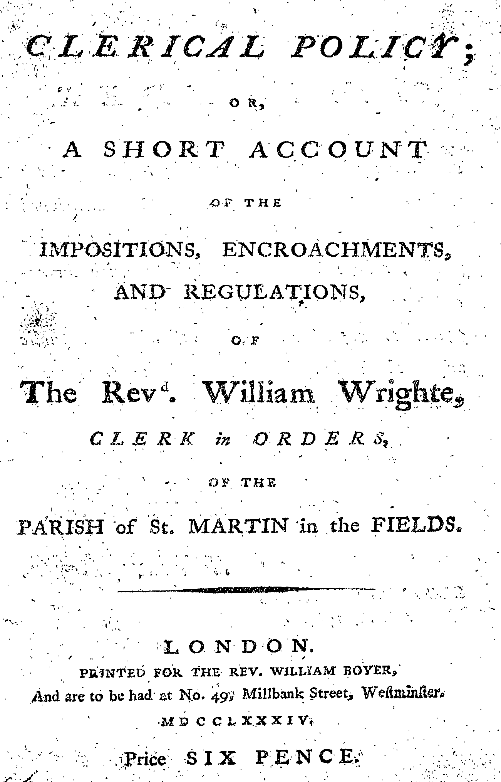
The Wrighte-Boyer dispute 1782-4

Slide 25
The baptism fee books do not record private christenings consistently....
Percentage of baptisms labelled as privately baptized or as home christenings 1751-1810

Slide 26
Data in Figure 2 (percentage distribution of fees) would (assuming that all fees over 18d represented a ‘home christening’ of some sort) suggest that private baptisms must have taken place in at least 31% of all christening ‘processes’ in the parish between 1751 and 1794. Moreover if we allow for 545 cases in this period when labelled home christenings were not charged fees, we get an overall figure of 33%.
Therefore the fees charged alone suggest that at least one third of all registered baptisms involved a private ceremony of some sort prior to, or instead of, a standard public ceremony.
If this estimate is reasonable, it must explain why so few infant children died without given forenames in the burial register (aged above a few days)
Both sick children and many others had already undergone a ‘naming’ even though they died before a registered public baptism or certification

Slide 27
The distribution of days of the week on which ‘baptism’ occurred helps to distinguish between the various fee & letter categories...
Handout Figure 7 Private and home baptisms
characteristics of 'P' baptisms differ between early series and later (1795+)
baptisms 1752-89 |  |  |  | baptisms 1785-1810
 | non-P | P |  | normal | P | HC
Sunday | 50.51 | 15.25 | Sunday | 57.25 | 48.65 | 25.60
Monday | 11.96 | 16.67 | Monday | 12.53 | 19.46 | 12.19
Tuesday | 9.54 | 12.26 | Tuesday | 9.59 | 10.27 | 13.04
Wednesday | 8.72 | 16.19 | Wednesday | 7.34 | 8.11 | 12.93
Thursday | 9.75 | 12.58 | Thursday | 6.02 | 5.95 | 20.26
Friday | 6.45 | 12.74 | Friday | 6.00 | 7.03 | 10.21
Saturday | 3.09 | 14.31 | Saturday | 1.26 | 0.54 | 5.77

Slide 28
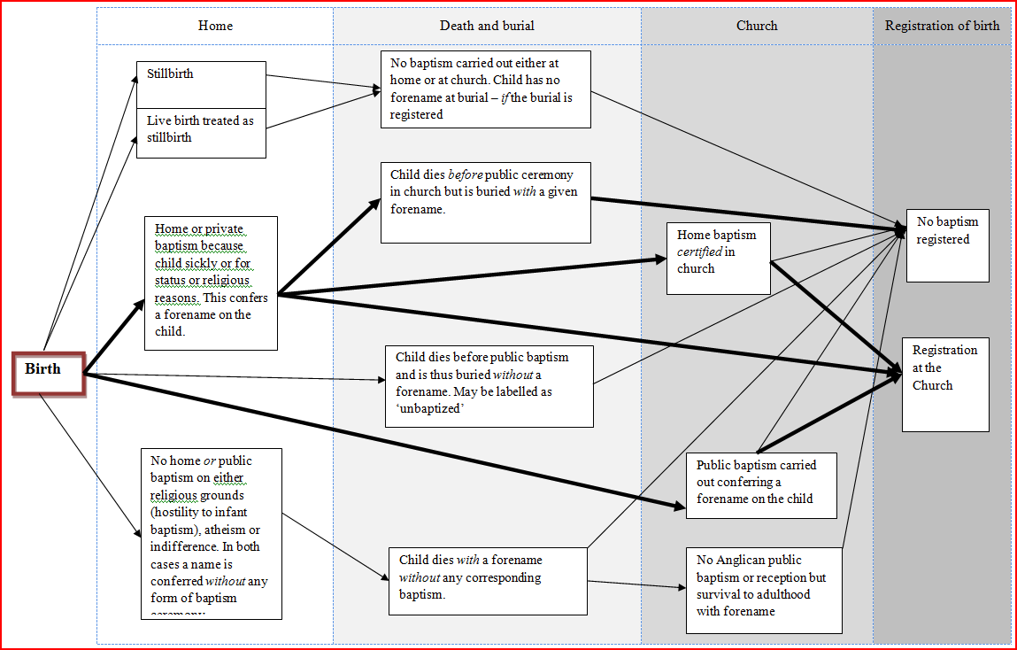
Handout Figure 8 The christening process in Georgian London...

Slide 29
Conclusions: this does muddy the water regarding the meaning of ‘baptism’ in Georgian parish registers
Christening was often a ‘process’ rather than an event in Georgian London
The birth-baptism interval is not necessarily measuring the interval between birth and baptism. It is often measuring the interval between birth and the public reception of a previous private baptism or ‘naming’
Sometimes it is measuring the interval between birth and a private baptism only (when the registers treat home baptisms as equivalent to public ones – the ‘Wrighte effect’)
As Tony Wrigley pointed out in 1977 (just like William Boyer two hundred years earlier), private baptisms might lead to double registration of events - if both the home and public ceremony appear in the baptism register. If there was a significant delay between private and public baptism, this would produce a ‘same name’ effect in the register
The proportion of home baptisms, and the way they were registered by parish officials, was clearly not constant over time
Therefore links from baptism registers to burials are not always as uniform as they seem since it is likely to be easier to link to registers with a high proportion of private baptisms than one in which they appear rarely
Unfortunately, however, it is rare for parish registers to identify private baptisms
It follows that one is very glad that we have ages at death in the burial books and birth and baptism dates in the baptism fee books , since it would be difficult to estimate ages at death with any certainty otherwise, given the variations in the proportion of private baptisms which would make the application of a constant correction factor problematic to say the least. ..

