Slide 1


Infant mortality by social status in Georgian London
Romola Davenport
(Cambridge Group for the History of Population and Social Structure)
Jeremy Boulton
(University of Newcastle)
John Black
(Cambridge)

Slide 2
Mortality change was most dramatic in urban populations
Infant mortality
London Quakers
English
reconstitution parishes
England & Wales

Slide 3
Urban reconstitutions are difficult because:
High mobility means families don’t remain in observation for long
High mobility and very large populations make it difficult to link records for individuals with the same name with confidence
the multiplicity of parishes provided a market for burials and baptisms outside the parish of residence (as well as lying-in hospitals etc)
Reconstitutions in the period 1750-1837 are difficult because:
increasing lag between birth and baptism means that the births of infants who died before baptism may have gone unregistered
private baptism was very popular esp. in urban areas
rising non-conformism and non-observance may affect birth and death registration differently

Slide 4
Amongst London Quaker children neonatal and infectious disease mortality declined substantially
Probability of dying in age interval per 1000
English national sample (Cambridge Group)
age (days) | 1752-74 | 1775-99 | 1800-24
0-29 | 79 | 71 | 57 | (neonatal )
30-364 | 91 | 92 | 83 | (post-neonatal)
365-730 | 48 | 51 | 48 | (age 1)
London Quakers (Landers)
age (days) | 1752-74 | 1775-99 | 1800-24
0-29 | 96 | 81 | 40 | (neonatal)
30-364 | 256 | 163 | 160 | (post-neonatal)
365-730 | 150 | 101 | 93 | (age 1)
‘endogenous causes’
breastfeeding
smallpox
Notes:
Neonatal dominated by ‘endogenous’ causes – prematurity, accidents in birth, genetic or in utero problems
Post-neonatal dominated by infectious diseases

Slide 5
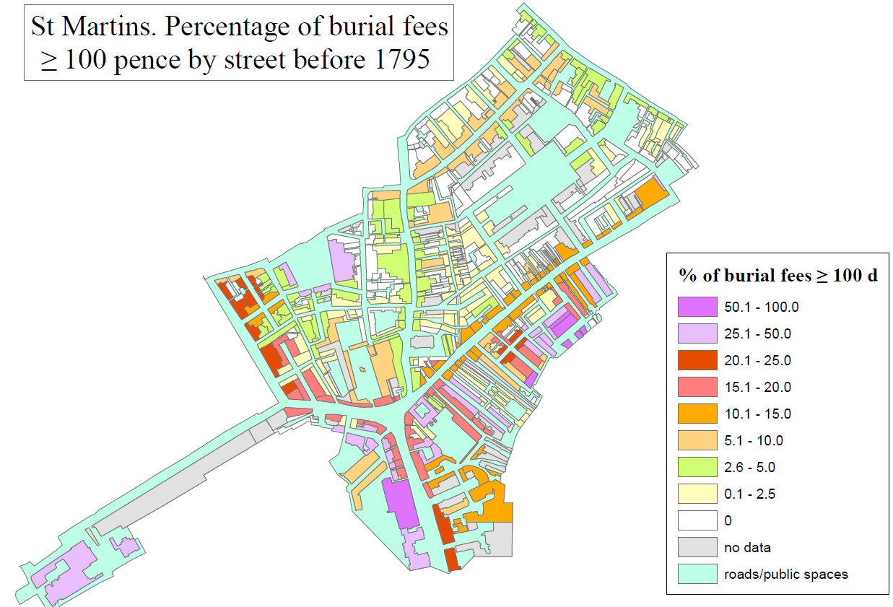
St. Martin in the Fields, Westminster
Percentage of baptism fees >100 pence before 1795, by street
Covent Garden
Workhouse
(National Gallery site)
% of baptism fees >100d
Parish church
Thames
river
Notes:
Wealthy West End parish of c.25k pop. Larger than most English towns in this period and with a corresponding social diversity. One of the largest workhouses in London. Wealthier residents concentrated on main thoroughfares but in close proximity to poor living in courts and lanes off main streets.

Slide 6
Some birth events are missing due to the practice of private baptism
Children of Charles and Theodosia Elizabeth Prater (married in St. Martin’s 02 Sept 1797)
forename | date of birth | date of baptism | address at baptism | type of baptism | date of burial | recorded age at death | burial fee (pence) | address at burial
Elizabeth Mary Ann | 10apr 1799 |  |  |  | 25may 1799 | 6 weeks | 264 | Charing Cross
Charles | 08mar 1800 |  |  |  | 29apr 1800 | 7 weeks | 264 | Charing Cross
Elizabeth | 17sep 1801 | 24oct 1801 | Charing Cross | home
Charles | 21mar 1805 | 26sep 1806 | Charing Cross | home
Louisa | 26aug 1806 | 26sep 1806 | Charing Cross | home
Jemima | 26apr 1808 | 25may 1808 | Charing Cross | home
Family exits observation at last baptism and last birth is excluded from analysis
Notes:
Partial reconstitution of population aged under two years. C.23% of families identified through baptisms could be linked to a marriage. High rates of ‘private’ baptisms, that seem in recon families to have been registered eventually if burial did not intervene.

Slide 7
Reconstitution families
Linked baptisms with same parental names
Linked burials aged 0-5 by name and age at death to baptisms
Linked burials aged 0-2 to families of same surname and address (and assigned dummy births)
Linked baptisms to marriages (23% of families)
Included only those baptisms occurring consecutively at the same address, and dummy births for burials aged<3 months
Period | Baptisms | Dummy births | Burials aged 0-5
1752-74 | 6,448 | 231 | 2,312
1775-94 | 6,308 | 314 | 2,047
1795-1812 | 4,611 | 204 | 1,041
totals | 17,367 | 750

Slide 8
Infant mortality in St Martin’s, unadjusted rates (probability of dying in age interval, per 1000)
neonatal (0-29 days) | St Martin in the Fields | London Quakers | national sample
1752-74 | 94 | 96 | 79
1775-94* | 57 | 81 | 71
1795-1812** | 53 | 40 | 57
post-neonatal (30-364 days)
1752-74 | 150 | 256 | 91
1775-94* | 137 | 163 | 92
1795-1812** | 78 | 160 | 83
1 year (365-730 days)
1752-74 | 103 | 150 | 48
1775-94* | 111 | 101 | 51
1795-1812** | 78 | 93 | 48
Mortality may be too low in St. Martin’s?
* 1775-99 for Quakers and national sample
** 1800-24 for Quakers and national sample
Notes:
Biometric analyses

Slide 9
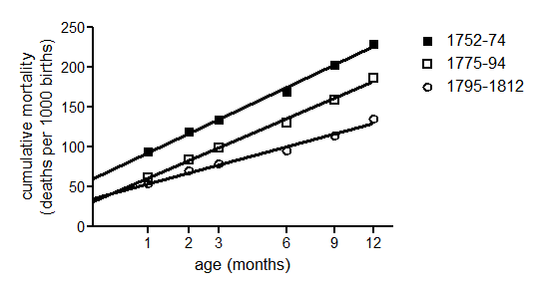
Biometric analysis did not indicate a burial deficit
‘endogenous’ infant mortality (y-intercept)
 | St. Martin’s | London Quakers | national sample
1752-74 | 61 | 43 | 61
1775-94* | 31 | 48 | 53
1795-1812** | 36 | 27 | 41
* 1775-99 for Quakers and national sample
** 1800-24 for Quakers and national sample

Slide 10
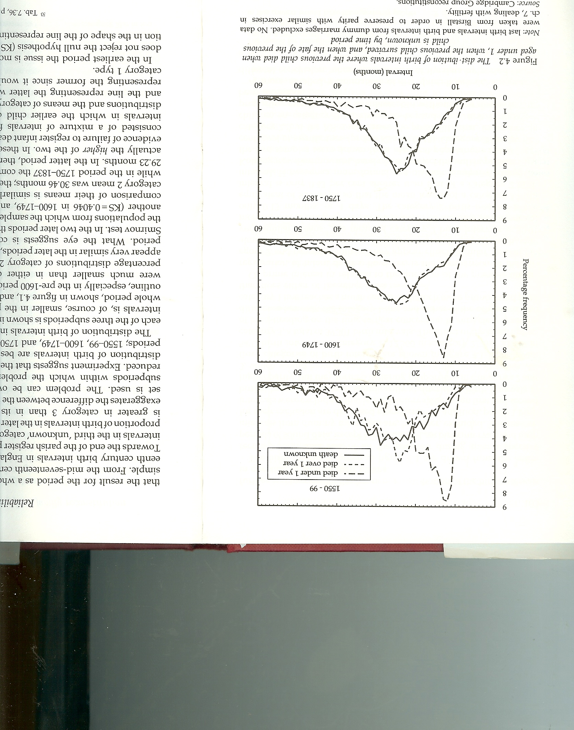
Birth interval analysis can give some indication of missing burials and possibly missing births
First infant died in infancy
First infant survived infancy – fate known (solid line)
First infant fate unknown
Wrigley et al. (1997) Population history from family reconstitution: 104

Slide 11
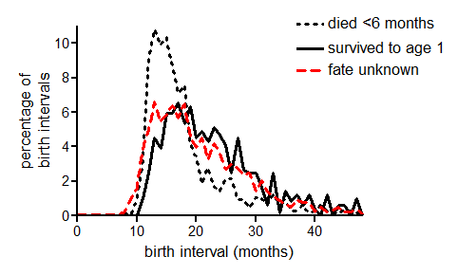
Birth intervals were short in St. Martin’s
1752-74

Slide 12
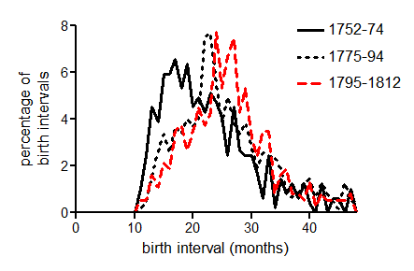
Birth intervals lengthened in the late eighteenth century in St. Martin’s
Interval to next birth where first child survived to age 1

Slide 13
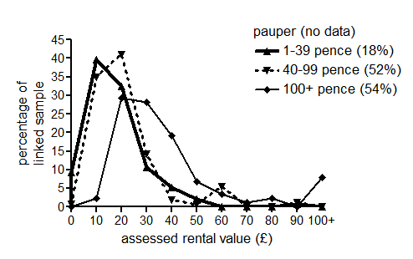
Social status groups defined by baptism fees overlapped but represented a distinct gradient in wealth and status
Male rate-payers, 1784

Slide 14
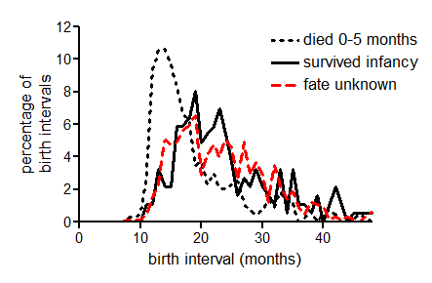
Amongst the poorer half of the population relatively short maternal breastfeeding appears to have been the norm (mid-C18th)
First infant in interval
1752-74

Slide 15
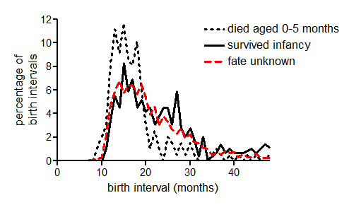
Amongst the wealthier half of the population maternal breastfeeding was mainly very brief or absent (mid-C18th)
First infant in interval
1752-74

Slide 16
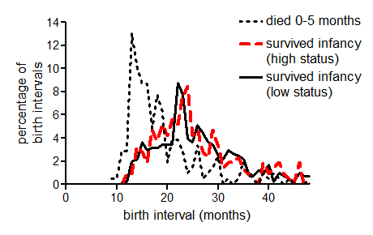
By the last quarter of the C18th maternal breastfeeding was apparently common in all status groups
First infant in interval
1775-94

Slide 17
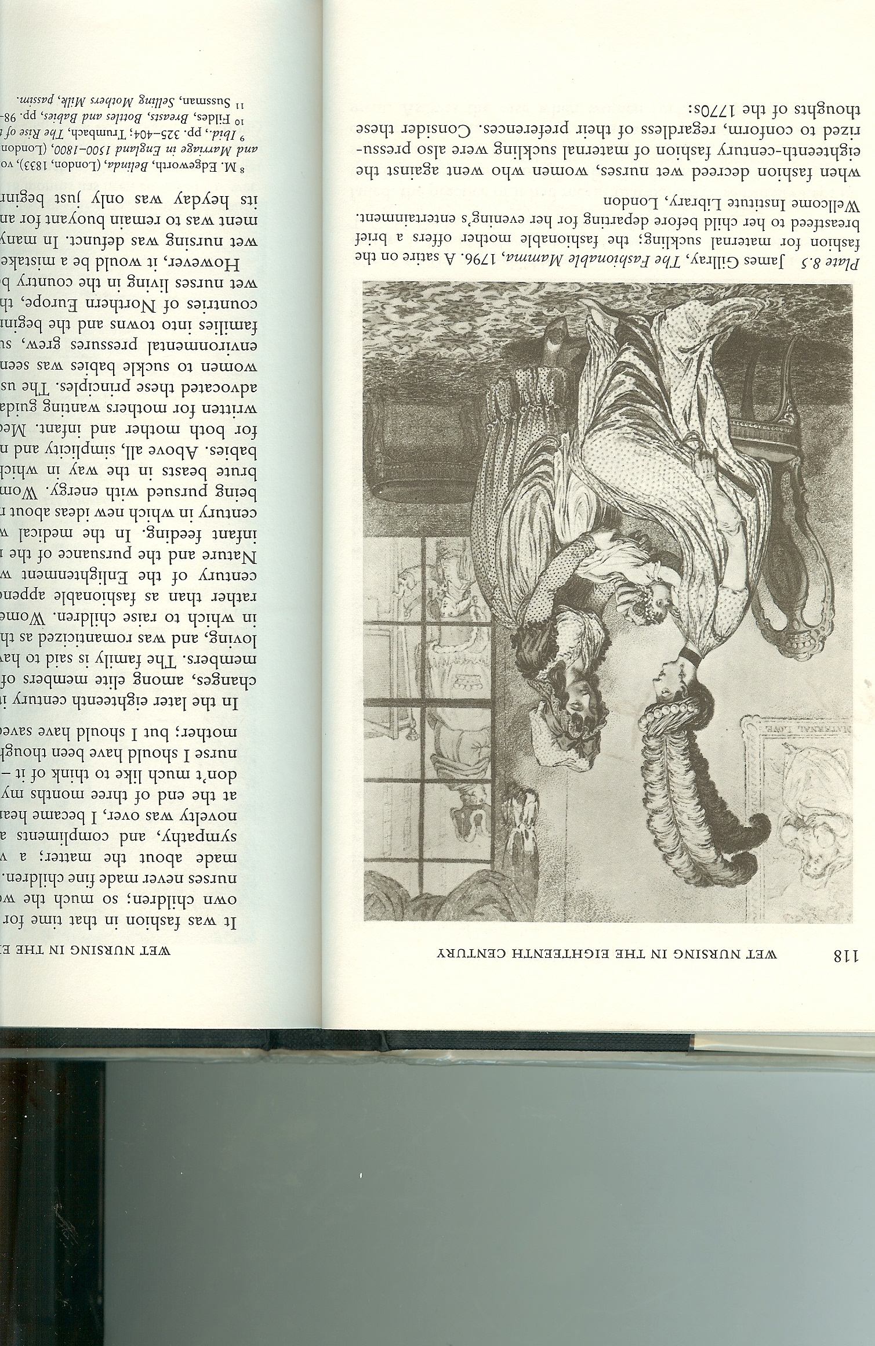
Birth interval analysis indicated a rise in maternal breastfeeding
Alternatives to maternal milk in London:
wet-nursing in a rural parish
wet-nursing in family home/parish
hand-feeding in family home
Anectdotal evidence for an increase in breastfeeding amongst elite women in the late eighteenth century (and use of colostrum)
Fildes: growing aversion to wet-nursing drove rises in maternal breastfeeding and hand-feeding

Slide 18
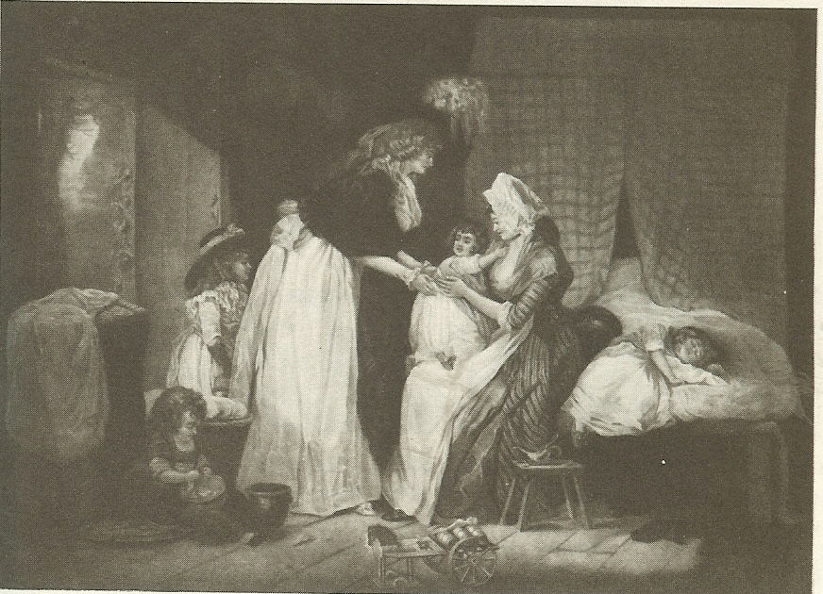
Birth interval analysis also suggested that many burials or infants were ‘missing’, especially in wealthier families
This could reflect:
Unobserved movement of families out of observation
Families remaining in observation but sending infants out (eg. to rural parishes)
Unregistered export of burials
(all of the above...)
Mother visiting her child at nurse, England, 1780

Slide 19
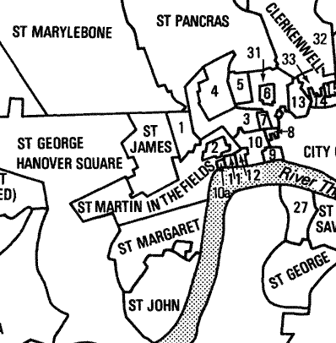
Exported burials were recorded in St. Martin’s sextons’ books but clandestine burials also occurred.
1. St Anne Soho
2. St Paul Covent Garden
3. St Giles in the Fields
4. St George Bloomsbury
5. St George the Martyr
Queen's Square
6. Gray's Inn
(extra-parochial)
7. Lincoln's Inn
(extra-parochial)
8. Liberty of the Rolls
9. Temple (extra-parochial)
10. St Clement Danes
10a. St Clement Danes
(detached)
11. Precinct of the Savoy
12. St Mary le Strand

Slide 20
Wealth may have conferred little survival advantage in infancy
Unadjusted
1752-74 | social status
age (days) | 0 (pauper) | 1 | 2 | 3 (richest 10%) | All
0-29 (neonatal) | 121 | 83 | 97 | 84 | 94
30-364 | 159 | 166 | 149 | 108 | 150
365-730 (age 1) | 142 | 158 | 85 | 53 | 103
Adjusted (missing infants removed)
0-29 | 121 | 83 | 98 | 87 | 95
30-364 | 163 | 172 | 166 | 162 | 166
365-730 | 147 | 163 | 96 | 82 | 117
N (births) | 373 | 1000 | 2413 | 465 | 4251

Slide 21
Wealth may have conferred little survival advantage in childhood
Unadjusted
1752-74 | social status
age (days) | 0 (pauper) | 1 | 2 | 3 (richest 10%) | All
0-29 (neonatal) | 121 | 83 | 97 | 84 | 94
30-364 | 159 | 166 | 149 | 108 | 150
365-730 (age 1) | 142 | 158 | 85 | 53 | 103
Adjusted (missing infants died)
0-29 | 123 | 96 | 162 | 237 | 112
30-364 | 184 | 191 | 290 | 562 | 305
365-730 | 147 | 184 | 151 | 205 | 144
N (births) | 373 | 1000 | 2413 | 465 | 4251

Slide 22
Falls in neonatal mortality occurred in the last quarter of the eighteenth century, in all social groups
Adjusted (missing infants removed) probability of dying in age interval, per 1000
 | social status
 | 0 (pauper) | 1 |  | 2 | 3 (richest) | all
neonatal
1752-74 | 121 | 83 |  | 98 | 90 | 95
1775-94 | 70 | 54 |  | 70 | 68 | 57
1795-1812 | 59 (pauper) |  | 54 (non-pauper) |  |  | 54

Slide 23
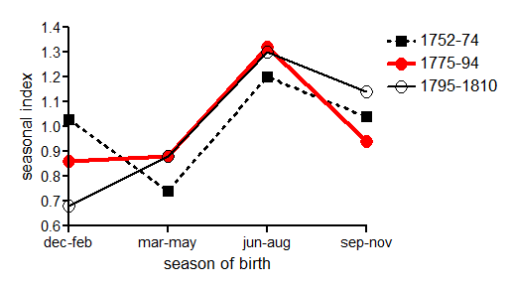
Summer peak in neonatal mortality persisted despite evidence of increased maternal breastfeeding

Slide 24
Falls in post-neonatal and childhood mortality occurred mainly post-1795
Adjusted (missing infants removed) probability of dying in age interval, per 1000
 | social status
 | 0 (pauper) | 1 |  | 2 | 3 (richest) | all
Post- neonatal
1752-74 | 163 | 172 |  | 166 | 162 | 166
1775-94 | 193 | 142 |  | 148 | 107 | 148
1795-1812 | 160 (pauper) |  | 84 (non-pauper) |  |  | 87
1 year olds
1752-74 | 147 | 163 |  | 96 | 65 | 117
1775-94 | 149 | 113 |  | 137 | 57 | 122
1795-1812 | 160 (pauper) |  | 84 (non-pauper) |  |  | 87
2-4 year olds
1752-74 |  |  |  |  |  | 207
1775-94 |  |  |  |  |  | 163
1795-1812 |  |  |  |  |  | 115

Slide 25
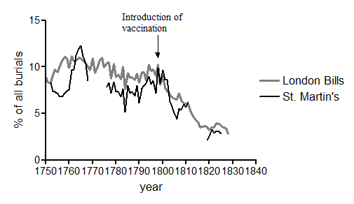
The timing of the falls in post-neonatal mortality resembles trends in smallpox mortality
Smallpox burials as a percentage of all burials

Slide 26
Conclusions
Mortality in the first two years of life in St. Martin in the Fields was fairly similar in levels and trends to London Quakers except that reductions in infectious disease mortality were later (post-1795)
No evidence for an advantage of wealth to infant survival, but children of wealthiest families may have benefited post-infancy. Maternal nutrition apparently unimportant.
Neonatal mortality converged across status groups, coincident with convergence in breastfeeding practices.
But, summer peak of neonatal mortality remained unaffected: complex changes in infant feeding practices?
Trends in infectious disease mortality at ages 1-23 months corresponded to patterns of smallpox mortality. Smallpox was a major component of excess urban mortality, that was probably decisively reduced only by vaccination.

Slide 27
Implications
If St. Martin’s is more representative of London’s population than London Quakers then:
Infant mortality fell relatively slowly in London between 1750-1800 and rapidly after 1800 (closer to national pattern than Quakers with respect to trends if not levels)
Smallpox inoculation was probably important only for select groups within the London population, before the introduction of vaccination c.1796.
The endemicisation hypothesis may account for the rise in urban mortality 1650-1750, but specific changes in infant feeding and smallpox immunisation may be responsible for most of the falls in infant and childhood mortality after 1750 in urban populations

Slide 28
Neonatal mortality in the workhouse of St. Martin in the Fields
Figure 2. Early and late neonatal mortality rates in St. Martin-in-the-Fields workhouse, five year moving means (excluding the day of birth, and the period 1756-60).
Source: Admissions register of the workhouse of St. Martin-in-the-Fields.

Slide 29
Workhouse neonatal mortality by day of age
Figure 3. Daily mortality rates by neonatal age in the workhouse of St. Martin-in-the-Fields.
Source: Admissions register of the workhouse of St. Martin-in-the-Fields.

