Slide 1
‘Undertakers of the poor’? Death, disease and mortality in a Westminster workhouse, 1725-1824
LPSS ‘Death and Disease in the Community, 1400-2010’
Centre for English Local History, University of Leicester
12th November 2011
© Romola Davenport (University of Cambridge)
Jeremy Boulton (University of Newcastle)

Slide 2
Contemporaries, on the whole, believed, like most historians, that workhouses harmed the health of their inmates
Such institutions did this by poor internal conditions, poor management and especially overcrowding which led to poor air quality and the mingling of healthy and sick

Slide 3


Slide 4
The custom of receiving an indefinite number, subverts the best oeconomy: it hazards the breeding an epidemical disease. I have often wondered, that the plague has not issued forth from the gates of a workhouse, to mow down the inhabitants of these vast cities.
How often it really occasions disorders of the most morbific nature, particularly among the common people, is not difficult to comprehend. Take any given number of people in a workhouse, of the same age and state of health as those out of it, and see what the comparative mortality will be. Nothing can be more obvious, than that the present mode of receiving without limitation, and crouding a house with numbers, is not less dangerous to the community at large, than it is cruel to the individuals… The difference of keeping a workhouse cleanly and dirty, I know in one instance, was one person in five, in the mortality of adults. I do not say but that the mortality in both cases, was very large, owing to its being crouded.
(Hanway, The Citizen’s Monitor, 106-7)

Slide 5
John Howlett’s careful estimates of the mortality of children aged under 15 suggested to him:
that the houses of industry are in general almost five times as unhealthy for children as my but moderately healthy parish of Dunmow (Essex)’ The Houses of Bulkingham, Heckingham, Shipmeadow, and Gressinghall… [He thought he was] ‘much mistaken if they have not killed very nearly one thousand poor children’
The Insufficiency of the Causes, London, 1788, 99-100.
Concern at workhouse mortality presumably explains why the 1776-8 ‘Gilbert Returns’ led to deaths from workhouses being included…

Slide 6
Parish | Able | Infirm | Infants | Total average numbers resident in workhouse 1772-4 | Able | Infirm | Infants | Total average deaths per year | Total death rate per 1000 inmates
St. Andrew Holborn, &c (and St George the Martyr) | 0 | 273 | 68 | 341 | 0 | 113 | 14 | 127 | 372
Bethnal Green | 104 | 107 | 20 | 231 | 0 | 39 | 10 | 49 | 212
Christchurch (Spitafields) | 0 | 0 | 0 | 305 | 0 | 0 | 0 | 95 | 311
St Clement Danes | 144 | 39 | 110 | 293 | 37 | 15 | 13 | 65 | 222
St George, Hanover Square | 179 | 291 | 137 | 607 | 44 | 138 | 38 | 220 | 362
St Giles (in the Fields and St George Bloomsbury) | 163 | 244 | 32 | 439 | 0 | 203 | 42 | 245 | 558
St James, Westminster | 233 | 452 | 328 | 1013 | 0 | 185 | 105 | 290 | 286
St John Hackney | 0 | 0 | 0 | 140 | 0 | 0 | 0 | 23 | 164
St Luke, Middlesex | 0 | 0 | 0 | 412 | 0 | 0 | 0 | 129 | 313
St Margaret and St John, Westminster | 195 | 236 | 8 | 439 | 34 | 83 | 26 | 143 | 326
St Martin in the Fields | 0 | 591 | 13 | 604 | 0 | 190 | 36 | 226 | 374
St Marylebone, Middlesex | 69 | 91 | 76 | 236 | 21 | 31 | 33 | 85 | 360
St Mary, Whitechapel | 242 | 60 | 101 | 403 | 65 | 54 | 9 | 128 | 318
St Nicholas, Deptford | 30 | 30 | 33 | 93 | 7 | 5 | 7 | 19 | 204
St Paul, Shadwell | 108 | 45 | 53 | 206 | 30 | 15 | 4 | 49 | 238
St Saviour, Southwark | 144 | 49 | 124 | 317 | 35 | 52 | 27 | 114 | 360
St Sepulchre, Middlesex | 71 | 22 | 0 | 93 | 7 | 11 | 0 | 18 | 194
 |  |  |  | 6172 |  |  |  | 2025 | 328

Slide 7
However, of course, such ‘rates’ are entirely bogus, since they take no account of the often very high ‘throughput’ of early modern workhouses and the fact that very large proportions of those admitted were already sick, ill, dying or even dead.
Many paupers can be shown to have been admitted actually dying. A small number were brought in dead and others died on or shortly after admission. The fact that a parish mortuary was located on some workhouse sites added to the grim statistics, as dead bodies were brought to the workhouse from the locale
Such problems were recognised by contemporaries, and similar problems lay at the heart of a bogus set of statistics on the supposed dangers of hospitals in the nineteenth century

Slide 8
Moreover, although both contemporary observers and some modern historians have described workhouses as insanitary and unhealthy, it is possible to construct an alternative picture
Where they survive, the rules and regulations – and some descriptions – of contemporary workhouses paint a picture of significant concern to provide a clean and healthy environment.

Slide 9
all Persons, as soon as there is an Opportunity, after their Admission, be viewed and examined by the Surgeon, Apothecary or Nurse, whether they have any infectious Distemper, and be washed, as soon as they are taken in, if it may be without prejudice to their Health. And that such as are found to be lousy or to have the Itch, be put into the particular Wards assigned for them, and not be removed, till perfectly clean...
That separate Wards be also assigned for the Foul-Disease, Small-Pox, Malignant Fevers, and all other infectious Distempers, and that Care be taken to convey and remove all who are so afflicted in due Time thither, for preserving others from Infection
Other orders ordered the regular fumigation of wards, rooms, infirmaries and bed sheets with wormwood.
Workhouse nurses were to:
take care to search all the Beds for Fleas, Buggs and other Vermin, once a Week, or oftener if occasion, and to have all their Beds made, and to sweep and clean their respective Wards, every Morning between the Hours of Eight and Ten; that every Ward be washed once a Week, or oftener as Need shall require; and the Windows be kept open in all, except the Sick Wards, every Day during Dinner, to air the Rooms, except in very rainy Weather
Regulations Agreed upon and Established This Twelfth Day of July 1726 by the Gentlemen of the Vestry then present, for the better GOVERNMENT and MANAGEMENT of the WORK-HOUSE belonging to the Parish of St. Giles in the Fields, London, 1726, 2-4, 14

Slide 10
The St Martin’s workhouse enacted similar rules and regulations - although not at this level of detail - at varying times throughout the eighteenth and early nineteenth century
‘a sink for washing of hands, be made in the Dining Room’ (1725)
In this workhouse, they have what they call a sweeper, whose business it is to take his rounds daily, and see that every part of the house be clean (Jonas Hanway, on a visit to St Martin’s Workhouse, c. 1775)
Nurses of the Children’s Wards do take care that the Children are washed, cleaned and combe’d every Morning (1775)
‘Two Wards be appropriated for the reception of Paupers upon their Admission previous to their being Warded which shall in no case be, until first examined by the Surgeon & properly cleaned, then to be cloathed with the Parish Garments’ (1805)
An official was thanked by the workhouse governors ‘for superintending and enforcing the good Government of the Workhouse, particularly in the essential point of its cleanliness’ in 1814

Slide 11
We cannot possibly know, however, whether hygiene regimes were ever observed or had any impact on the health and survival of inmates
The question is, just how unhealthy were ‘the first workhouses’, to what extent do their mortality regimes reflect that of their surroundings, and what does an analysis of their mortality experience tell us about mortality in the eighteenth century?

Slide 12
Workhouses can shed useful light on mortality in the eighteenth century, if records covering admissions and discharges survive in sufficiently long and unbroken runs, and contain information detailing the ages and fates of inmates
The bulk of this talk represents an investigation of mortality in one large Westminster Workhouse, that of St Martin-in-the-Fields
This is part of a much larger project, which is ongoing and expanding
The Project Documentation includes long runs of detailed burial books for the parish as a whole, which supply cause of death, residence and age at death from 1747
There is also a mass of other documentation including settlement examinations, overseers accounts etc .

Slide 13
To understand the mortality experience of the workhouse, one needs to know a little about its institutional history...

Slide 14
Actual numbers in the workhouse over time, 1725-1824

Slide 15
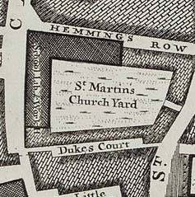
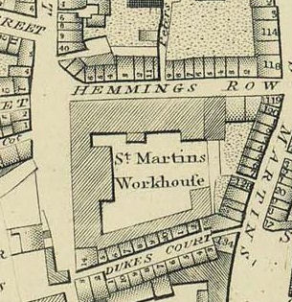
Rocque Map 1746/7 detailing Workhouse Site
Horwood map 1799 detailing rebuilt Workhouse
I have some really good pictures of the workhouse in 1871, but not before...

Slide 16
Notes:
Percentage of all deaths at each age, that occurred in the first week or month after admission. [Reflects both the concentration of deaths close to admission, due to use of the workhouse as a hospital, and the age structure of the workhouse population. Infants and young adults stayed only for relatively short periods, so fewer deaths occurred at longer durations of stay because few stayed].

Slide 17
Mortality rates cannot be crudely calculated using deaths per 1000 inmates due to the problems involved in establishing a population at risk
However, the admission and discharge dates, and ages at admission, do allow us to calculate age specific mortality rates for the institution using ‘deaths per person year’. That is, deaths per year of time spent by inmates...
This technique allows us to compute mortality rates by age and sex within the institution over a one hundred year period, based on a relatively large sample size

Slide 18
Some features of mortality rates in the St Martin’s workhouse

Slide 19
Dramatic improvement in survival chances with increasing length of stay in the workhouse was evident at all ages
Mortality rates by length of stay in the workhouse, ages 20-49
Notes:
These rates are deaths per person year- that is, deaths per year of time spent by inmates in this age range in the workhouse for each period of stay. There is an approximately 50-fold decline in risk of death (NOTE LOG AXIS) between the first week and the second year of stay, mainly reflecting the hospital function of the workhouse for the acutely ill. Adult males were at particularly high risk in the first weeks of admission, presumably because a higher proportion of all male entrants were admitted ill. As those with acute illnesses either died or recovered, the composition of the inmates at longer durations of stay changed, and the proportion of those admitted for reasons unrelated to illness (poverty, pregnancy etc) rose. Therefore the improvement in mortality with length of stay reflects changes in the average robustness of the inmates (a kind of ‘positive selection’). However operating against this positive selection was a negative selection against the robust, since the healthiest adult inmates were also most likely to find, or be judged capable of, employment, and to leave the workhouse earlier than those with chronic illnesses or disabilities. This would have applied particularly to males, and women without dependents [WE CAN CHECK THIS]. This pattern of dramatic improvement in survival chances with increasing length of stay in the workhouse was evident at all ages.

Slide 20
The hospital function of the workhouse produced strange age-patterns of mortality
Notes:
The hospital function of the workhouse produced strange age patterns of mortality. While infants and young children suffered extreme mortality in the workhouse, young adults, usually a relatively low risk group, experienced mortality as high as the elderly and young children, when mortality is considered as a whole. This reflects the very poor condition on average of those young adults who were admitted to the workhouse, and the fact that healthy young adults did not stay long (so the denominator for the rates, the time spent in the workhouse by all those in a given age group, is small relative to deaths for these age groups, making the calculated death rate higher).
A more normal age pattern of mortality was established amongst those long-stay inmates, with the ‘J-shape’ pattern observed in ‘normal’ populations (red line).

Slide 21
Large apparent improvements in survival at all ages
Notes:
When mortality in the workhouse is calculated for all inmates, there is a very substantial drop in mortality at all ages over the century 1725-1824,. However…

Slide 22
Apparent improvements in adult mortality are probably a consequence of either changes in admissions policies, or in survival of the acutely ill
survival after 6 months’ residence in workhouse (females)
Notes:
Risk of dying in each age interval, for those remaining in the workhouse six months after admission. (e.g. chance of dying between first birthday and fifth birthday (ages 1-4)). There are large improvements in survival for children, albeit from horrific levels (e.g. nearly 90% risk of dying in period 1725-49 between ages 1 and 4, reducing to 60% after 1800). The actual proportion of inmates dying was not this high, because many stayed in the workhouse for relatively short periods. Adults appear to have experienced very little improvement. Therefore the reductions in adult mortality, shown in the previous graph, are a consequence of improvements in survival in the first six months of residence in the workhouse (I.e. when the risk of dying was very high, as shown for young adults in the first slide). These improvements could be a function of changes in admissions policy. For instance, if the parish moved to provide relief mainly indoors, then the ratio of sick to healthy paupers admitted would go down, as the proportions admitted for medical compared to other reasons reduced. This would reduce the death rate in the initial period after entry, when death rates were high due to deaths of those admitted acutely ill. Alternatively, there may have been reductions in the numbers of acutely ill, or improvements in their survival. One might expect that reductions in the incidence or lethality of acute illnesses would also result in improvements in survival of long-stay inmates, if they were exposed to the same diseases. However, where we have managed to establish the causes of death in the workhouse (by linking workhouse deaths to the workhouse burials recorded in the parish burial books), the distribution of causes of death was different for long-stayers versus those who died shortly after admission. For instance, adults dying of smallpox in the workhouse were almost always new entrants, almost certainly infected before entry. Similarly, adult fever deaths were highly concentrated in the days and weeks after admission, and rarer amongst long-stay inmates (NEED TO CHECK HOW FIRMLY I CAN ASSERT THIS!]. However children did experience significant improvements in survival in both the period shortly after admission and even after months of residence. This could support an argument that the incidence or fatality of acute illnesses declined over the period, since acute infectious diseases causes a much higher proportion of deaths in children. Even long-stay child inmates were liable to die from acute infectious diseases (smallpox, typhoid and other diarrhoeal diseases, typhus, and respiratory diseases), since these were the main child killers, and susceptibility depended on age, in childhood. In adults, susceptibility to diseases conferring long or lifelong immunity (such as smallpox, measles, typhoid, probably typhus, influenza) probably depended mainly on origin and length of stay in London.

Slide 23
Mortality in the workhouse was much higher than in the national population, even for long-stay inmates
Notes:
The evidence from Quakers, in the previous slide, suggests that adult mortality may have been similar in London and the wider population, at least for a relatively select group such as the Quakers. However mortality in the workhouse was clearly extremely high, even for those surviving six months (where hopefully most of the effect of the hospital function of the workhouse has been removed). It is not clear to what extent this reflects the poverty of those entering the workhouse, the conditions inside the workhouse, or the likelihood that those remaining in the workhouse for any length of time were much more likely than the general pauper population to be chronically ill or disabled.

Slide 24
Infant survival improved across the first year of life, but especially in the first month of life
Notes:
There were massive improvements in infant survival especially in the first month, and in the first 6 months of life. This improvement in neonatal mortality is consistent with changes in the wider population and with John Landers’ study of the London Quakers. However where both the London Quakers and the St. Martin’s workhouse population differed from the national population is in the evidence for improvements in survival in older infants, where infectious diseases are an important component of mortality. In the national family reconstitution sample improvements in survival were confined to the neonatal period. Older infants and young children experienced a worsening of mortality over the late C17th and early C18th, and little improvement in the late C18th. Wrigley et al. argued that this was a consequence of the endemicisation of many infectious diseases in the national population, increasing the incidence of disease in later infancy and childhood, but sparing adult survivors (and neonates). As a consequence, very young infants benefited from improvements in maternal health (as a consequence of reduced maternal infectious disease morbidity). However in the workhouse and in the Quaker population, there was clearly a decline in infectious disease exposure or lethality in infancy. Indeed, a reduction in infant infectious disease exposure probably contributed to declines even in neonatal mortality (see next slide).

Slide 25
Workhouse improvements in neonatal mortality probably occurred partly as a result of reductions in neonatal tetanus - ‘eight-day sickness’ - possibly caused by better management of workhouse births
Notes:
This slide shows daily death rates by days since birth. ‘Normally’ mortality should decline in the days and weeks after birth, as those born very weak, with severe abnormalities or hurt during birth die (the red line shows the expected pattern, which held in the workhouse from the 1780s). However before the 1780s neonatal mortality in the workhouse showed several curious features. The first is that the day of birth, the most dangerous day of all, was apparently less risky than later days, and than the first day of life in the period after 1780. The reason for this is that before 1783 many first day deaths seem to have been described as stillborn, and the infants buried as such in the burial books. From 1783 the policy seems to have changed. Many more first day deaths were recorded as deaths of live-born infants, and none described as stillborn were recorded as buried in the burial books. This suggests that the criteria for recording stillborns changed in the early 1780s, and infants that lived a short time before death were no longer recorded as stillborn. A second curious feature of the pre-1780 period is the peak of mortality in the second week of life. This pattern is very typical of neonatal tetanus – also known as the ‘eight-day sickness’. Neonatal tetanus is still a significant cause of neonatal mortality in some developing countries, and usually arises from infection of the umbilical cord stump, for example by cutting with a contaminated blade. This peak in the second week appears to persist, although with some decline, until the early 1780s, when a more normal pattern of neonatal mortality was established. Again this suggests a possible change in practices surrounding birth in the workhouse. Maternal mortality (here simply deaths attributed to childbirth in the burial books) is also lower in the 1780s compared with previous decades, and no ‘childbed’ deaths were recorded from the workhouse after 1790.

Slide 26
Conclusions:
The hospital function of the workhouse explains why mortality in the institution was astronomically high
The likelihood of dying shortly after admission was very high and was related to this feature of workhouse life. Adult men were most likely to be admitted when dangerously ill.
Once those dying within six months of admission are excluded, more ‘normal’ – if still much higher – rates of mortality can be calculated
Mortality rates fell for all age groups as length of stay increased, partly due to positive selection of those who survived, although this was offset by the departure of the most healthy.
The fall in adult mortality rates over time is mostly to be explained by changes in the composition of inmates admitted. The ‘improvements’ in mortality for adults was caused by a reduction in the mortality of those dying shortly after admission i.e. more relatively healthy adults were admitted in the later period, perhaps because of a renewed emphasis on indoor rather than outdoor relief (or a reduction in the incidence of acute infectious diseases amongst the adult pauper population)

Slide 27
Conclusions:
There was a real and dramatic improvement in both infant and child mortality rates over time
There were massive improvements in infant survival especially in the first month, and in the first 6 months of life.
This could support an argument that the incidence or fatality of acute illnesses declined over the period, since acute infectious diseases causes a much higher proportion of deaths in children
There may also have been a reduction in neonatal tetanus. A curious feature of the pre-1780 period is the peak of mortality in the second week of life. This pattern is very typical of neonatal tetanus – also known as the ‘eight-day sickness’.

Slide 28
Appendix: Picture break....

Slide 29
Adult mortality probably improved in London in the second half of the C18th (more sickness amongst children less amongst adults)
Notes:
Note that the data here are life expectancies, not mortality rates, and they refer to life expectancy remaining from age 25 (for English recon sample) and from age 30 for London Quakers (so life expectancy appears lower for the Quakers, but this is mainly a consequence of the five year difference in the age from which life expectancy was calculated – no need to discuss this. It’s just interesting, because in the case of Quakers married adults really don’t seem to have suffered an urban penalty). Adult survival improved in the national population over most of the C18th, and there was some improvement amongst the London Quakers between the first and second halves of the eighteenth century. The Wrigley et al. argument is that adult life expectancy improved at least partly as a function of endemicisation of some infectious diseases, that became increasingly confined to childhood, at the expense of child mortality but to the benefit of adults.

Slide 30
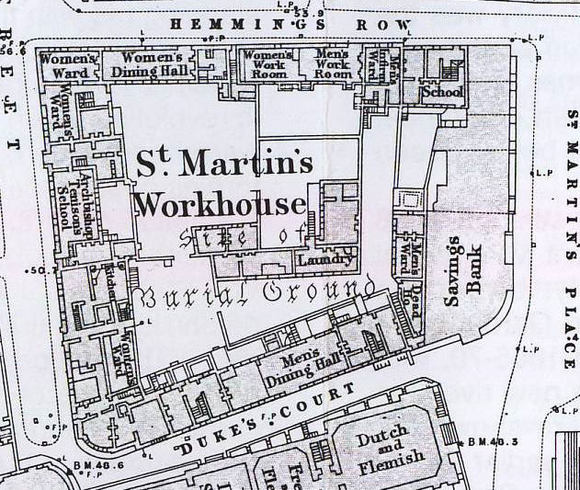
Large scale Ordnance survey map, c. 1871

Slide 31
The Workhouse was depicted very comprehensively by C. J. Richardson in 1871 and J. P. Emslie in 1886

Slide 32
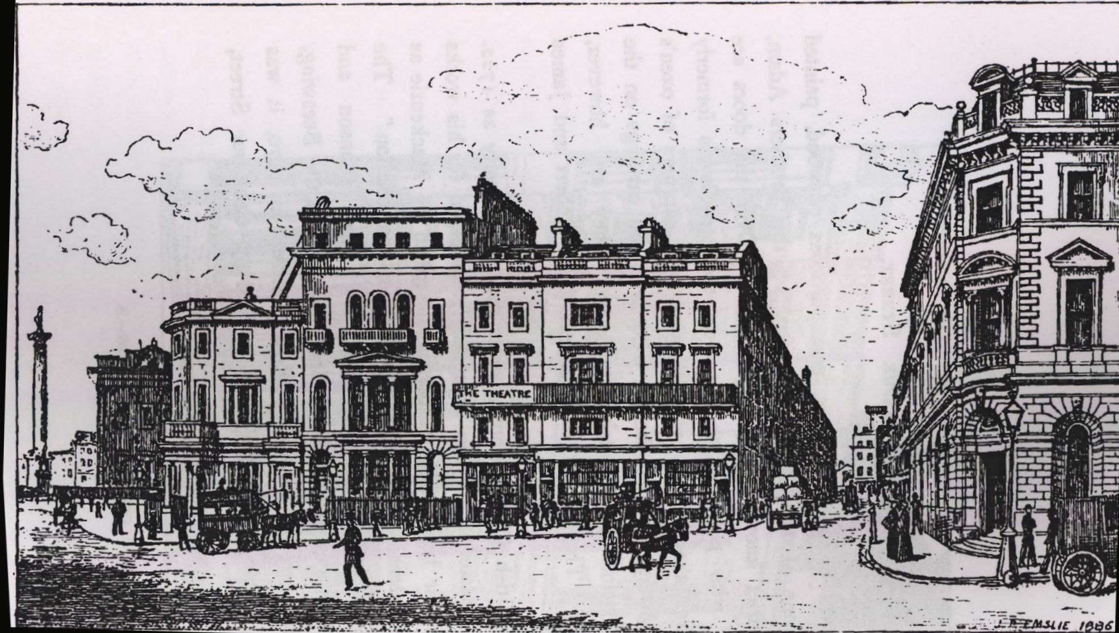

Slide 33
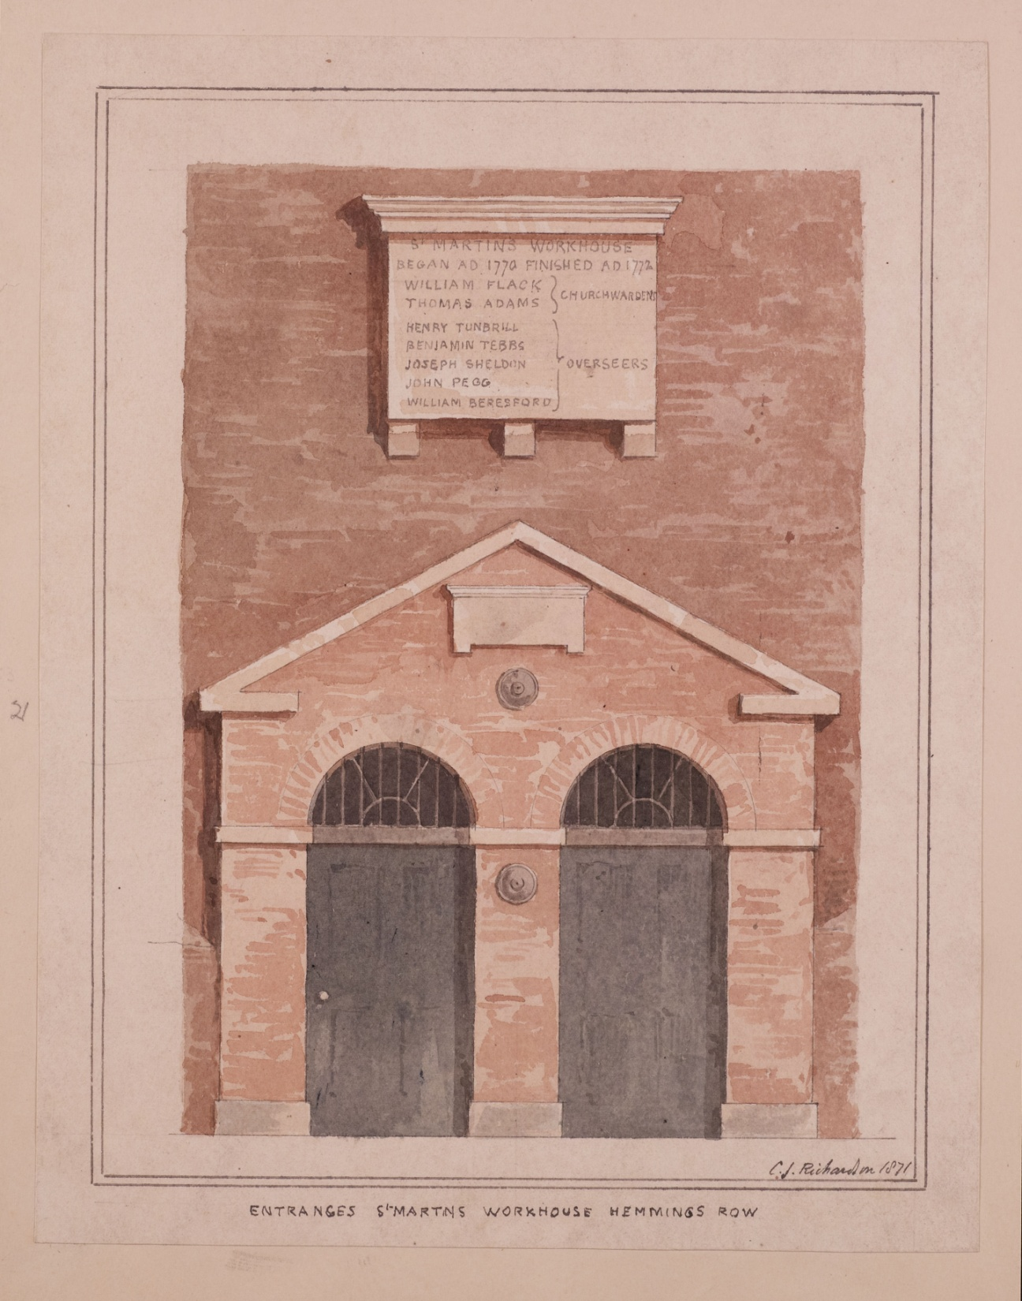
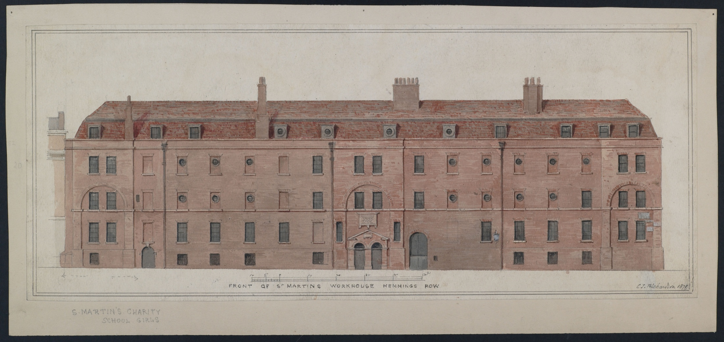
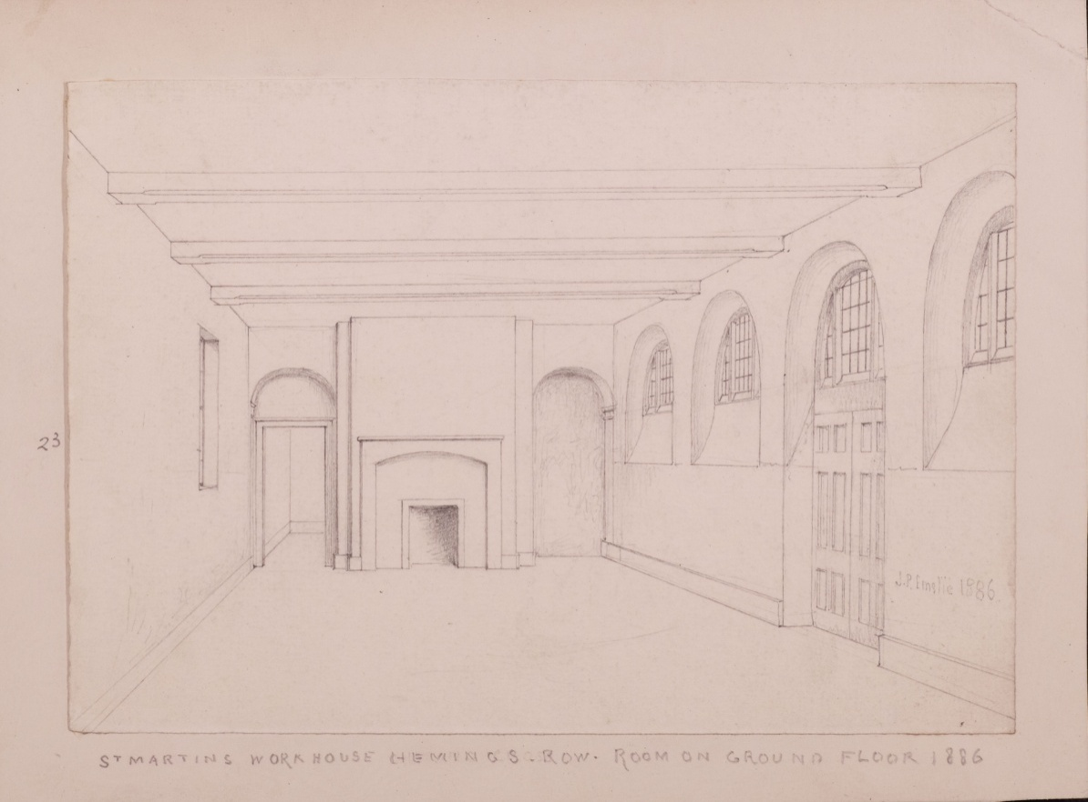
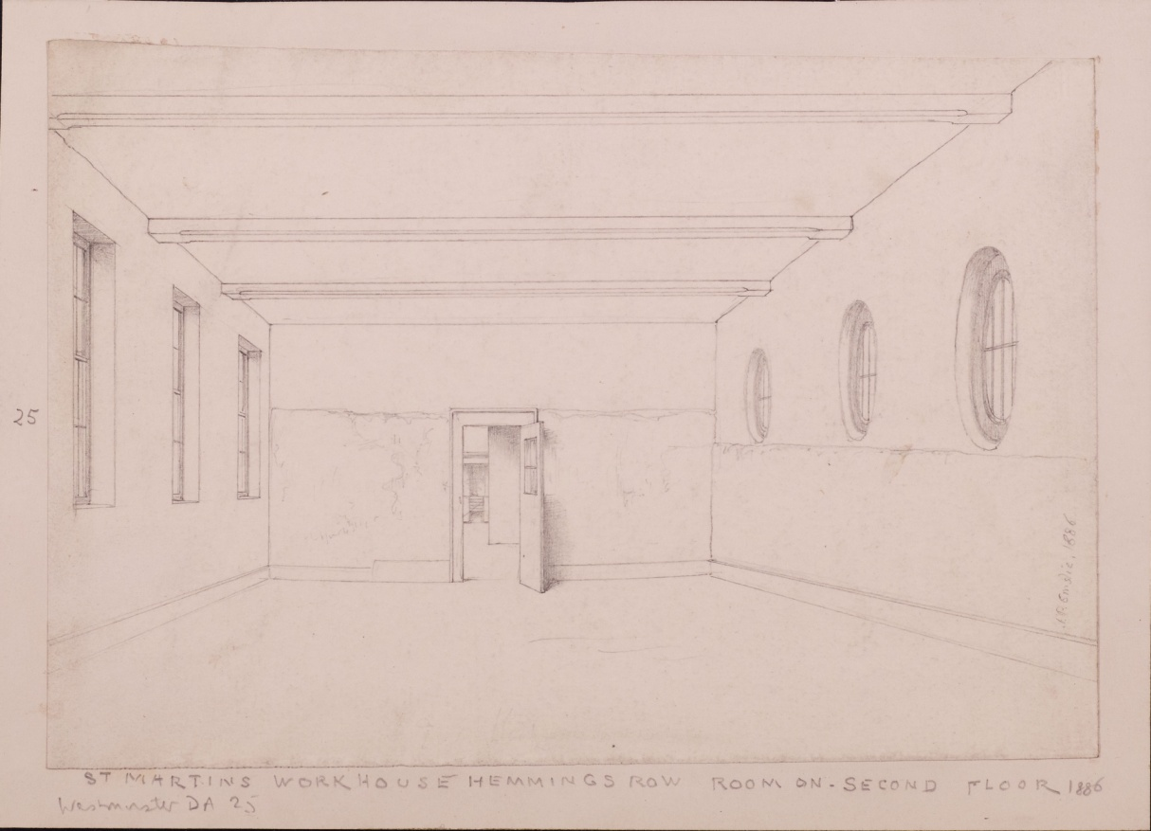

Slide 34
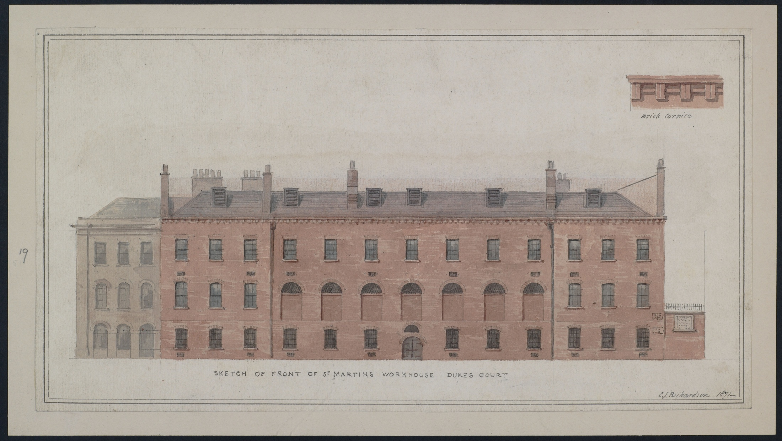

Slide 35
