Slide 1
Welfare, accounting and financial priorities in a London parish, 1725-1824
© Jeremy Boulton, Newcastle University
Economic History Society
Annual Conference, University of Cambridge
2nd April 2011

Slide 2
London and its poor: why bother?
‘Mixed economy of welfare’, Jo Innes
‘something of an oddity’ Steve King, Poverty and Welfare, 13
‘Wencentric’? Hunt and Botham

Slide 3
Eighteenth-century London living standards
L. D. Schwarz, ‘The Standard of Living in the Long Run: London, 1700-1860’, Economic History Review 38, 1 (1985), 39-40

Slide 4
Historiography: relative generosity of Poor Law welfare systems, and new interest in relative generosity of pre-1834 workhouses
Pauper palaces?
Concentrate on pre 1800 period, far more information about post 1800 period including Pauper Capital...
Complexity of eighteenth-century relief: how did workhouses fit into Old Poor Law?
How responsive and flexible was parish welfare system run by the overseers?

Slide 5
St Martin’s - the parish
Reasonably stable population in the eighteenth century 25-30,000 people
Large tax base, some prominent palaces and government departments located in London’s West End
Plenty of poor and artisans, dubious back alleys etc.
Strand and other major thoroughfares
Far from being the wealthiest area of the West End
Relatively few Coaches per 100 houses (1739) compared to some other West End parishes

Slide 6
Accounting year | Parish Name | Total spent by overseers in £s | Number of houses (1000+) | Shillings spent per house per year | Percent coach owners
1727 | High Holborn Liberty, St Andrew, Holborn, Middx | £3,071 | 1863 | 33 | 13.3
1726 | St James, Westminster | £4,550 | 3317 | 27 | 9.0
1728 | St Clement Danes | £2,283 | 1691 | 27 | 2.9
1726 | St George, Hanover Square | £2,557 | 1909 | 27 | 23.1
1726 | St Anne, Westminster | £1,553 | 1337 | 23 | 5.5
1726 | St Martin in the Fields | £3,270 | 3089 | 21 | 2.8
1726 | St Margaret, Westminster [includes St John] | £3,323 | 3282 | 20 | 1.8
1727 | St James Clerkenwell | £1,684 | 1889 | 18 | 1.2
1727 | St Botolph Bishopsgate | £1,249 | 1709 | 15 | 1.7
1725 | St Saviour's Southwark | £1,826 | 2554 | 14 | 0.5
1727 | St Mary Rotherhithe | £918 | 1320 | 14 | 0.1
1724 | St Mary Lambeth | £1,046 | 1625 | 13 | 0.9
1726 | St Sepulchre's, the City Liberty | £767 | 1226 | 13 | 0.4
1723 | St Luke Old Street | £1,842 | 3035 | 12 | 0.2
1725 | St Bride's | £627 | 1052 | 12 | 0.8
1727 | St George the Martyr, Southwark | £859 | 1503 | 11 | 0.0
1734 | St George in the East, Middx | £1,047 | 1946 | 11 | 0.4
1727 | St Botolph Aldgate, East Smithfield Liberty | £762 | 1435 | 11 | 0.7
1725 | St Giles Cripplegate | £974 | 1895 | 10 | 0.4
1725 | St Botolph's Aldgate, the City liberty | £634 | 1239 | 10 | 0.6
1727 | Christchurch, Spitalfields, Middlesex | £1,144 | 2244 | 10 | 0.2
1727 | St Mary Whitechapel | £1,354 | 2792 | 10 | 0.9
1727 | St Leonard Shoreditch | £1,034 | 2266 | 9 | 0.2
1736 | St Paul Shadwell | £726 | 1696 | 9 | 0.1
1726 | Christchurch, Southwark | £403 | 1011 | 8 | 0.2
1727 | St John Wapping | £517 | 1342 | 8 | 0.4
1723-7 | St Dunstan Stepney | £1,663 | 4338 | 8 | 0.7
1724 | St Mary Magdalen Bermondsey | £745 | 2111 | 7 | 0.1
1724 | St Anne, Limehouse | £302 | 1262 | 5 | 0.1
1727 | St Olave Southwark | £356 | 2012 | 4 | 0.2
 | Source: Maitland, 1739
St Martin’s in a relatively favourable position compared to most other London parishes of comparable size
Wealth of West End meant favourable ratio between tax payers and recipients
Range of per capita payments very wide in the capital
Within the West End, St Martin’s was far from being the wealthiest area
76/155 in ranking of coach-owning parishes

Slide 7
Discontinuities in indoor provision the key to understanding changing balances of ‘parish welfare system’
Regular pension payments (until 1725)
Extraordinary or ‘casual’ poor relief paid throughout the period at varying volumes
‘Settled poor’ receiving small regular pensions increasingly seen in the accounts after 1730s. Essentially equivalent to pensioners
Almswomen (not treated here) inhabiting parish almshouses with weekly pension (throughout the period)
Infant poor nursed in the country (from 1752)
Parish apprentices (throughout the period)
Pauper lunatics: either cared for in house or farmed out (throughout the period)
Parish workhouse inmates (from 1725)

Slide 8
St Martin’s workhouse ‘capacity’
Capacity is not the same as ‘throughput’
1732 reported as 344 Men, women & children
1772-4 Parliamentary returns suggested max ‘capacity’ of 700
1797 Eden reported 573 inmates (473 adults, 100 children)
1803 Returns suggest 665 inmates, including children

Slide 9
St Martin’s workhouse was the third biggest in terms of ‘capacity’ in the London area in 1803
Number of workhouse inmates 1803 | %
1- 100 | 22
101-200 | 28
201-300 | 16
301-400 | 12
401-500 | 8
500+ | 14
Total workhouses outside City within the walls | 50
Notes:
Not THE biggest. The biggest workhouse was that of St Marylebone, which contained 1013 inmates in 1803. Westminster contained three of the next biggest: St George, Hanover Square, contained 708. St James, Westminster 630.

Slide 10
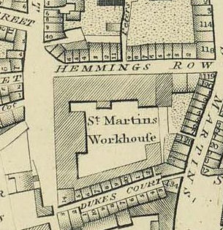
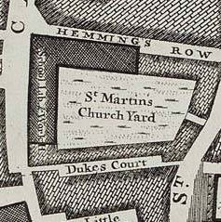
Horwood’s map 1799: detail of workhouse site
Rocque’s Map, 1746

Slide 11
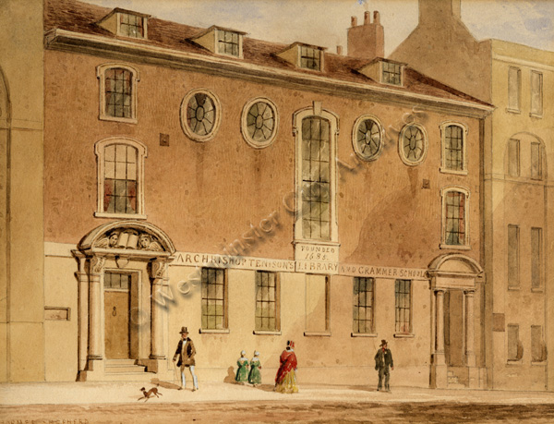
Archbishop Tenison's Library and Grammer School (founded 1685)
Notes:
Archbishop Tenison Library and Grammer School, Castle St/St Martin-in-the-Fields ; F139 Tenison's School (001) ; By Thomas Hosmer Shepherd 19th century

Slide 12
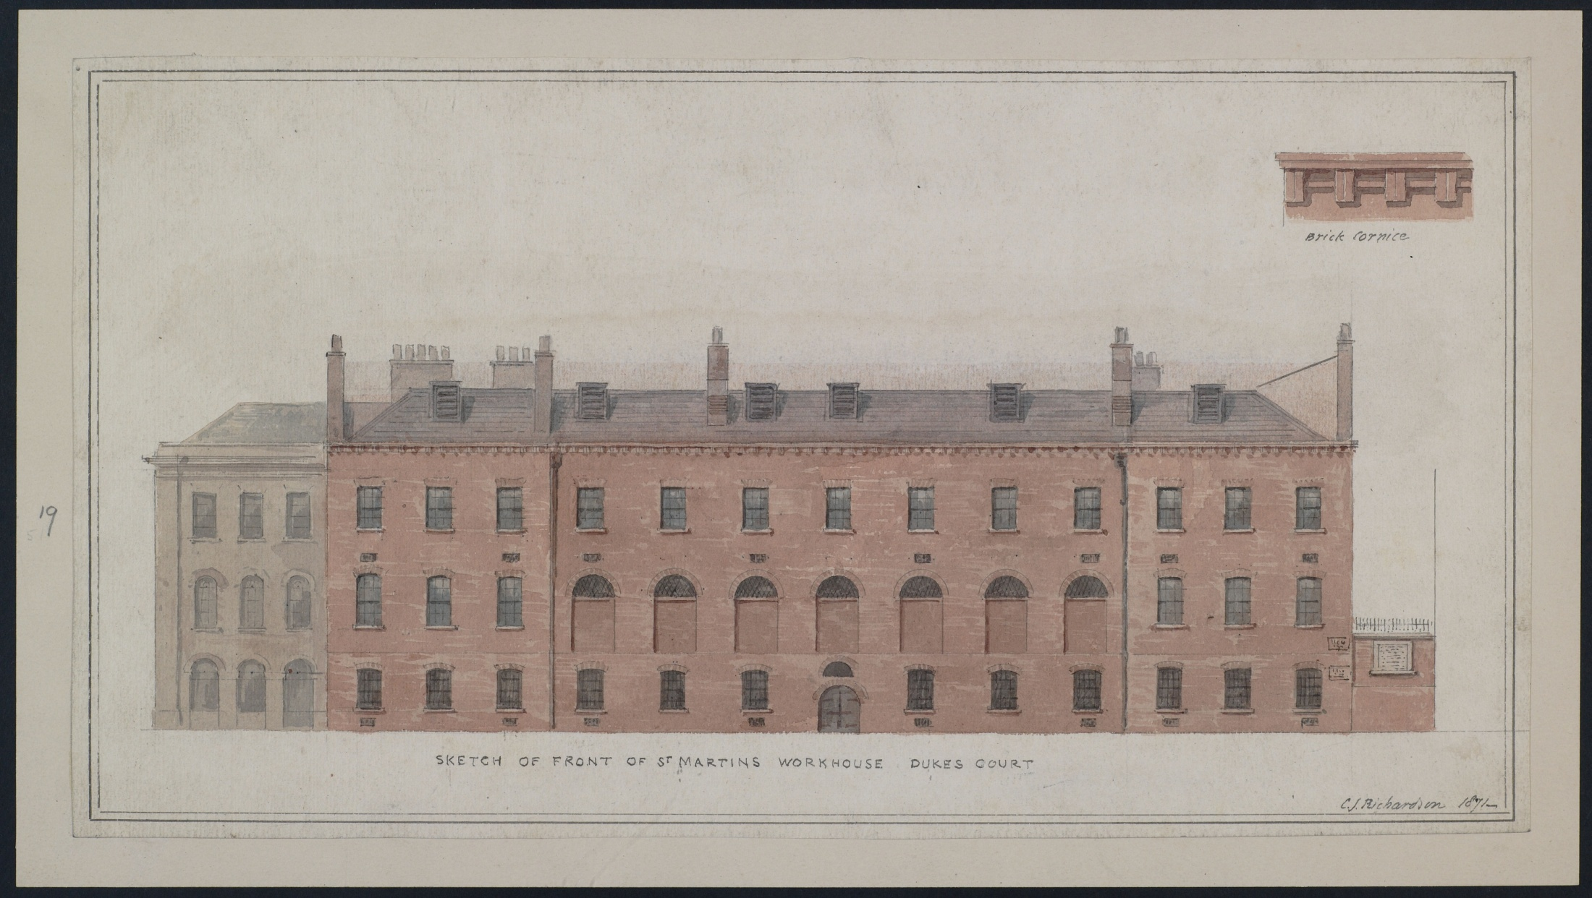
Front of Workhouse, Dukes Court 1871

Slide 13
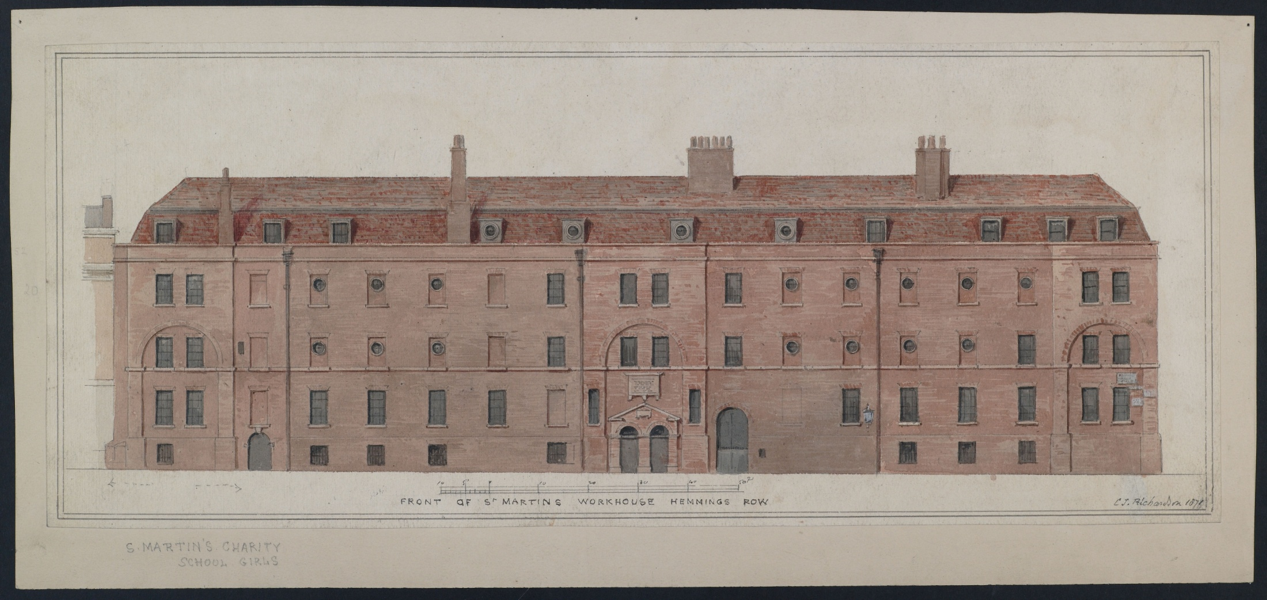
Front of Workhouse Hemmings Row 1871

Slide 14
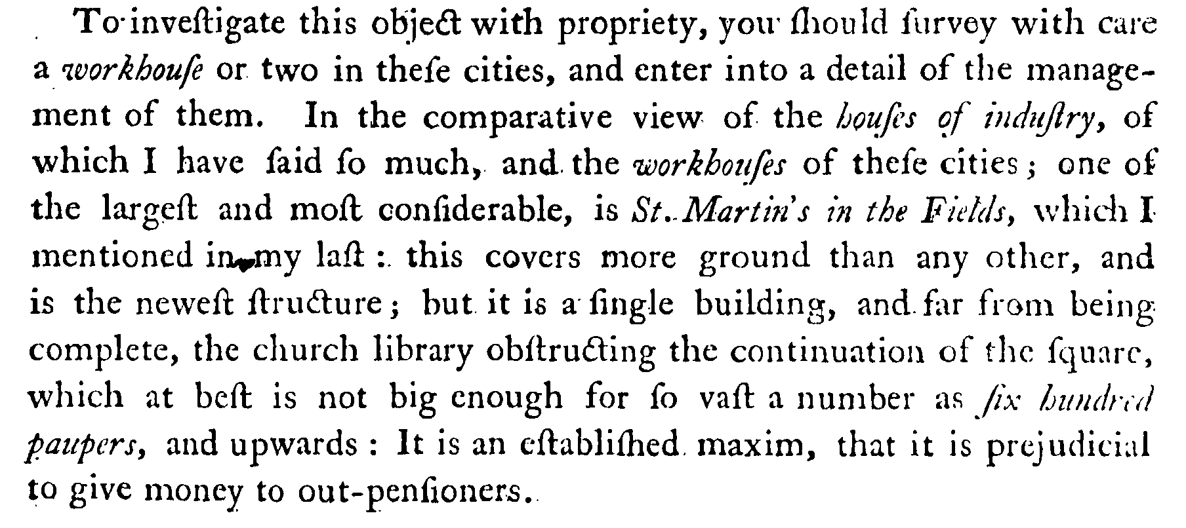
Jonas Hanway, The Citizen’s Monitor, 1780, 173.

Slide 15
Number of workhouse inmates over time

Slide 16
Overseers’ Accounts: income

Slide 17
Breakdown of income sources in overseers’ accounts: dominance of the poor rate, 1765-1803
Income source | Total income 1765-1803 | % income 1765-1803
POOR RATE | £395,926.56 | 94.84%
WORKHOUSE EARNINGS | £9,266.66 | 2.22%
BASTARDY | £5,979.67 | 1.43%
FINE | £2,189.01 | 0.52%
MILITIA | £1,389.13 | 0.33%
MAINTENANCE | £1,273.22 | 0.30%
JUSTICE | £1,238.46 | 0.30%
CHARITY | £99.23 | 0.02%
SUNDRIES | £95.98 | 0.02%
BURIAL FEES | £8.78 | 0.00%
 | £417,466.70 | 100.00%

Slide 18
Poor rate an institutionalised feature of London local government by start of eighteenth century

Slide 19
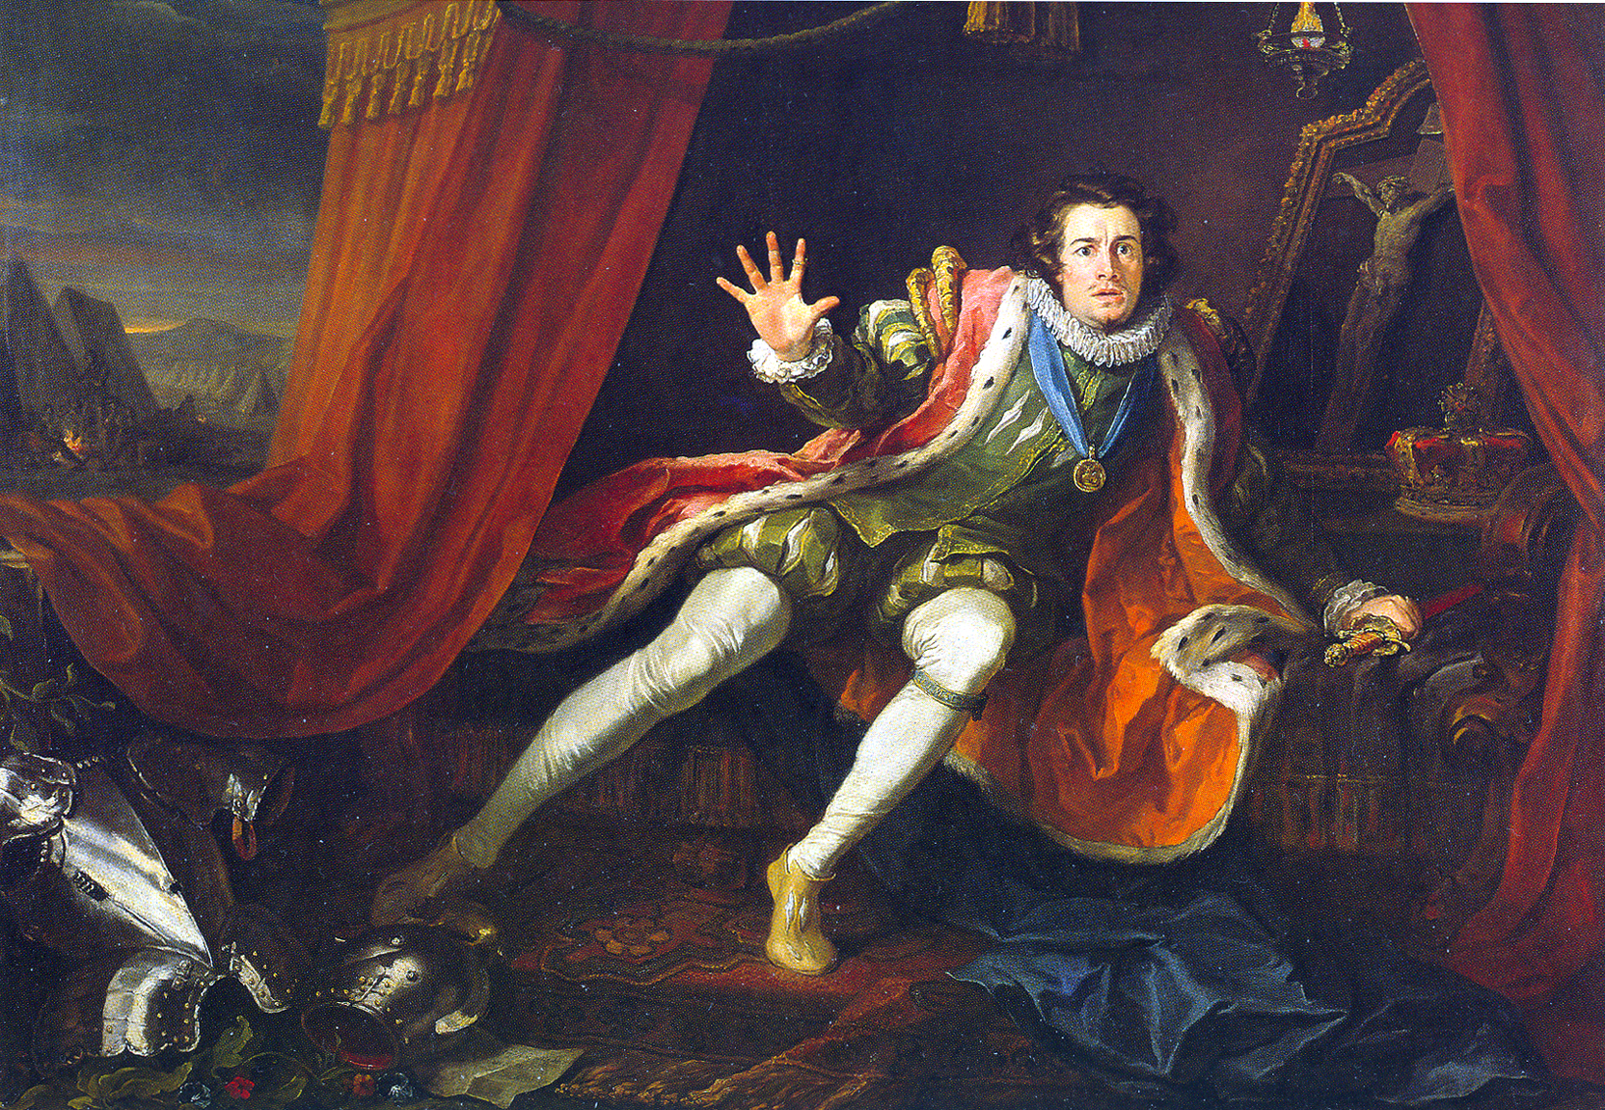
David Garrick (1717 – 1779) on realising his poor rate payment is overdue… His widow was visited by the parish authorities in 1782 after she left the parish without paying..
Notes:
David Garrick as Richard III in Colley Cibber's adaptation of the William Shakespeare play. The king has just awakened from a nightmare. The painting was made by William Hogarth in 1745, based on Garrick's appearance in 1743. The original is oil on canvas and is at the Walker Gallery, Liverpool

Slide 20
Total income and expenditure over time, 1725-1803

Slide 21
Overseers’ accounts: Expenditure

Slide 22
Real expenditure over time, 1725-1803
(deflated by PBH food price index).
Income would have followed the same trend

Slide 23
Breakdown of Overseers expenditure, 1765-1803
Expenditure heading | Total spend | %
ADMINISTRATION | £4,612.80 | 1.23%
ALMSWOMEN | £2,987.20 | 0.79%
ANNUITANTS | £14,698.73 | 3.91%
APPRENTICESHIP | £3,952.19 | 1.05%
BALANCE | £2,031.99 | 0.54%
CHARITY SCHOOL | £806.33 | 0.21%
COUNTY RATE | £19,837.65 | 5.28%
INFANT POOR | £22,974.76 | 6.11%
LOCAL GOVERNMENT | £1,354.04 | 0.36%
LUNATICS | £2,778.44 | 0.74%
MILITIA | £7,476.34 | 1.99%
OUTDOOR POOR | £42,736.11 | 11.37%
PERMISSIVEPASS | £916.73 | 0.24%
SALARY | £8,538.51 | 2.27%
SETTLEMENT | £1,837.43 | 0.49%
WORKHOUSE | £238,318.51 | 63.41%
 | £375,857.77 | 100.00%

Slide 24
Spending on outdoor poor over time: (a decline in real terms)

Slide 25
Spending on indoor relief

Slide 26
Spending on Workhouse over time
Tradesmen appointed to serve the workhouse for the year 1774:
bakers, butchers, milk, coffins and shrouds, cheesemongers, grocer, oilman, pease and oatmeal, tobacconist, wine for the sick, linen drapers, upholsterer, serge, woollen draper, haberdasher, leather seller for shoes, plumber, lamp lighter, tin man, smith, ironmonger, pewterer, brazier, cutler, cooper, turner, hatter, candles, worsted, carpenter, bricklayer, mason, stationer, leather seller, glazier, earthen ware, hosier
COWAC F2072/1v-2r
Reflects the ‘total care’ directed towards workhouse inmates?

Slide 27
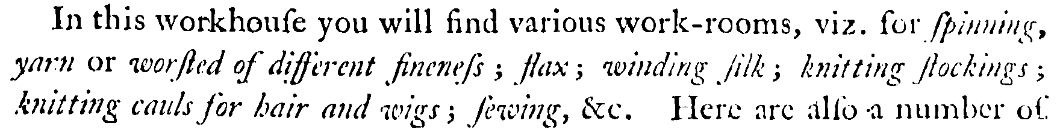
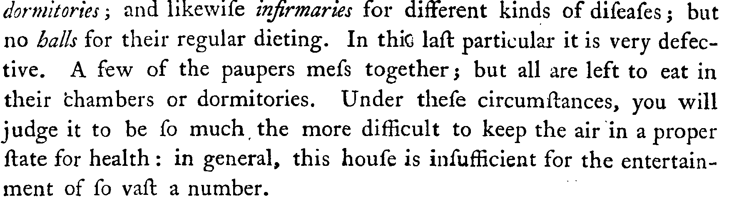
Jonas Hanway, The Citizen’s Monitor, 1780, 173-4.

Slide 28
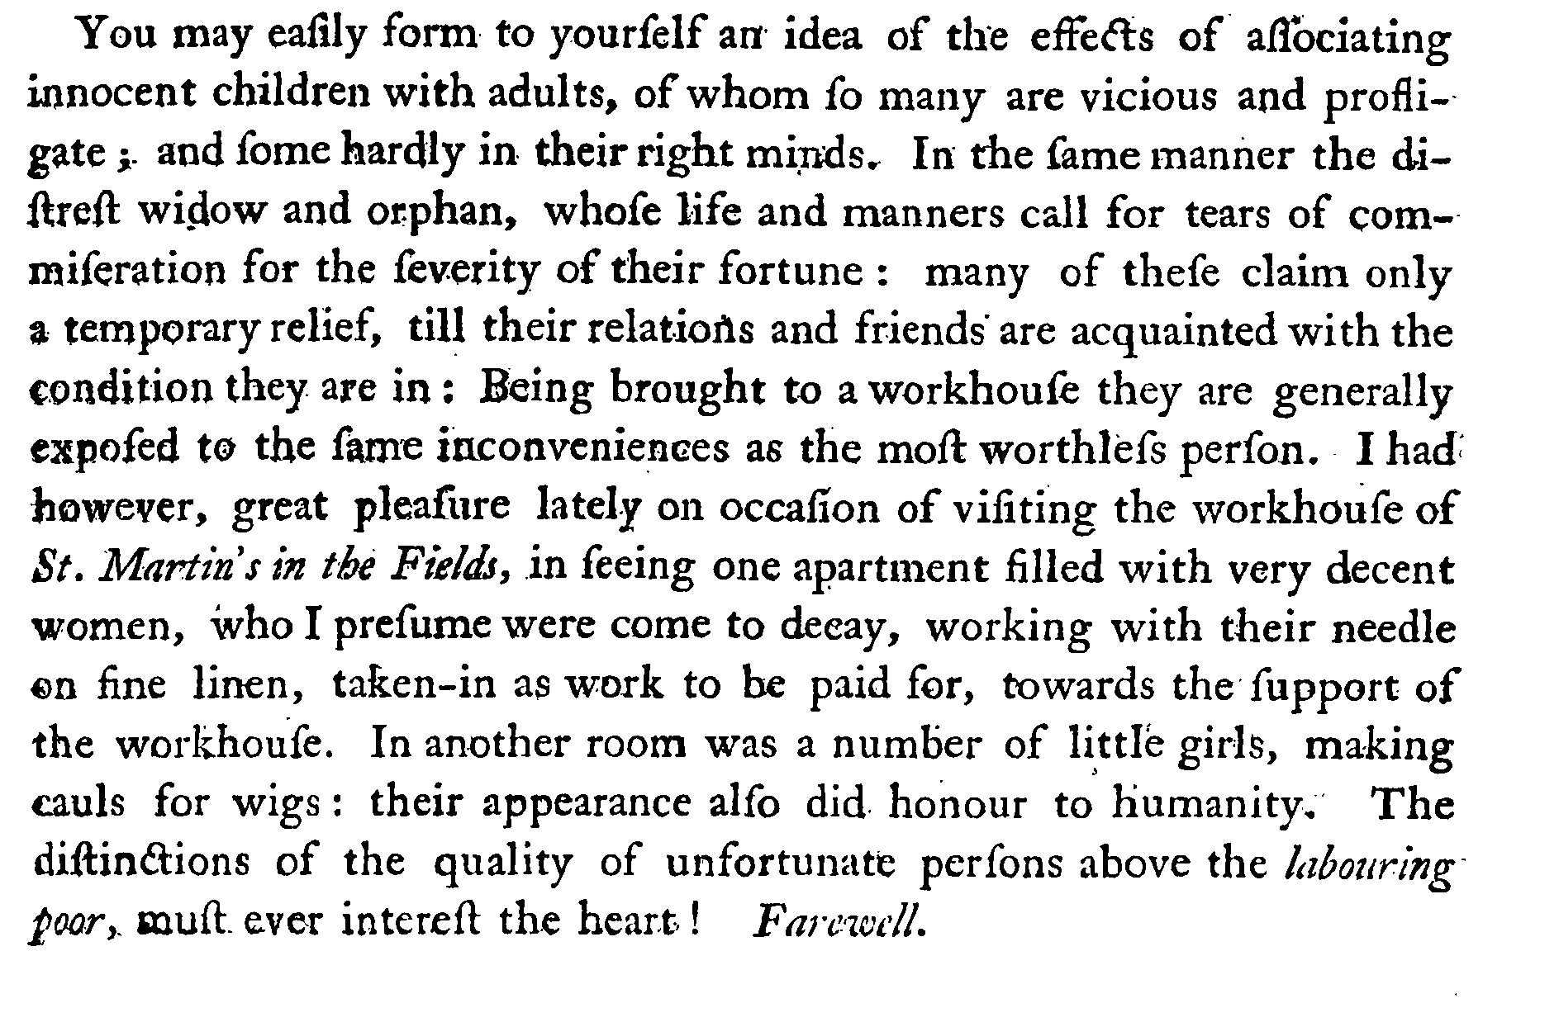
Jonas Hanway, The Citizen’s Monitor, 1780, 141.

Slide 29
Earnings from workhouse over time, should really be deducted from expenditure
Those running the workhouse never lost sight of the original notion that paupers should work where possible to earn their keep and inculcate industrious habits
Existing records are full of references to work-sheds, taskmasters and various tasks, including incentive payments especially in later periods...
Their principal employment is spinning flax, picking hair, carding wool, &c: their annual earnings, on an average of a few years past, amount to about £150. It was once attempted to establish a manufacture in the house; but the badness of the situation for business, the want of room for workshops, and the difficulty of compelling the able Poor to pay proper attention to work, rendered the project unsuccessful...
Frederic Morton Eden, The State of the Poor, II, 440.

Slide 30
Eden’s remarks related to a particularly poor decade of inmate earnings...

Slide 31
Spending per workhouse inmate over time
(shillings per inmate per week)

Slide 32
Maintenance contracts also reveal the per capita costs of maintaining paupers in the workhouse
These contracts are not those relating to maintenance of bastard children
The majority relate to husbands paying for the maintenance of abandoned wives
Some relate to payments to cover the costs of sick husbands, wives and children in the workhouse sick wards
A few relate to paupers who were paying for their own maintenance in the parish workhouse
Very occasionally paupers who came into unexpected legacies were charged retrospectively for their keep...

Slide 33
Weekly ‘maintenance contracts’ for workhouse inmates

Slide 34
The per capita cost of maintaining paupers in house greatly exceeded the per capita cost of out relief
That is, outdoor pensions were in effect (and sometimes explicitly) capped
Most of the destitute had to go into the workhouse and thus rarely appear as recipients of outdoor relief
Pensions were significantly higher and pensioners much more numerous before 1725
‘It is an established maxim, that it is prejudicial to give money to out-pensioners’,
(Jonas Hanway, describing St Martin’s Workhouse, 1780 )
Year | Settled poor average payment in shillings per week
1724 | 1.61
1749 | 1.21
1750 | 1.24
1751 | 1.24
1754 | 0.93
1765 | 1.34
1766 | 1.35
1767 | 1.34
1768 | 1.31
1771 | 1.32
1772 | 1.32
1773 | 1.32
1774 | 1.24
1775 | 1.25
1776 | 1.00
1777 | 1.02
1778 | 1.06
1779 | 1.36
1780 | 1.30

Slide 35
Relatively generous workhouse provision?

Slide 36
Local policy changes

Slide 37
Relative spending on parish workhouse compared to spending on outdoor poor

Slide 38
Ratio of spending on ‘settled poor’ and ‘casual poor’

Slide 39
Recap and conclusions
Eighteenth-century workhouses had a huge potential impact on the level and nature of outdoor relief given
  The cost of keeping the poor in workhouses was exceptionally high per capita and greatly exceeded the costs of outdoor relief
  The balance of outdoor relief (settled or casual) varied over time
  Regular outdoor pensions were usually capped well below levels needed to keep a pauper in the workhouse
  Falling real wages coincided roughly with increasing investment in in-house provision and a relative decline in outdoor casual relief
  Before 1772 and the enlargement of the workhouse the local welfare system was much more reliant on outdoor relief

Slide 40
Recap and conclusions
Relatively generous provision per capita in the workhouse.
  Some truth in the notion that Old Poor Law Workhouses relatively benign compared to those run after 1834
  Total care: regime which gave clothing, shelter, food, medicine, education, prayers and even small sums of money to its inmates
  Increased by addition of mass of payments for workhouse tasks in early 19th
  However generous it was many paupers persisted in attempts to abscond or escape particularly after the rebuilding of 1772
St Martin’s may have been exceptionally attached to in-house provision.
  This may have been partly due to its relatively large local resources
  which could offset the relatively high costs of running a substantial workhouse.
  It may also be that the workhouse was felt to be necessary to deter applications for casual relief from non parishioners

