Slide 1
The poor in crisis: price shocks, mortality surges, economic depression, bankruptcies – and warfare: London “crises” and a parish workhouse, 1725-1824
Jeremy Boulton (jeremy.boulton@ncl.ac.uk) ,
'Coping with Crisis Conference: Re-evaluating the role of crises in economic and social history', Durham University, 26th July 2013.

Slide 2
‘Crisis’?
A vitally important or decisive stage in the progress of anything; a turning-point; also, a state of affairs in which a decisive change for better or worse is imminent; now applied esp. to times of difficulty, insecurity, and suspense in politics or commerce
Historians tend to define a crisis more loosely as an unusually stressful or disrupted state of affairs.
Many types of historical crisis don’t involve any imminent turning point (such as crisis mortality) and don’t necessarily serve as a decisive stage in progress or development...

Slide 3
Historians love crises
They can’t get enough of them
1773 hits on a title word ‘crisis’ in the Bibliography of British and Irish History (and another 189 for ‘crises’)
Historical ‘crises’ can be political, financial, ones of identity, agrarian, demographic, professional, sexual, philosophical, religious, military, femininity, humanitarian, parliamentary, dynastic, subsistence, feudalism, constitutional, mercantile, economic, industrial…
Short term crisis shocks are the subject of this paper
To what extent do the workhouse admission registers reflect the various crises that best eighteenth-century London?
Might they provide historians with another way to measure the incidence of crises in the past?

Slide 4
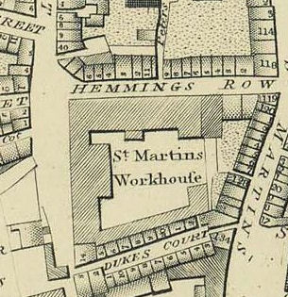
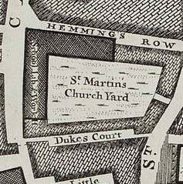
Horwood’s map 1799: detail of workhouse site
Rocque’s Map, 1746

Slide 5
Number of workhouse inmates over time

Slide 6
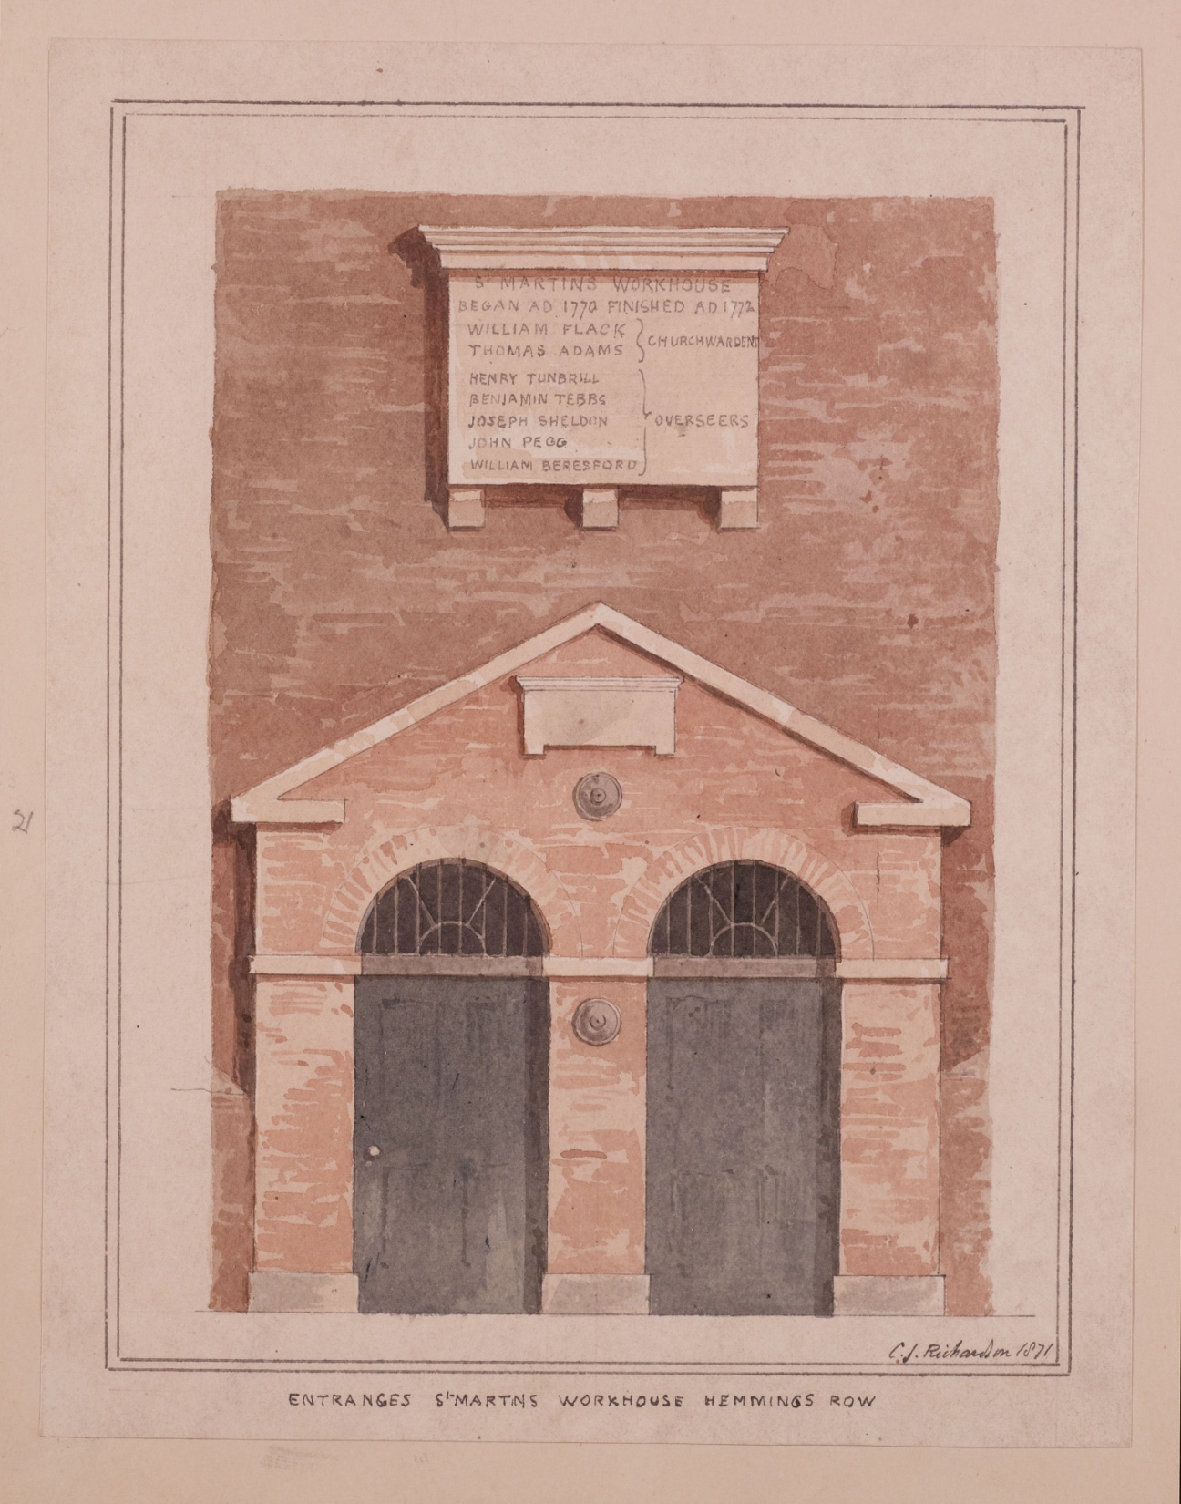
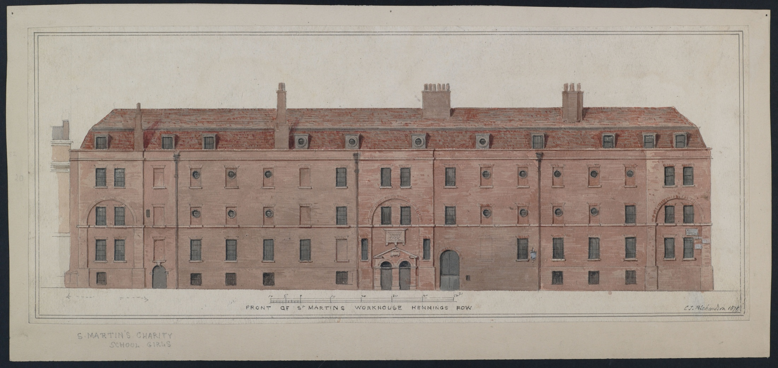
Front of Workhouse Hemmings Row 1871

Slide 7
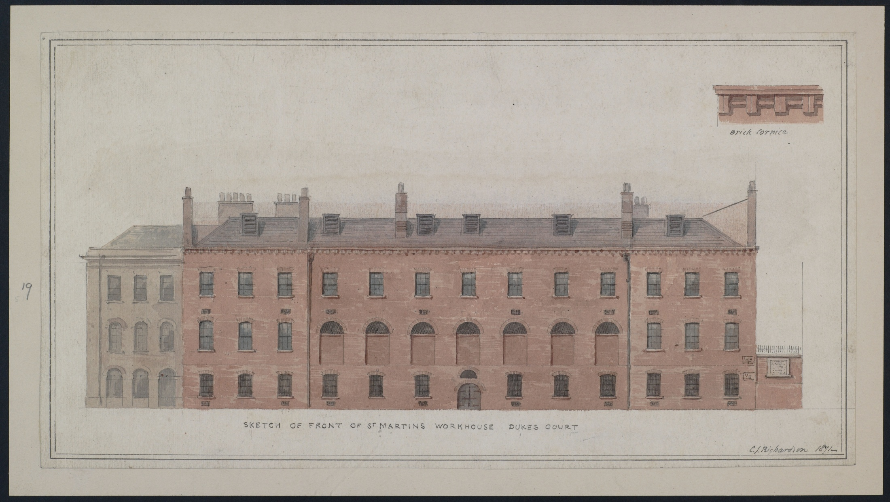
Front of Workhouse, Dukes Court 1871

Slide 8
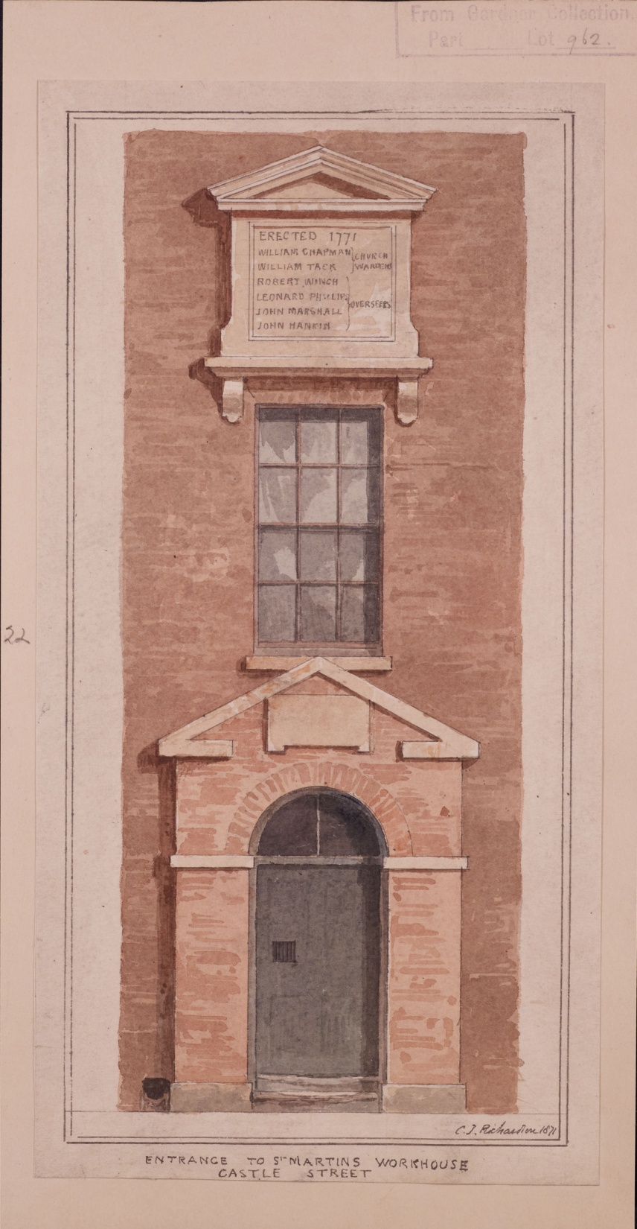
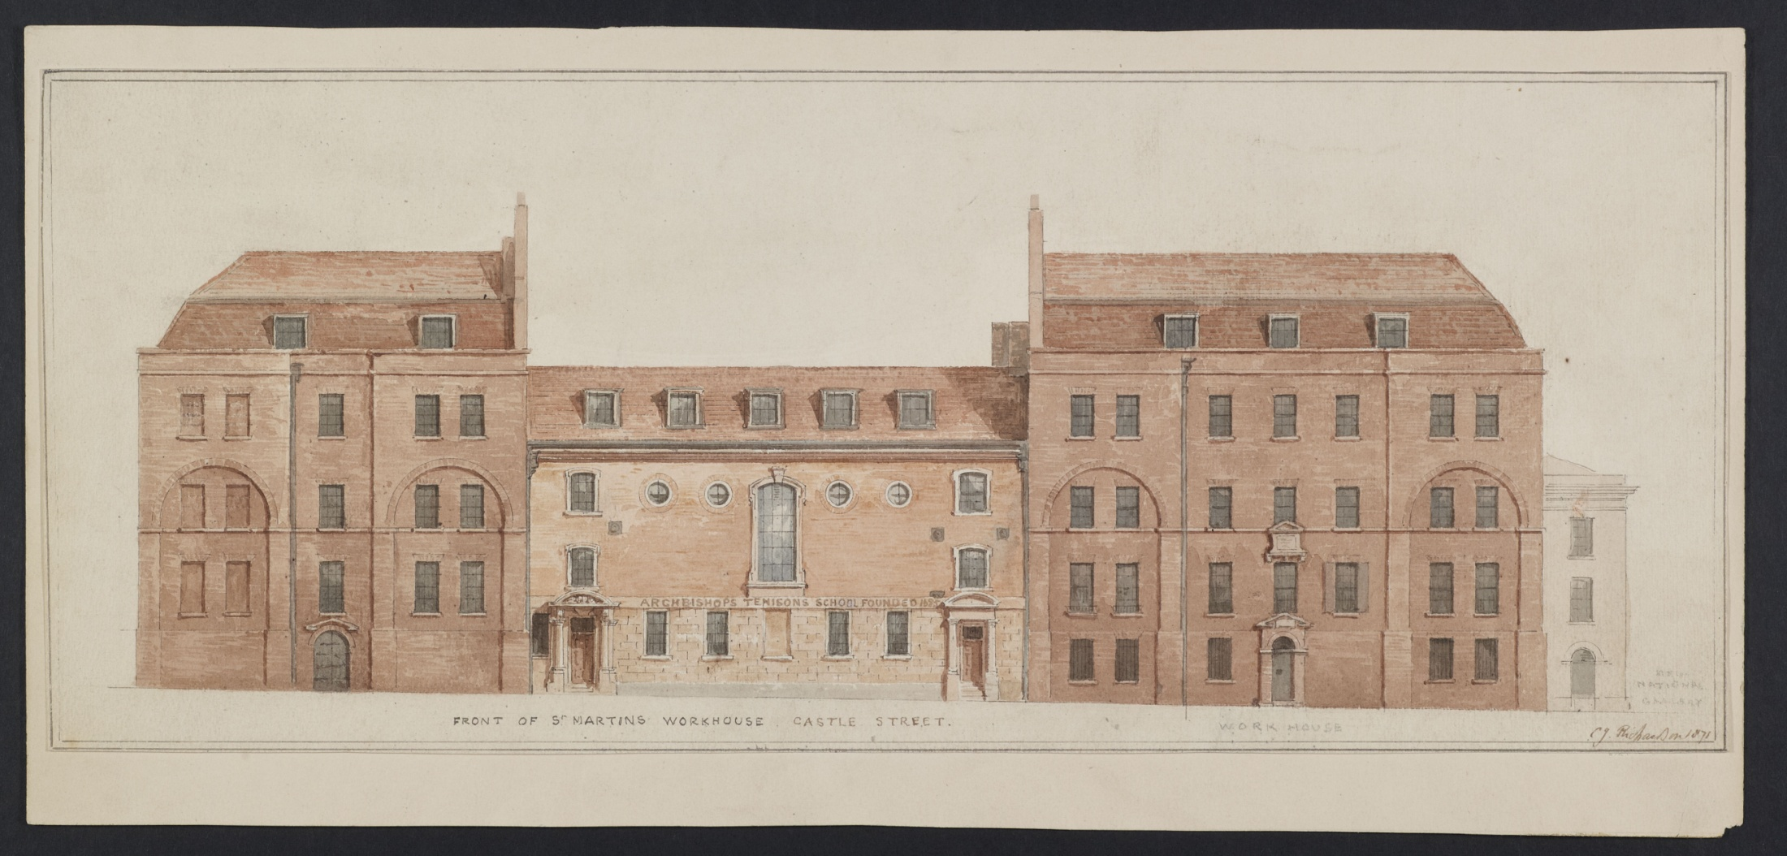

Slide 9
The poor in crisis...
The idea here is to use the detailed admission register for the workhouse to attempt to measure the responsiveness to ‘crisis’ in Georgian London
Treating the register as a time series which records the personal crises that afflicted 86,489 individuals and caused them to be admitted to the workhouse between 1725 and 1824
The workhouse was, throughout our period, a mixed general workhouse -admitted a cross section of men, women and children
Workhouses were multi-functional: medical services, shelter, food and drink but also disciplinary, deterrent, restrictive and moralistic
It must be remembered that we are here talking only about ‘indoor relief’ – thousands of payments were made each year – in most years – to the ‘outdoor poor’ and the balance between the two forms of relief was not constant

Slide 10
Why were individuals admitted?
How? Individuals were admitted by individual churchwardens and overseers, by JPs and local vestrymen, by the Board of Guardians or were brought to the House by other parish officers
When? Admissions were rare on Sundays, but otherwise spread evenly across the week
Why? Only 18% of admissions have some reason or comment against their admission
Reasons for admission to the workhouse suggest a host of different variables
 |  | %
Pregnancy or born in workhouse | 5,678 | 36.3%
Settlement related | 5,848 | 37.3%
Admitted by parish officers | 997 | 6.4%
Foundling or abandoned | 348 | 2.2%
Medical condition | 1,069 | 6.8%
Inmate personal details | 1,639 | 10.5%
Admitted for diet or lodging | 79 | 0.5%
Total | 15,658 | 100.0%

Slide 11
Annual admissions into St Martin’s Workhouse 1725-1823 (i.e. The flow, as opposed to the stock)

Slide 12
No close correlation between long term movements of ‘real wages’ of London building labourers and the annual totals of admissions...
Nb. Falling RW after 1760 are associated with a rise in WH admissions (facilitated by the 1770-2 rebuilding) but then with a fall in admissions until the early 19th century - i.e. increasing hardship in the late eighteenth century was associated with fewer, not more, WH admissions...

Slide 13
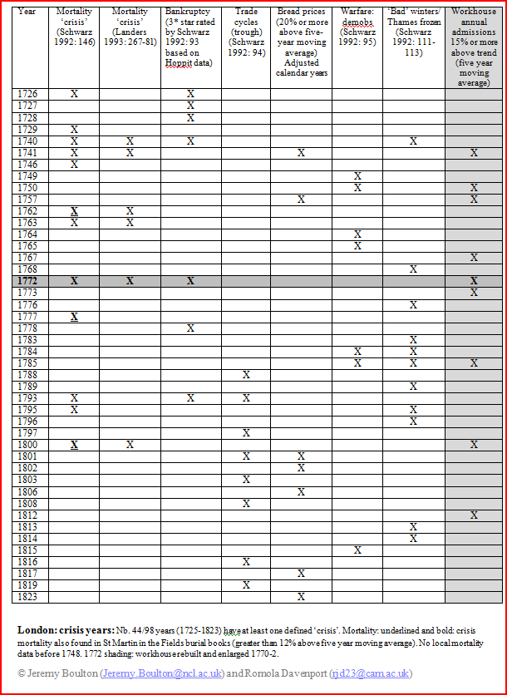
We are interested in short term crises... Crises are (most commonly) expressed as annual fluctuations
The trick here is obviously to identify relatively sharp fluctuations – usually expressed as large deviations from an average figure
This is the approach taken by most London historians...
A summary table of the various types of annual ‘crisis’ helps to sort out possible annual fluctuations
Arguably some of the ‘crises’ (particularly the mortality crises) would have been scoffed at by people living in earlier periods...
Many had no immediate impact on WH admissions

Slide 14
Identifying the responsiveness of annual WH admissions to the multiplicity of metropolitan ‘crises’ is complex
Different streams - or perhaps ‘pipelines’ - of human misery could easily be submerged beneath others
As an exercise, for example, consider the impact of military recruitment
London was an important recruiting ground for both the army and the navy... And the period was one of frequent large scale warfare

Slide 15
Warfare tightened the London labour market and clearly impacted on WH admissions of males of military age
Dips during war and modest peaks during demobilisation...

Slide 16
The impact is clearer still when one looks at the changing SR of WH admissions – the heavy female advantage increases during the four periods of warfare

Slide 17
Hardship and the chance of personal crises were – of course – seasonal. This truism is also reflected in WH admission registers...

Slide 18
However, the fine grained nature of the WH admissions data allow us to investigate whether we can detect significant monthly ‘crises’

Slide 19
Clearly a lot of stochastic noise
Technique does allow us to identify some monthly peaks in admission

Slide 20
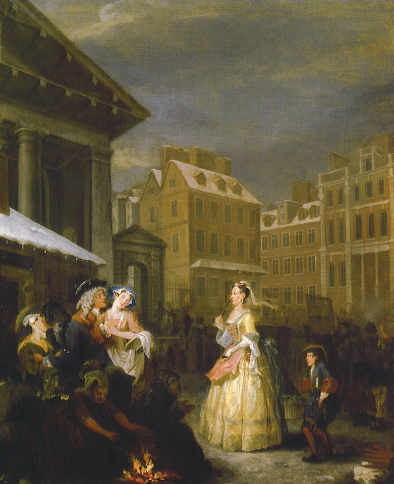
Temperature extremes...

Slide 21
CET average monthly temperatures 1725-1825

Slide 22
Table 1 Months of unusually large variation from five monthly moving average of admissions
Admission peaks of 40% or more |  | Admission troughs of 40% or more
November 1725 | January, 1795* | July, 1727
January, 1740* | May, 1805 | April, 1805
June, 1745 | November, 1805 | June, 1822
April, 1759 | October, 1821
October, 1760
October, 1766
January, 1767*
May, 1769
January, 1776*
January, 1793
*Unusually low average monthly temperature in CET data. Nb. Not all relatively cold months produced surges in the admissions data. Of 14 sharp monthly admission peaks, four were corresponded exactly with unusually cold January months. The November 1725 peak is an artifact of the opening of the workhouse, the reasons for the other monthly peaks are not as yet clear.

Slide 23
Conclusions:
To say that the pattern of personal misfortune superimposed on annual and monthly crises produces a complex mix is an understatement
Some variables had little tangible effect – local rainfall had little impact (there seems no obvious link between monthly admissions and monthly rainfall data)
Some variables are difficult to reconstruct – surges of local regulative activity or changes in local admissions policy
Finer-grained analysis might well throw up more associations
Cold winters, high prices, local mortality and warfare have relatively clear impacts on workhouse admission totals
That said, it was rare for all types of ‘crisis’ to coincide in any one year
Some crises had little immediate measurable impact on workhouse admissions – some might have had a lagged effect (e.g. bankruptcies) on sub sections of the population)
Warfare could reduce the number of people/alter the gender balance of those admitted into the workhouse

