Slide 1
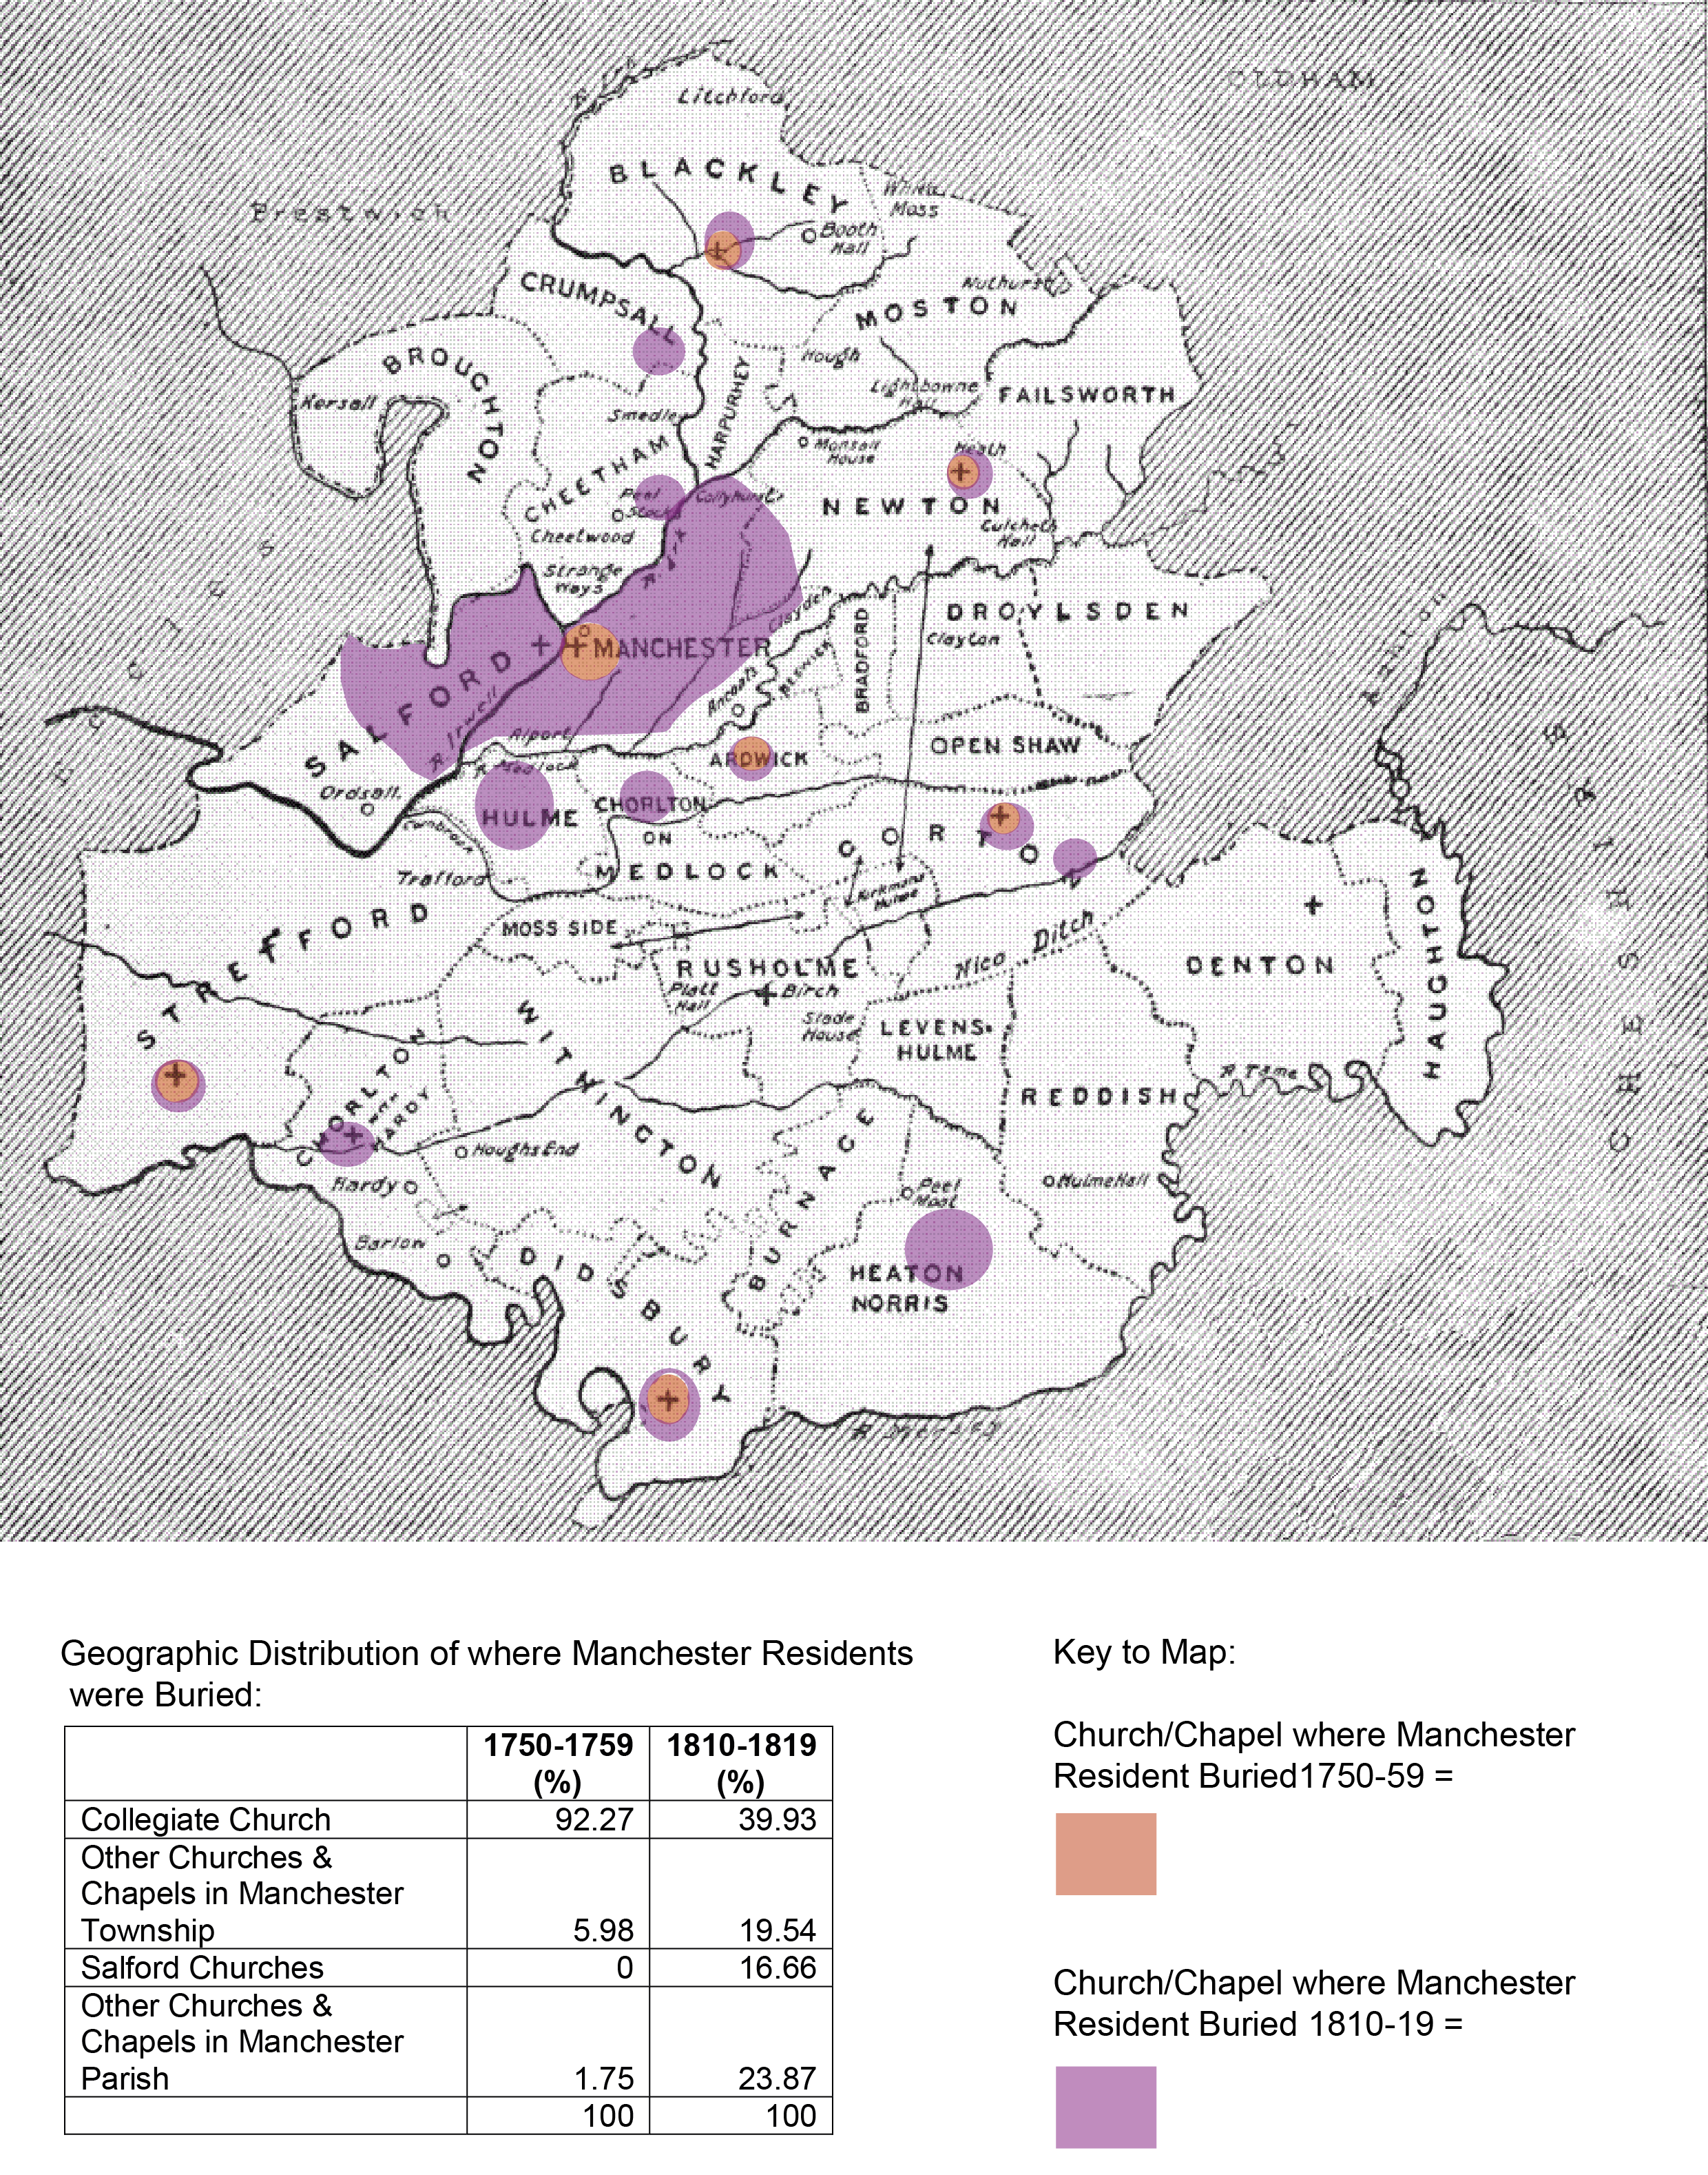
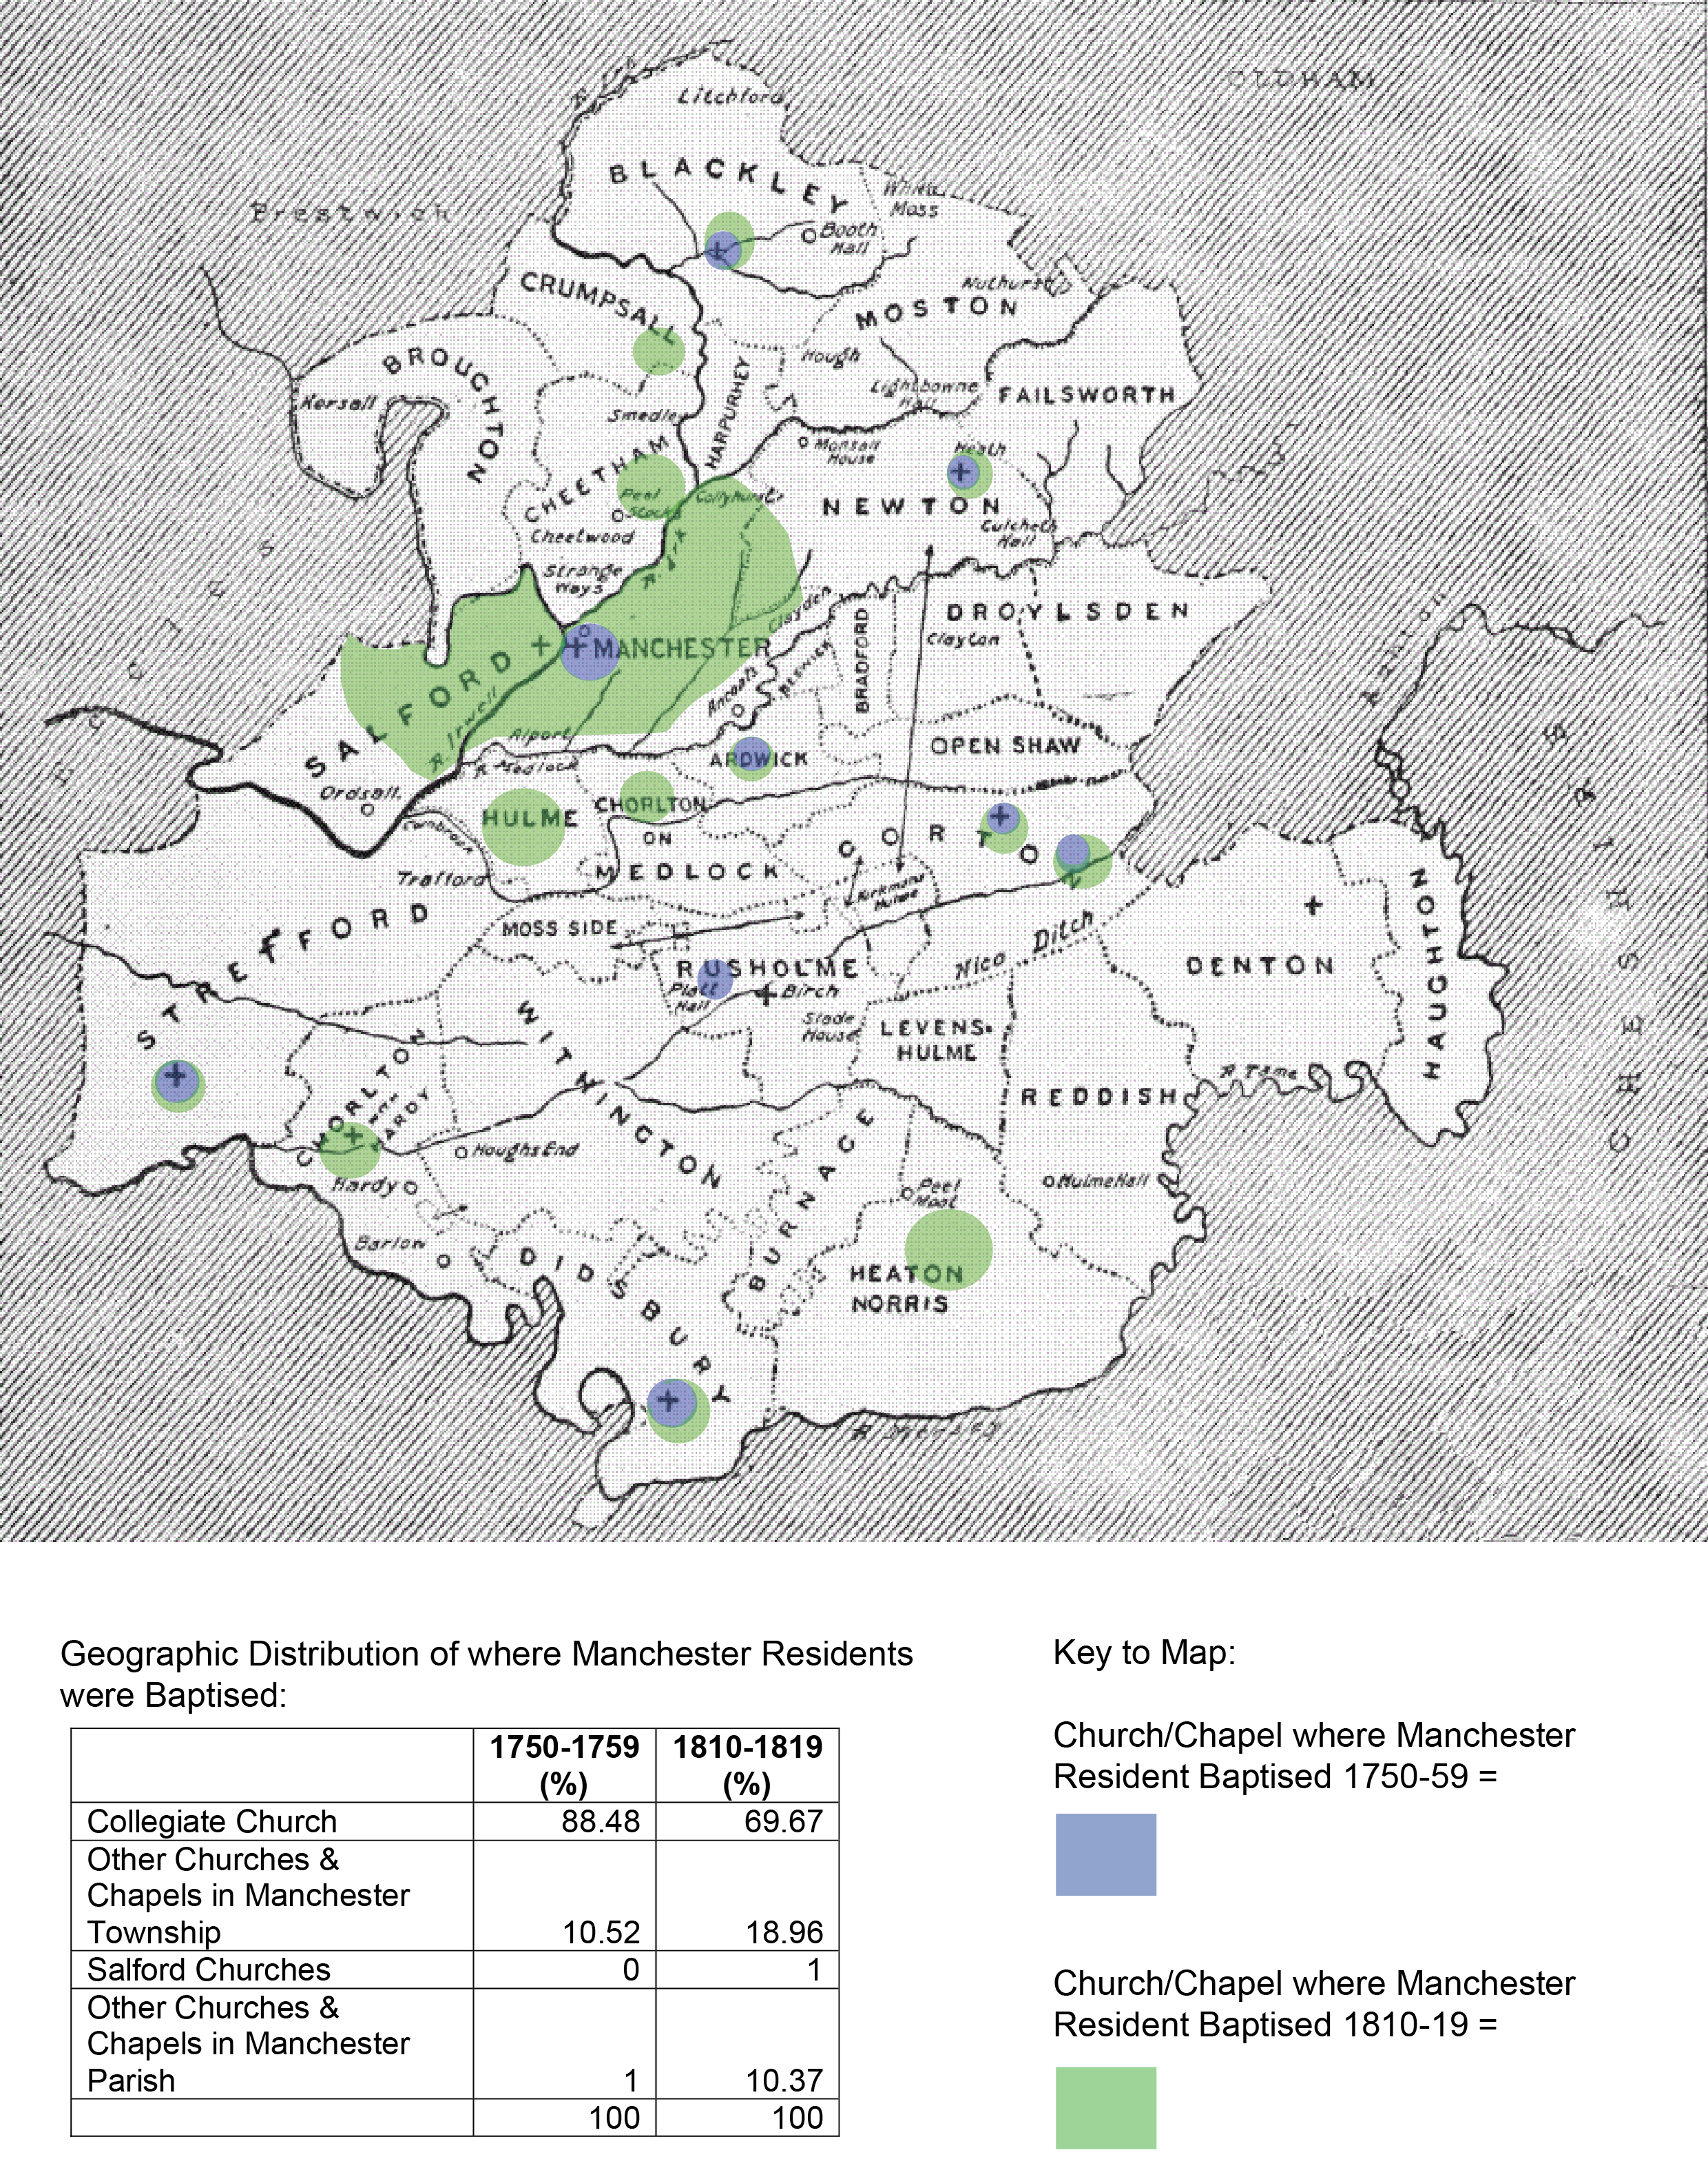
Burial Practices in Manchester, 1750-1820
John Black, (Cambridge Group for the History of Population and Social Structure),
Romola Davenport (Cambridge Group for the History of Population and Social Structure )
and Jeremy Boulton (Newcastle University)
Mortality and epidemiological change in Manchester
The research project, ‘Mortality and epidemiological change in Manchester, 1750-1850’, has two main goals. Using as a focal point of research the industrialisation and rapid urbanisation of the township of Manchester in the years 1750 to 1850, this project will attempt to outline the extent and causes of the decline in urban mortality, and the impact of the industrialisation process on the health and mortality of the population of English cities during this period.(1) Any analysis of mortality and population growth must question the veracity of the birth and death figures upon which this growth is based. It has already been noted, within the historiography of urbanisation in the late eighteenth and early nineteenth centuries, a divergence in baptism and burial practices and registration within the Anglican Church. This poster will show how changes in burial practices in the township and parish of Manchester led to the under-registration of burials in the Bills of Mortality and underpinned contemporary observations on the extraordinary fertility and rapid expansion of the Manchester population.
.
As the graph of the numbers of burials grounds opened in Manchester parish in the years 1531 to 1832 illustrates, the latter part of the eighteenth and early decades of the nineteenth centuries saw a rapid expansion in the number of burying grounds opened throughout Manchester parish. Twenty burials grounds were established between 1531 and 1769. In contrast thirty-five cemeteries were created in the years 1785-1832.
The Geographic Distribution of Baptisms and Burials in Manchester Township
The maps showing changes in the geographic distribution of the baptism and burial of Manchester township residents in Manchester parish between the years 1750-59 and 1810-19 appear to tell the same story. However the accompanying tables relay a different tale. In the earlier period the vast majority of the baptisms of Manchester township residents were found in the registers of the Collegiate Church (about 88%), with another 10% being recorded in a few Anglican and Non-conformist churches and chapels within the township (mainly St Ann and Cross Street Unitarian), and just 1% of baptisms recorded in the rest of the parish. The proportion of baptisms registered in the Collegiate Church during 1810-19 falls to just under 70%, but the majority of baptisms still took place in the township as almost 19% were recorded in the other Anglican churches, the proliferating Non-conformist chapels and St Mary Mulberry Street Roman Catholic (founded in 1794). Although more than 10% of baptisms were distributed throughout the rest of parish, more than half were to be found in St Chad Roman Catholic Church in adjacent township of Hulme.
The Geographic Distribution of the Baptisms of Manchester Residents, 1750-59 & 1810-19
Though the distribution of burials in these periods followed a similar pattern, moving away from the Collegiate Church into the wider parish. The proportion of residents being buried outside the township was much greater. The proportion of burials registered in the Collegiate Church fell from 92% in the years 1750-1759 to 40% in 1810-19. The percentage of burials of residents recorded in the other churches and chapels of Manchester township rose from 6% to almost 20% (mainly in the Anglican churches), but more than 40% of the burials of Manchester residents were recorded in the church and chapel registers of the remaining townships of Manchester parish-particularly those of the adjacent townships Hulme, Salford, Cheetham and Newton Heath .
The Geographic Distribution of the Burials of Manchester Residents, 1750-59 & 1810-19
Conclusion
The scale of burial registration of Manchester residents away from the Collegiate Church and other Anglican churches in the township and in the other townships of Manchester parish, and the subsequent under-reporting of burials in the Bills of Mortality, must call into question the apparent decline in death rates in the Manchester Bills of Mortality during the late eighteenth and early nineteenth centuries. At the same time the numbers of new burying grounds being opened, and the distribution of the significant numbers of Manchester residents being buried throughout the parish would suggest that limited options for burial withing the township were pushing the population towards burial in other areas of the parish. The next stage for this project is to expand the counts of baptisms, burials and marriages to all the existing registers in the churches and chapels of Manchester Parish. This should lead to a more accurate analysis of the fertility rates of Manchester in this period
.
Manchester Collegiate Church and the Bills of Mortality
The township of Manchester developed within the extensive parish of Manchester, with an estimated population of approximately 17,000 in 1757 rising to 108,000 in 1821.(2) The Collegiate Church was the parish church and maintained a monopoly of fees for baptisms, burials and marriages in the parish. As a consequence, to avoid the double payment of fees for ceremonies performed at other churches, almost all marriages, particularly after the enforcement of Hardwick’s Act in 1754, and a high proportion of all Anglican baptisms, were registered at the Collegiate Church.
By comparing the numbers of baptisms and burials recorded in both the Collegiate Church registers and the Bills of Mortality, the line chart above demonstrates the extent to which figures entered in the former constituted the major component within the numbers quoted in the latter. For the greater majority of the timespan viewed, changes in the numbers of baptisms and burials documented in the collegiate church registers closely mirrored fluctuations found in the Bills of Mortality.(3)
The Manchester Bills of Mortality line graph also highlights the divergence in the numbers of baptisms and burials in the Bills of Mortality. Notably from the 1790s when annual births in Manchester township were just over half that of baptisms. The Collegiate Church registers reinforce these figures, with burials being about 40% of baptisms in the late eighteenth and early nineteenth centuries.
This gap between baptisms and burials recorded in the Collegiate Church, and the Bills of Mortality, began to widen significantly as the pressure of more burials began to increase on the limited space available.
Endnotes
(1) De Vries, J. European urbanization 1500-1800 (London: Methuen, 1984); Woude, A.M. van der, 'Population developments in the Northern Netherlands (1500-1800) and the validity of the “urban graveyard” effect', Annales de
Démographie Historique: 55–75 (1982).) S. Modern economic growth (New Haven, Yale UP, 1966): 60.
(2) Wrigley, E.A. The early English censuses (Oxford: OUP, 2011.
(3) For the Manchester
Bills of Mortality see,
Baines, E & Harland, The
History of the County
Palatine of Lancaster,
(1868), pp. 347-349.
Acknowledgments
The ‘Mortality and epidemiological change in Manchester, 1750-1850’ research project is funded by the Leverhulme Trust.
The A0 poster design template employed in this poster can be found at the colinpurrington.com website- with much relief and many thanks.
Thanks are also due to the British History Online website for the use of The Index Map to the Parish of Manchester as the basis for the maps created for this poster.
Notes:
Copyright Colin Purrington (http://colinpurrington.com/tips/academic/posterdesign).

