Slide 1
Sustainable Thermal Energy Management Industrial Forum Professor Tony Roskilly

Slide 2
SusTEM National Network
Promote and disseminate internationally recognised research.
Support knowledge transfer to all stakeholders.
Industry, buildings and transport - significant reductions in CO₂ emissions and energy use can be made through the better utilisation of thermal energy.
EPSRC for funding the SusTEM network and to the Swan Centre for their additional financial support which has made this industrial forum possible

Slide 3
Sir Joseph Swan Centre
for Energy Research
The overarching focus of our energy research is to address three key challenges to ensure a sustainable future … “enough, for all, for ever”
Enough: Ensuring that there is sufficient energy to meet demand through appropriate and secure resources, and the efficient and resilient conversion, distribution and use of energy.
For all: Guaranteeing universal access to affordable energy to meet demand through technological developments and effective policy and governance.
Forever: Safeguarding sustainable resources, the natural environment and the health and well-being of all life through environmentally sensitive practices, processes and systems.

Slide 4
Sir Joseph Swan Centre
for Energy Research
Institute for Sustainability
Chemical Engineering and Advanced Materials
Civil Engineering and Geosciences
Electrical and Electronic Engineering
Marine Science and Technology
Mechanical and Systems Engineering
Agriculture, Food and Rural Development
Biology
Chemistry
Computing Science
Mathematics and Statistics
Institute for Health & Society
Institute for Cell and Molecular Biosciences
Architecture, Planning and Landscape Newcastle University Business School Geography, Politics and Sociology Newcastle Law School
Institute for Ageing
Institute for Social Renewal

Slide 5
Sir Joseph Swan Centre
for Energy Research
Energy themes where Newcastle University has key research strength:
Resilient Infrastructure and systems
Intelligent networks and energy storage
Electrochemistry and hydrogen
Bio-resource production, recovery and use
Renewable energy systems
Environmental impact assessment and mitigation
Building, industrial and transport demand reduction
Justice and governance
Logistics and planning
Clean use
of fossil fuel
Mechanical and electric power systems
Thermal systems and combustion

Slide 6
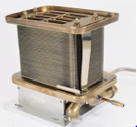
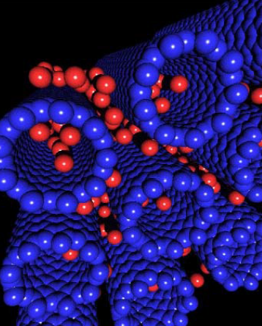
Sir Joseph Swan Centre
for Energy Research
Energy themes where Newcastle University has key research strength:
Intelligent networks and energy storage
Electrochemistry and hydrogen
Resilient Infrastructure and systems
Electrochemistry and hydrogen
Bio-resource production, recovery and use
Renewable energy systems
Environmental impact assessment and mitigation
Building, industrial and transport demand reduction
Justice and governance
Logistics and planning
Clean use
of fossil fuel
Mechanical and electric power systems
Thermal systems and combustion

Slide 7
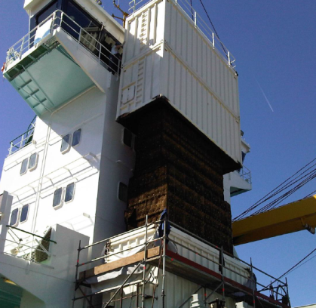
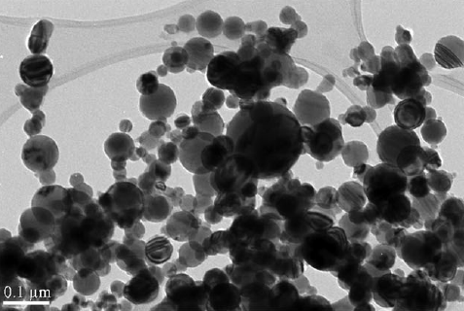
Sir Joseph Swan Centre
for Energy Research
Energy themes where Newcastle University has key research strength:
Resilient Infrastructure and systems
Intelligent networks and energy storage
Electrochemistry and hydrogen
Bio-resource production, recovery and use
Renewable energy systems
Environmental impact assessment and mitigation
Building, industrial and transport demand reduction
Justice and governance
Logistics and planning
Clean use
of fossil fuel
Clean use
of fossil fuel
Recovery and clean use of fossil fuel
Mechanical and electric power systems
Thermal systems and combustion

Slide 8
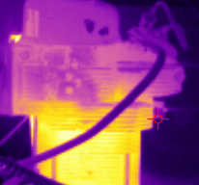
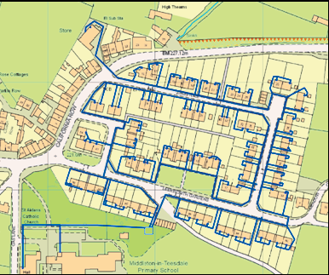
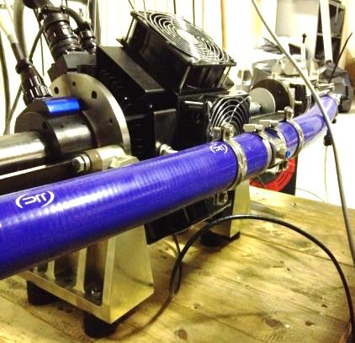
Sir Joseph Swan Centre
for Energy Research
Energy themes where Newcastle University has key research strength:
Resilient Infrastructure and systems
Intelligent networks and energy storage
Electrochemistry and hydrogen
Bio-resource production, recovery and use
Renewable energy systems
Environmental impact assessment and mitigation
Building, industrial and transport demand reduction
Justice and governance
Logistics and planning
Thermal systems and combustion
Clean use
of fossil fuel
Mechanical and electric power systems
Thermal systems and combustion

Slide 9
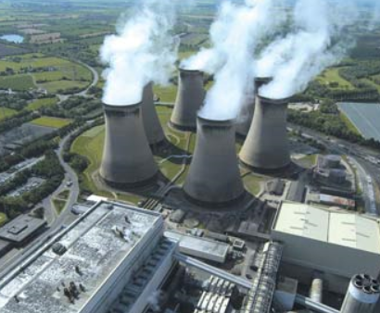
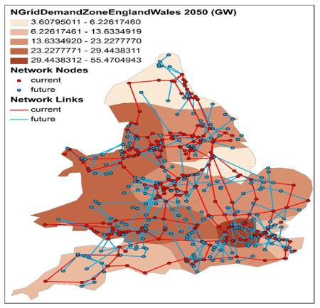
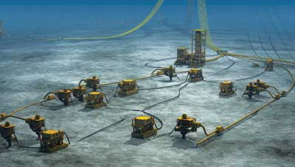
Sir Joseph Swan Centre
for Energy Research
Energy themes where Newcastle University has key research strength:
Resilient
Infrastructure and
systems
Intelligent networks and energy storage
Electrochemistry and hydrogen
Resilient Infrastructure and systems
Resilient Infrastructure and systems
Bio-resource production, recovery and use
Renewable energy systems
Environmental impact assessment and mitigation
Building, industrial and transport demand reduction
Justice and governance
Logistics and planning
Clean use
of fossil fuel
Mechanical and electric power systems
Thermal systems and combustion

Slide 10
Sir Joseph Swan Centre
for Energy Research
Energy themes where Newcastle University has key research strength:
Resilient Infrastructure and systems
Intelligent networks and energy storage
Electrochemistry and hydrogen
Renewable energy
systems
Bio-resource production, recovery and use
Renewable energy systems
Renewable energy systems
Environmental impact assessment and mitigation
Building, industrial and transport demand reduction
Justice and governance
Logistics and planning
Clean use
of fossil fuel
Mechanical and electric power systems
Thermal systems and combustion

Slide 11
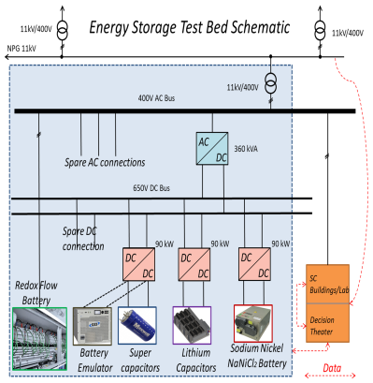
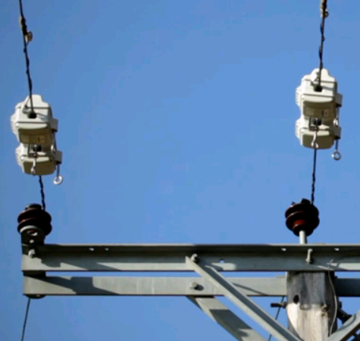
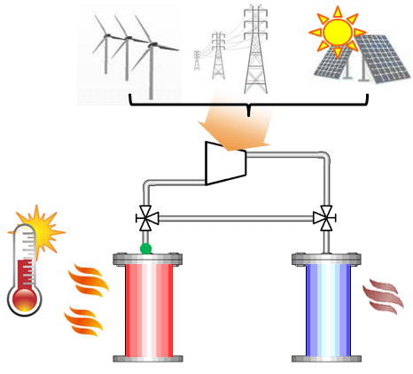
Sir Joseph Swan Centre
for Energy Research
Energy themes where Newcastle University has key research strength:
Intelligent networks and energy storage
Intelligent networks
and energy storage
Electrochemistry and hydrogen
Resilient Infrastructure and systems
Intelligent networks and energy storage
Bio-resource production, recovery and use
Renewable energy systems
Environmental impact assessment and mitigation
Building, industrial and transport demand reduction
Justice and governance
Logistics and planning
Clean use
of fossil fuel
Mechanical and electric power systems
Thermal systems and combustion

Slide 12
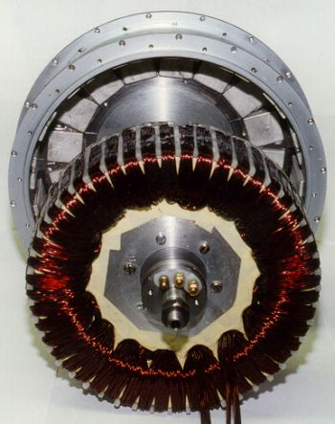
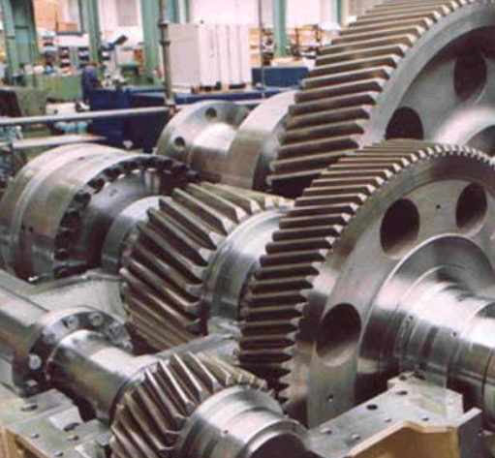
Sir Joseph Swan Centre
for Energy Research
Energy themes where Newcastle University has key research strength:
Resilient Infrastructure and systems
Intelligent networks and energy storage
Electrochemistry and hydrogen
Bio-resource production, recovery and use
Renewable energy systems
Environmental impact assessment and mitigation
Building, industrial and transport demand reduction
Justice and governance
Logistics and planning
Mechanical and
electric power
systems
Clean use
of fossil fuel
Mechanical and electric power systems
Mechanical and electric power systems
Thermal systems and combustion

Slide 13
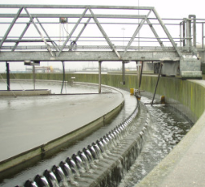
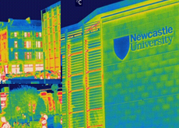
Sir Joseph Swan Centre
for Energy Research
Energy themes where Newcastle University has key research strength:
Resilient Infrastructure and systems
Intelligent networks and energy storage
Electrochemistry and hydrogen
Bio-resource production, recovery and use
Renewable energy systems
Environmental impact assessment and mitigation
Building, industrial and transport demand reduction
Building, industrial and transport demand reduction
Justice and governance
Building, industrial
and transport demand reduction
Logistics and planning
Clean use
of fossil fuel
Mechanical and electric power systems
Thermal systems and combustion

Slide 14
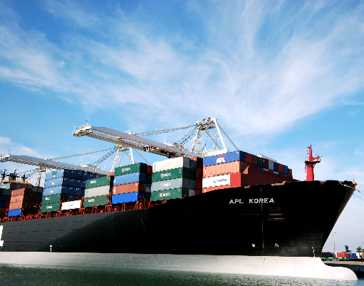
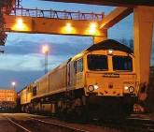
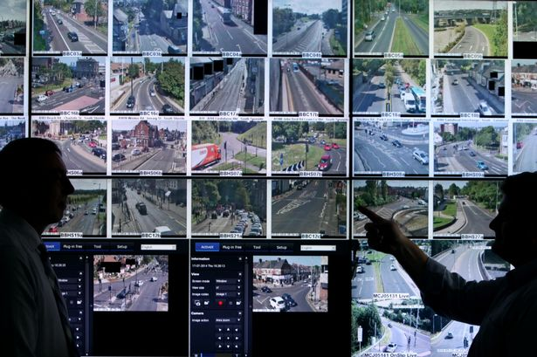
Sir Joseph Swan Centre
for Energy Research
Energy themes where Newcastle University has key research strength:
Resilient Infrastructure and systems
Intelligent networks and energy storage
Electrochemistry and hydrogen
Bio-resource production, recovery and use
Renewable energy systems
Environmental impact assessment and mitigation
Building, industrial and transport demand reduction
Justice and governance
Logistics and planning
Logistics and planning
Logistics and planning
Clean use
of fossil fuel
Mechanical and electric power systems
Thermal systems and combustion

Slide 15
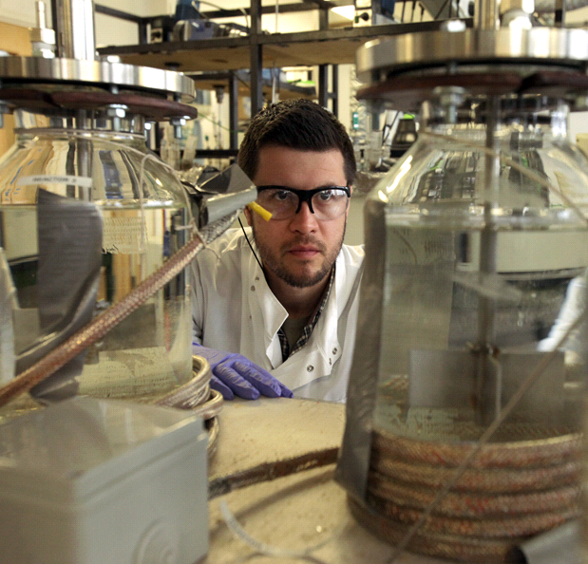
Sir Joseph Swan Centre
for Energy Research
Energy themes where Newcastle University has key research strength:
Resilient Infrastructure and systems
Intelligent networks and energy storage
Electrochemistry and hydrogen
Bio-resource
production, recovery
and use
Bio-resource production, recovery and use
Bio-resource production, recovery and use
Renewable energy systems
Environmental impact assessment and mitigation
Building, industrial and transport demand reduction
Justice and governance
Logistics and planning
Clean use
of fossil fuel
Mechanical and electric power systems
Thermal systems and combustion

Slide 16
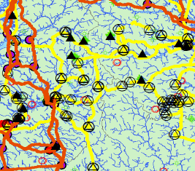
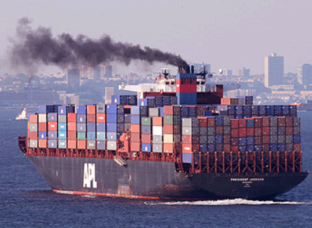
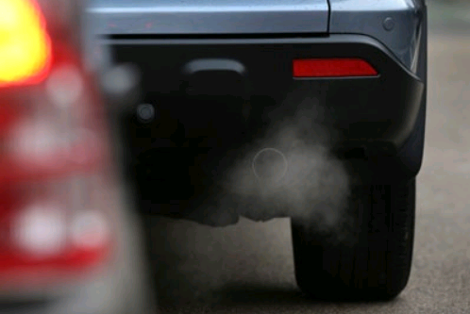
Sir Joseph Swan Centre
for Energy Research
Energy themes where Newcastle University has key research strength:
Resilient Infrastructure and systems
Intelligent networks and energy storage
Electrochemistry and hydrogen
Environmental impact assessment and
mitigation
Bio-resource production, recovery and use
Renewable energy systems
Environmental impact assessment and mitigation
Environmental impact assessment and mitigation
Building, industrial and transport demand reduction
Justice and governance
Logistics and planning
Clean use
of fossil fuel
Mechanical and electric power systems
Thermal systems and combustion

Slide 17
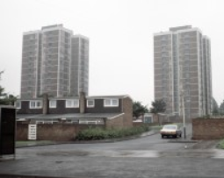
Sir Joseph Swan Centre
for Energy Research
Energy themes where Newcastle University has key research strength:
Resilient Infrastructure and systems
Intelligent networks and energy storage
Electrochemistry and hydrogen
Bio-resource production, recovery and use
Renewable energy systems
Environmental impact assessment and mitigation
Building, industrial and transport demand reduction
Justice and
governance
Justice and governance
Justice and governance
Logistics and planning
Clean use
of fossil fuel
Mechanical and electric power systems
Thermal systems and combustion

Slide 18
Sir Joseph Swan Centre
for Energy Research
Energy themes where Newcastle University has key research strength:
Resilient Infrastructure and systems
Intelligent networks and energy storage
Electrochemistry and hydrogen
Bio-resource production, recovery and use
Renewable energy systems
Environmental impact assessment and mitigation
Building, industrial and transport demand reduction
Justice and governance
Logistics and planning
Clean use
of fossil fuel
Mechanical and electric power systems
Thermal systems and combustion

Slide 19
SusTEM Industrial Forum
The purpose of the Industrial Forum builds on a number of previous conferences, workshops and forums
Permit us to get a deeper understanding of the challenges and opportunities of thermal energy management from an industrial perspective.
Example topics: Building Energy Performance , Heat Recovery, HVAC, Cooling, System Modelling and Optimisation, Thermal Management & Power, Heat Exchange, Thermal Networks

Slide 20
Sustainable Thermal Energy Management Industrial Forum

