Slide 1
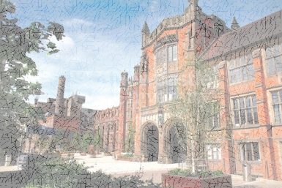
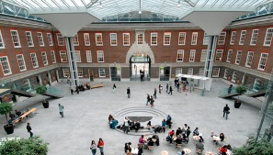
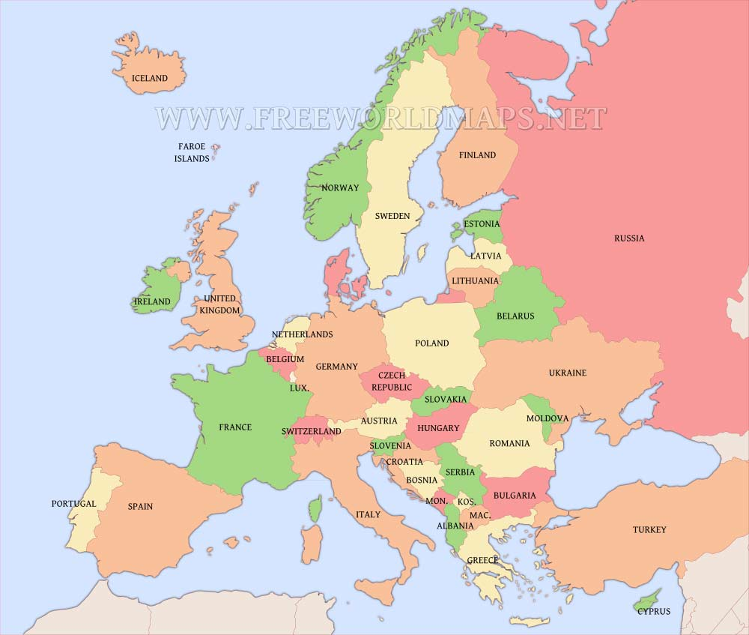
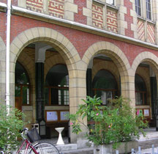
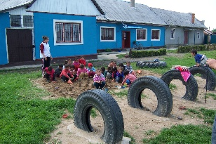
Erasmus+ research project
Newcastle University
Middlesex University
Helsinki University
Westgate Hill and Moorside!
Catholic University of Paris
Tinca School

Slide 3
I think it’s a bird
aký druh vtáka

Slide 4
So, we now need your help!

Slide 5
Which languages do you speak at home?

