Slide 1
Languages for Dignity: a pedagogy for success at school
Oradea, Romania
26th-27th October 2016
Lecture 1, day 1
Dr Leena Robertson, Dr Heather Smith
http://research.ncl.ac.uk/romtels/resources/

Slide 2
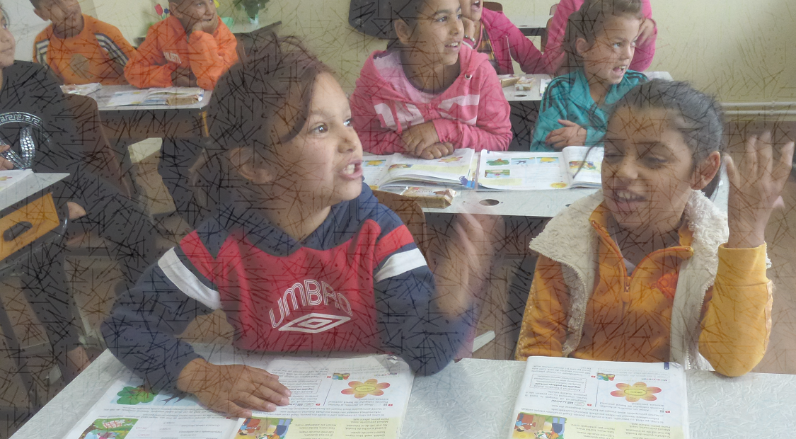
Languages for Dignity:
Welcome to our conference
A pedagogy for success at school

Slide 3
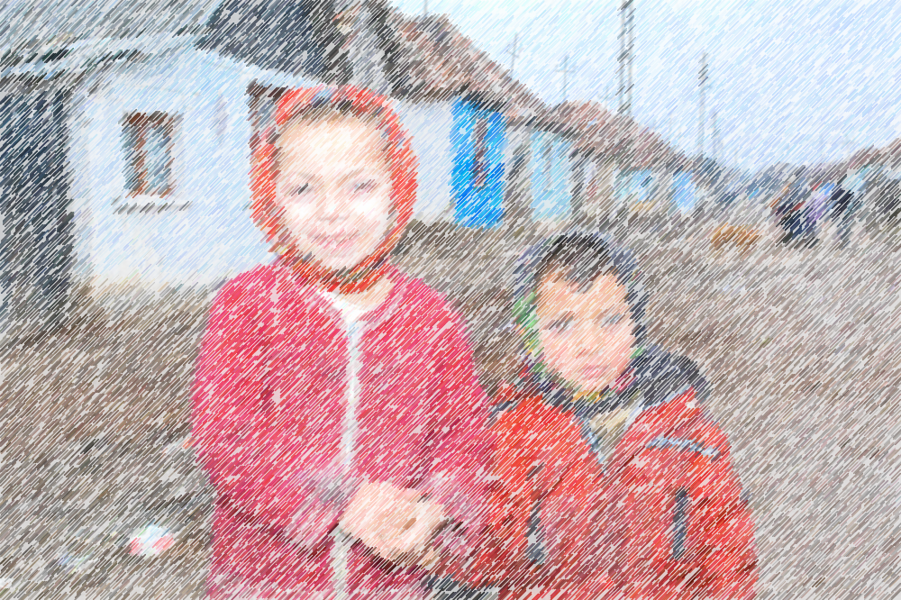
This conference is about:
Lost potential
Why so much potential is lost (thinking about individuals to structures and systems)
What can we do in response (principles and practices)
The role of language in maintaining and restoring human dignity

Slide 4
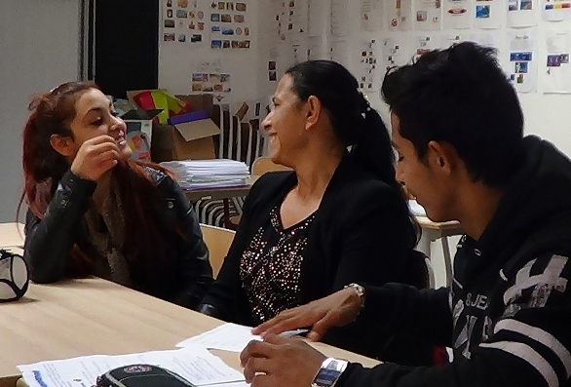
It is about:
Pupils’ incredible linguistic dexterity
The reality of plurilingual lives and ways of reflecting that reality in classrooms, drawing on partnerships with parents as language experts
More specifically it is about pedagogic approaches which encourage, support and enable children to use all their languages in the classroom as natural tools to support their learning.

Slide 5
This conference is not about:
Blaming individuals (children, families, communities, teachers, teacher educators)
Letting our emotions stop us addressing difficult topics

Slide 6
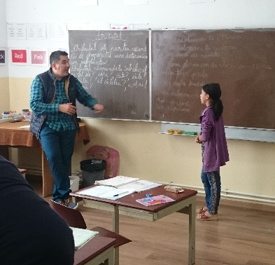
This conference assumes:
We, as educators, want all children to succeed in school, but we may differ in our understanding of how to achieve this.
We may also differ in our understandings of why some children aren’t succeeding.

Slide 7
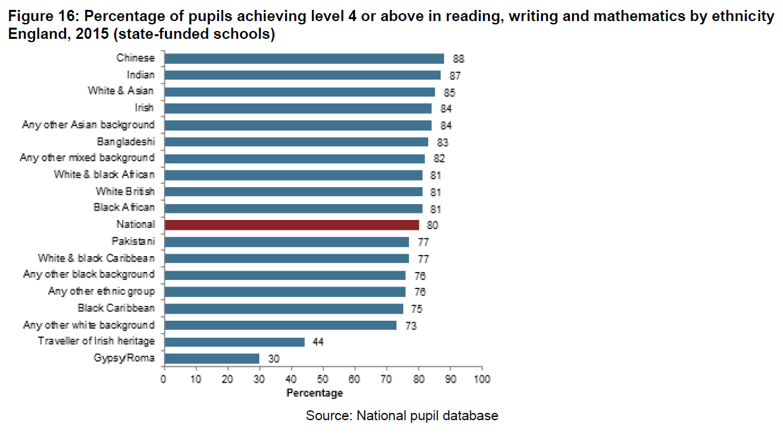
Children’s potential: a story of waste from UK to Romania
Department for Education, 2015

Slide 8
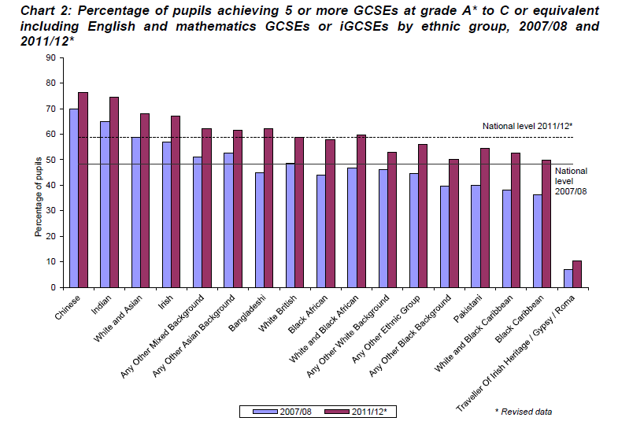
Department for Education 2012

Slide 9
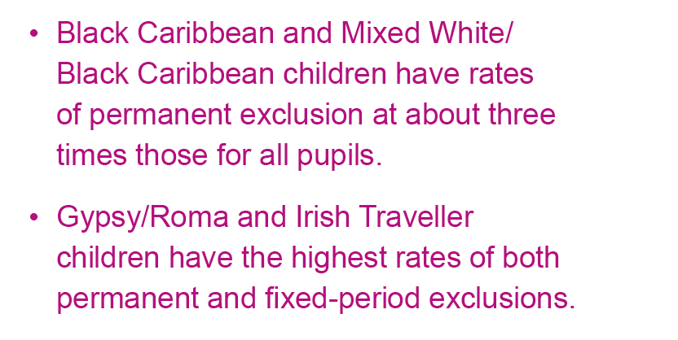
Healing a Divided Britain, EHRC, 2016

Slide 10
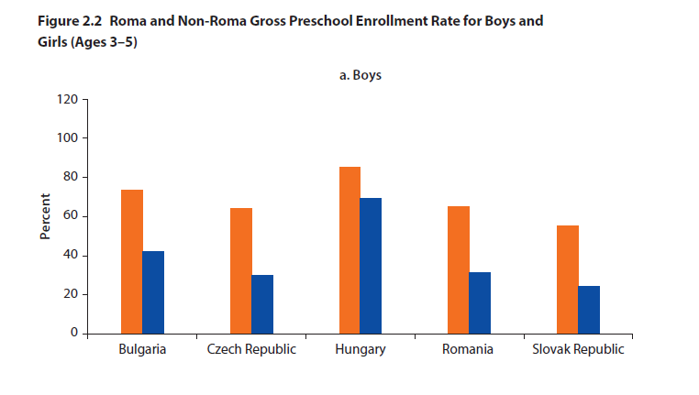
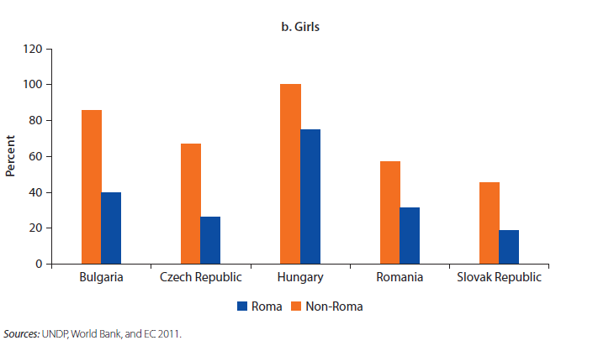
“Few Roma children have access to quality preschool education. In CEE, 43 percent of Roma children between three and six years of age are enrolled in preschool, compared to 56 percent of their non-Roma neighbours” p. 56.

Slide 11
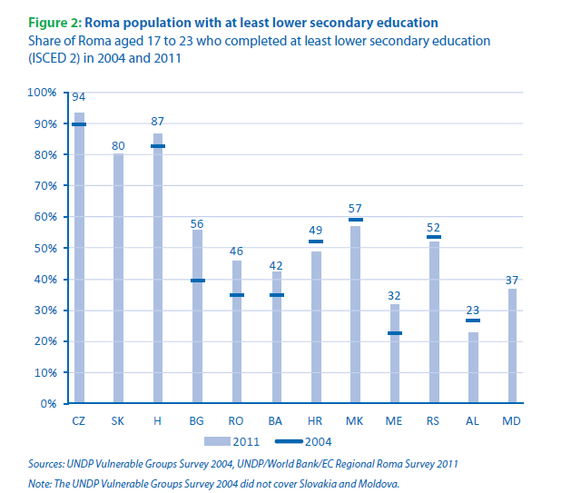
“Differences in lower secondary education attainment between 2004 and 2011 are statistically significant for Bulgaria and Romania (p < .01). In both counties, a higher share of Roma aged 17 to 23 have completed lower secondary education in 2011, in comparison to 2004.”(p. 22)
AL (Albania), BA (Bosnia and Herzegovina), BG (Bulgaria), H (Hungary), HR (Republic of Croatia), CZ (Czech Republic), MD
(Moldova), ME (Montenegro), MK (FYR of Macedonia), RO (Romania), RS (Republic of Serbia), and SK (Slovakia).

Slide 12
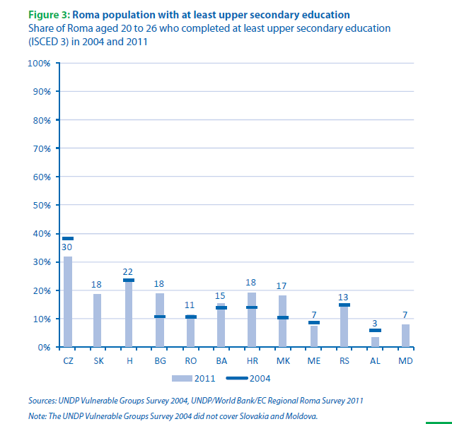
“In Romania, where a higher share of Roma completed primary and lower secondary education in 2011, in comparison to 2004, no significant differences were found with regard to upper secondary education” (p.22)
AL (Albania), BA (Bosnia and Herzegovina), BG (Bulgaria), H (Hungary), HR (Republic of Croatia), CZ (Czech Republic), MD
(Moldova), ME (Montenegro), MK (FYR of Macedonia), RO (Romania), RS (Republic of Serbia), and SK (Slovakia).

Slide 13
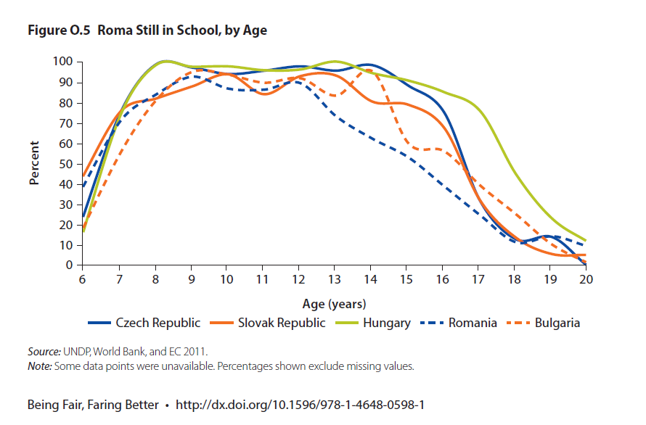

Slide 14
But what are the possible reasons underlying this waste of potential?
Is it something to do with parental attitude?

Slide 15
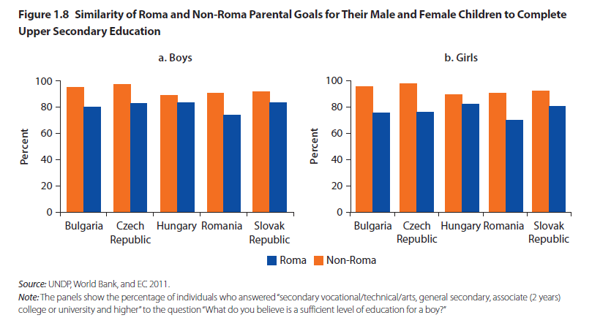
“Roma and non-Roma parents report the same educational aspirations for their children. When asked, “What do you believe is a sufficient level of education for a child?” Roma parents display similar preferences as non-Roma parents (see figure 1.8). … the preferences are similar for sons and for daughters.” (p.23)

Slide 16
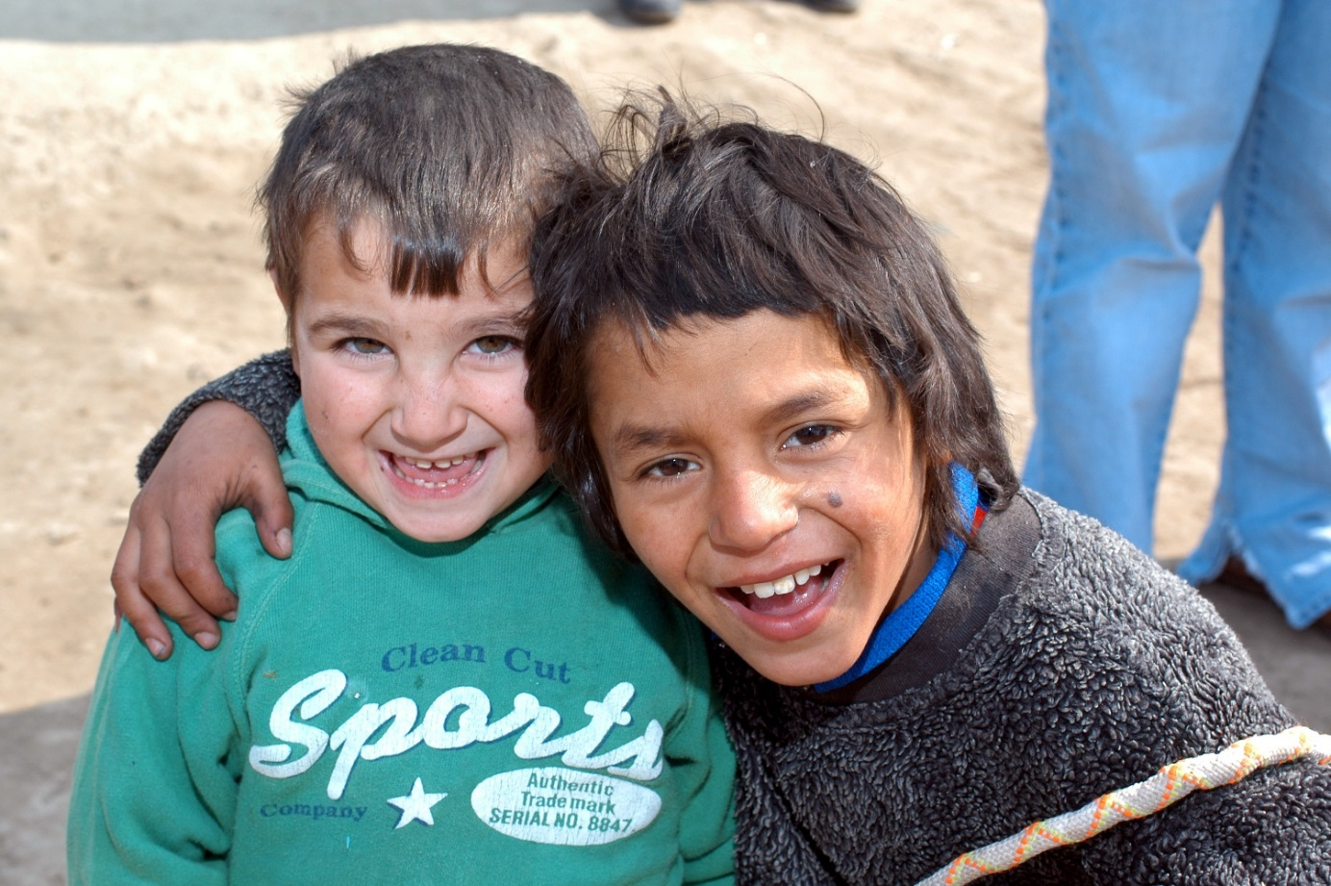
What role does poverty play?

Slide 17
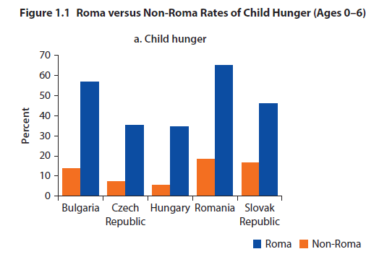

Slide 18
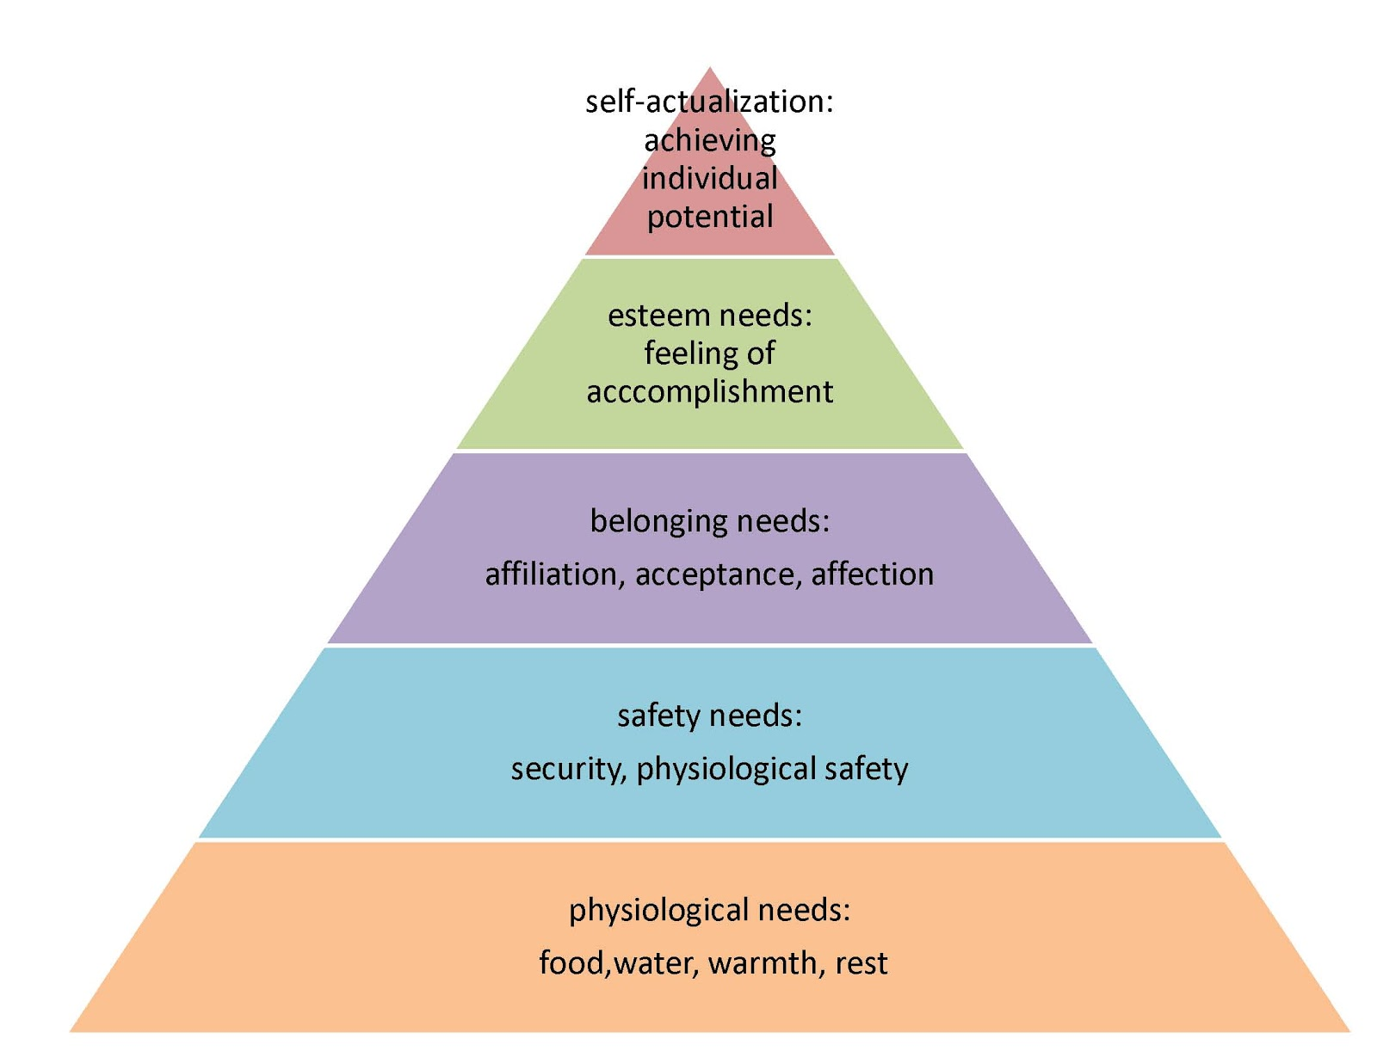
Maslow's hierarchy of needs

Slide 19
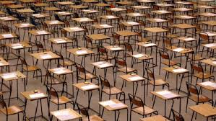
Or, is it about (Infra)structures and education systems?

Slide 20
Roma in early years and Primary schools in Romania
Barriers to enrolment: include:
Pre school lacks sufficient subsidized funding
Pre-school places are often allocated to those with working parents
7% of children in Romania do not attend Primary school; 80% of these are Roma. This is largely due to a lack of identity or registration documents
Multiple axes of poverty – poor road and transport infrastructure; lack of money for schooling, e.g. clothes, food school materials
“The language barrier for a part of the Roma population is not acknowledged or addressed. A lack of bilingual education in the Romanian education system prevents Roma children from accessing education and negatively influences their school achievements. With the exception of a small-scale project of a Roma NGO (Amare Romentza), which set up a bilingual kindergarten for 20 Roma children, there are no other initiatives in this respect.” (p.39)
Advancing Education of Roma in Romania: Country Assessment
and the Roma Education Fund’s Strategic Directions, Roma Education fund, 2007

Slide 21
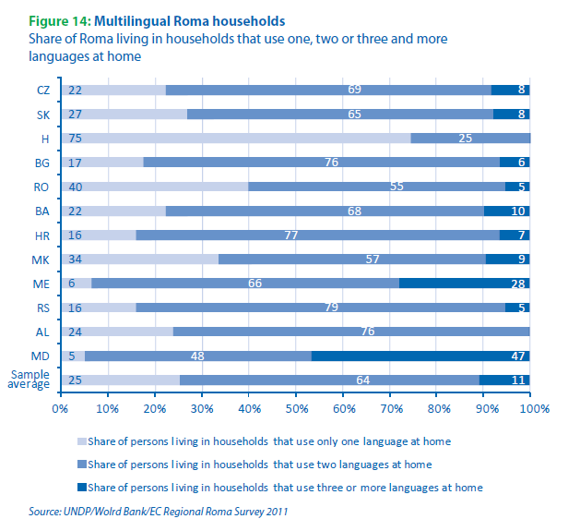
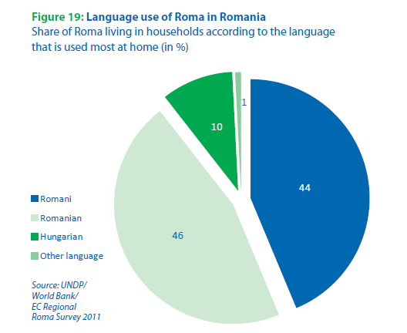

Slide 22
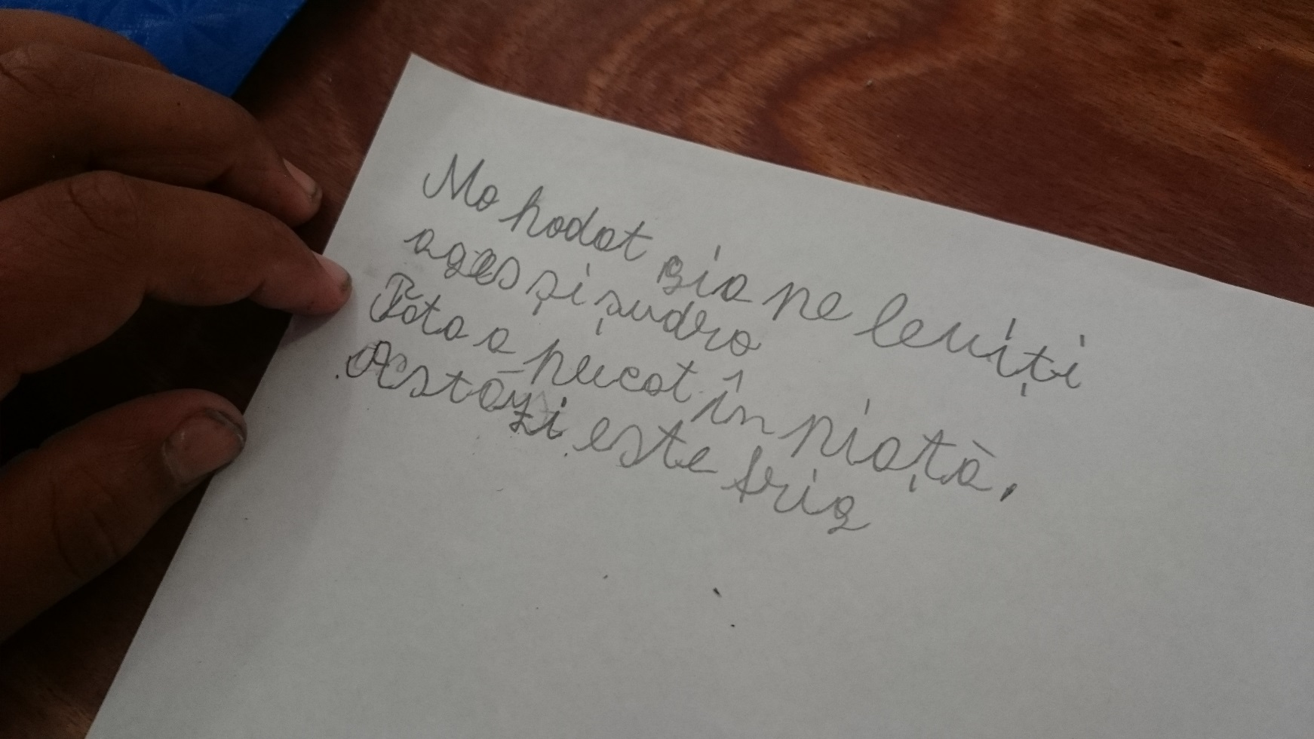
So, is it also about Roma children’s plurilingualism?

Slide 23
Roma Education Fund, Country assessment, Romania, 2012
“Among steps towards multicultural education taken by the authorities are the constitutional provision that national minorities are allowed to pursue education in their respective mother tongue; the creation of pedagogical programs aiming to qualify students for teaching in minority languages; …. and material support for providing national minorities’ children with textbooks in their mother tongue.” p.30 Roma Education Fund, Country assessment, Romania, 2012
“Studies conducted by the Ministry of Education and NGOs are consistent in presenting the educational gap between Romani and non-Romani children, and the factors affecting the educational trajectory of Romani children, such as poverty, widespread discrimination, monocultural curricula, segregation, lack of support, and absence of formal early Education.” Ibid: p.33

Slide 24
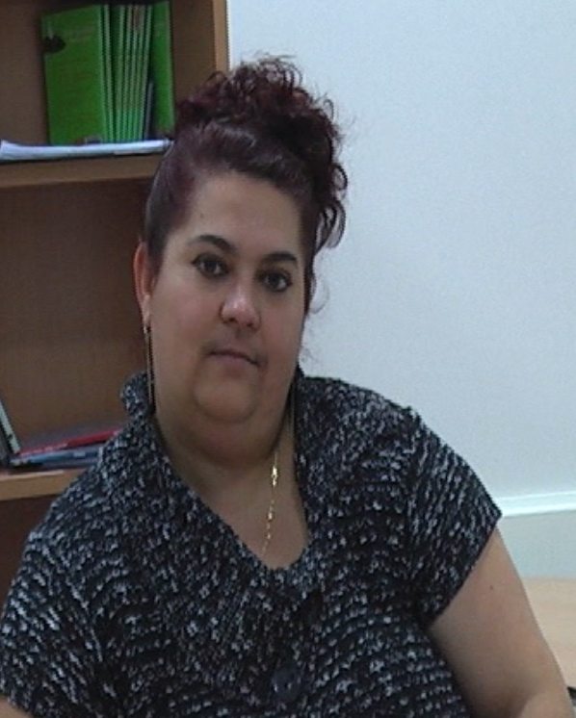
So, the statistics and research show us there is work to do, and thinking to be done.
But statistics can be impersonal.
Let us now hear a human story, from one woman called Marta, who is Roma and arrived in UK from The Slovak Republic. Marta had great potential to be a scholar, but ….

Slide 25
