Slide 1
Languages for Dignity: a pedagogy for success at school
Oradea, Romania
26th-27th October 2016
Lecture 4, day 1
Dr Heather Smith
http://research.ncl.ac.uk/romtels/resources/

Slide 2
Stereotyping
What is it? Is it harmful? If so, what harm does it do? How does it work? Can we do anything about it or is it ‘natural’?

Slide 3
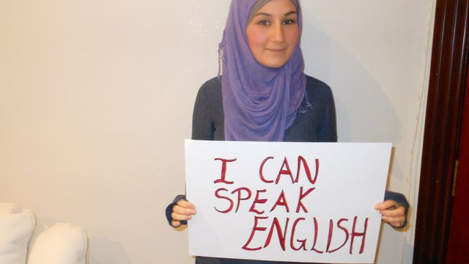
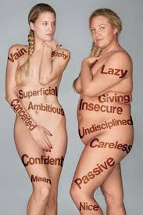
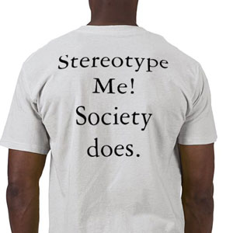
What is the difference between a stereotype and a generalisation?
I held a stereotypical image of old university buildings being cold places …. And I was right!
Who do you think of if I say the word ‘reggae artist’?)

Slide 4
Stereotyping can be a benign generalisation but it can also be a vessel of prejudice….
“when stereotypes are applied to groups of people and their relative worth, … they are not politically neutral. In the interpersonal case, the socialization behind our stereotypes leads us to seek evidence to cement existing biases (Jervis, 2006). Meanwhile, we often fail to note evidence that does not support these biases. Gorman explains, “People are more likely to notice and remember information that confirms an applicable stereotype than information that disconfirms it” (p. 704).” (Gorski, 2012, p.304)

Slide 5
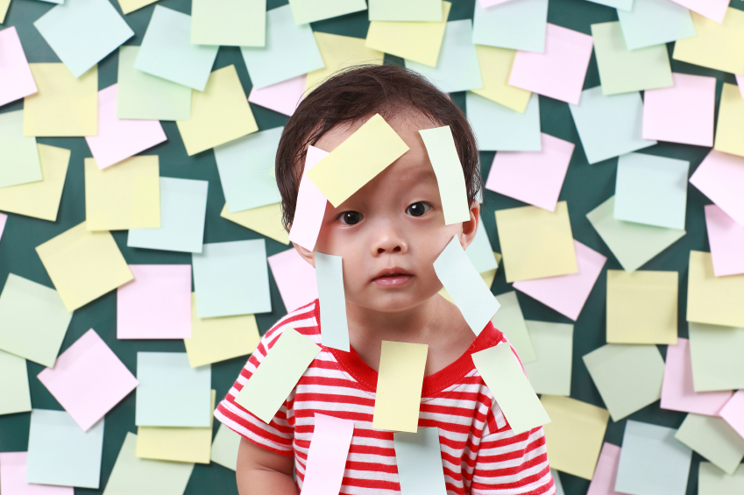
Of course, stereotypes tend to stick more strongly to disenfranchised communities that do not have the institutional power to popularize a counter-narrative (Salzer, 2000) than to privileged communities that do have the power, not only to popularize a false narrative, but also to use that narrative to justify their own privilege and, in Woddell and Henry’s (2005) words, “to rationalize discriminatory practices” (p. 302).” (Gorski, 2012: p.305).

Slide 6
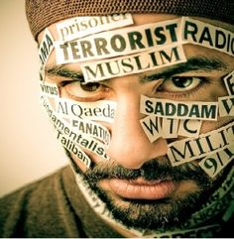
“Stereotypes are the language of prejudice, as such, they are part of the social heritage of a society. They appear in a range of materials from academic sources to rock-and-roll lyrics.” (Ammons, 1997: 277).

Slide 7
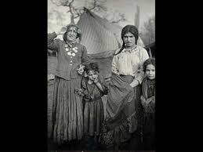
Stereotypes against some groups therefore often have a long history ….. Do any of you recognise this old English nursery rhyme: my mother said …? Let’s listen to a short clip

Slide 8
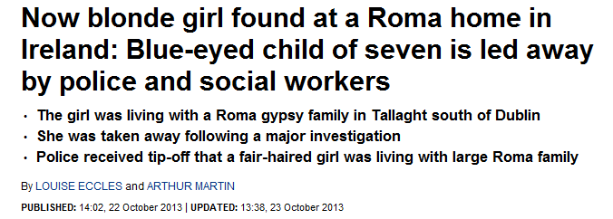
So, let us see some examples of stereotyping from the British press

Slide 9
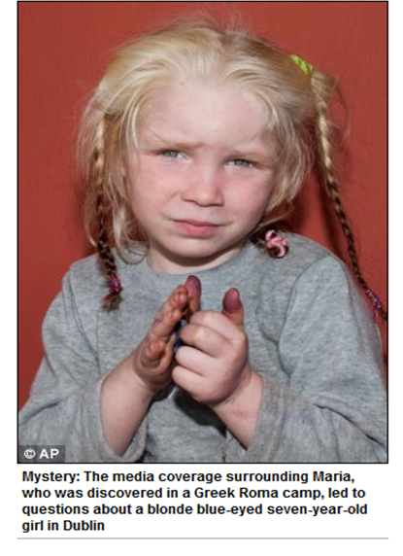

Slide 10
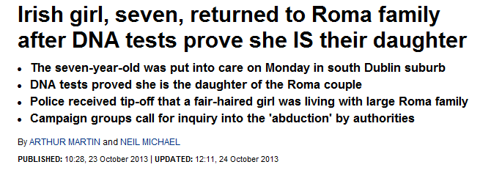

Slide 11
“Dr Adrian Marsh Researcher in Romani Studies said: ”The revival of the mediaeval myths around ‘Gypsy child stealing’ again point to longevity of these stereotypes through periods of historical crisis.”
At: http://romaniarts.co.uk/8287-myths-and-prejudice/

Slide 12
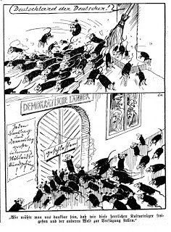
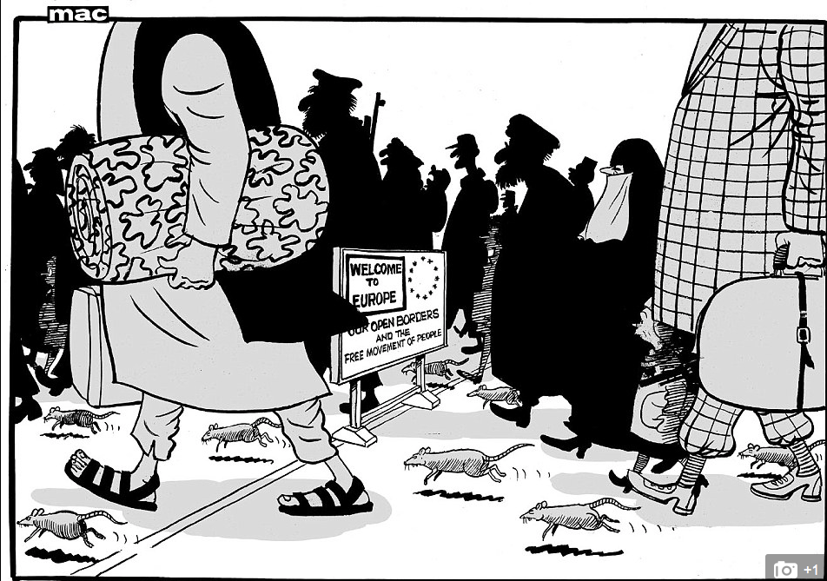
Media is obviously hugely important in normalising our perceptions of the world, and yet of course, is far from neutral (press owners hold particular political persuasions evident in their publications/productions).
The constant drip-drip effect of such presentations permeates our thinking over time normalising our perceptions of different racial categorisations, sometimes without us being aware of this.
Daily Mail, 18th November 2015
Nazi cartoon about Jews before the 2nd world war

Slide 13
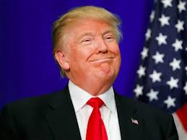
Then there’s political discourse … American presidential election?
https://www.youtube.com/watch?v=a_JvSVxIDTM

Slide 14
Yes well surely our Universities are free of such thinking?
LSE academic's claim 'black women less attractive' triggers race row (2011)
Dr Satoshi Kanazawa, an evolutionary psychologist at the LSE, published his comments on a blog and claimed he had analysed data from an online study of physical attractiveness.
In his article for Psychology Today, Kanazawa wrote: "Black women are … far less attractive than white, Asian, and Native American women.” http://www.theguardian.com/commentisfree/2011/may/18/satoshi-kanazawa-black-women-psychology-today

Slide 15
So stereotyping pervades our cultural landscape and this has an effect over time
“The mainstream proliferation of such [stereotyping] language has the effect of justifying it; such phrases come to seem like simple, natural descriptions rather than motivated symbolic choices that perform significant ideological work.” (156).
References:
Steuter, E. & Wills, D. (2010) ‘The Vermin have struck again’: dehumanizing the enemy in post 9/11 media representations. Media, War and Conflict

Slide 16
Ok, stereotypes can be unpleasant but why are they so harmful?
Stereotype: Purple people are lazy (a known fact)
Prejudice: I don’t like purple people as they are lazy, so I don’t like the Peters family as they are purple (an emotion)
Discrimination: the reason Polly Peters isn’t achieving well at school is because she’s purple and therefore lazy. I must therefore withdraw her support until she learns to do her work without relying on this support (a behaviour).
QUESTION: what if Polly Peters who is purple isn’t lazy and actually needs that support to learn?
In short, the effects upon the holder lead to behaviours upon the person/people being stereotyped which are harmful. This can result in harm at an indivudual level but also at a structural level as you will discover tomorrow.

Slide 17
But what if such thinking is ‘natural’?
Some researchers agree and have called it implicit or unconscious bias:
““Implicit bias” is a term of art referring to relatively unconscious and relatively automatic features of prejudiced judgment and social behaviour.” (Stanford Encyclopedia of Philosophy)
Let’s watch a short clip to see how it works
https://www.youtube.com/watch?v=2RSVz6VEybk
Researchers also believe that implicit bias can be unlearned through:
Raised awareness
Concern about the effects of such biases
Application of strategies to reduce such biases such as the purposeful use of multi-racial images; living/working in more ethnically diverse contexts; and of course purposeful education right from the outset.

Slide 18
“Research studies have demonstrated that teachers – often unconsciously – adopt stereotypes of children. Some indicate that teachers have an unconscious model of the ideal pupil in their heads against which they judge the children in their class (e.g. Gillborn, 1990, Youdell, 2003). Race, gender and social class all play an important part in the judgements teachers make about children, and this initial judgement influences their developing relationship. … What the research does suggest is a subtle and complex process of which teachers are largely unaware.” (Sarah Pearce, 2005).

Slide 19
“Teacher candidates’ prior life experiences, beliefs and assumptions, ... act as powerful filters through which they interpret teaching, students and communities” (Sleeter, 2008, p. 1950).
Solomon et al (2005: 163) argue that white student teachers ought to be aware of the “ways in which their understanding of what it means to be black, Chinese, South-Asian, are categories that are replete with assumptions and that these assumptions impact on their interactions with these students.”

Slide 20
So, what specific harm can be caused in terms of schooling?
Vignette 1 -Michael
Michael, a mixed-race man, is a few months into his first teaching job, in a primary school in east London. On his way to the staffroom at lunchtime, he sees Henry, a boy in his class, sitting on the floor near the doors to the playground. It has been raining all morning and the floor is wet and muddy. He enters the staffroom and asks a group of colleagues why Henry is sat on the floor, pointing out that the floor is wet and dirty. A senior colleague stands up and walks out of the staffroom to look at Henry. Michael follows. She grabs a nearby chair and puts it down forcefully near Henry saying “Here you are Henry, do make yourself comfortable.” Without looking at Michael, she walks back into the staffroom. Michael decides to return to his classroom to eat his lunch.
In his first couple of weeks at the school, the same teacher had warned Michael about Henry’s ‘behaviour’ in class. She told him that his father was ‘African’ and ‘never around’ and his mother was ‘white trash’. Michael had not responded to her comments, but endeavoured to get to know Henry a little and praise him whenever seemed appropriate in class. The previous week, having been impressed by his efforts in class, Michael had selected him to stand in front of the whole school at ‘Good work assembly’.

Slide 21
Vignette 2 -Louise
On her final teaching practice, Louise perceives a pattern of Black boys being more harshly treated by a number of teachers and teaching assistants. Talking to the only Black teacher in the school, she learns that her perception is shared. The teacher tells her that she plans to leave the school shortly and advises Louise to “keep her head down” in order to complete her teaching practice successfully.
Later in her career, Louise works as a teacher in a school with a larger than national average intake of black and working class students. Her white deputy headteacher talks about the need to try to change the school intake in order to improve results.
Both from Darren Chetty as in: https://twitter.com/rapclassroom/status/662700450999857153 or: rapclassroom.blogspot.com

Slide 22
So we need to be aware of our biases and do something about them. If we are educators this means raising awareness in our schools with pupils and fellow teachers, and in our universities with student teachers.
Workshop 1 – Stereotyping: Roma in Romania
Workshop 2 - Barriers to schooling in Romania (structural and practice-based issues) and overcoming them
Who do you see in this photograph?

